Slide 1

Stress First Aid Train the Trainer
November 16, 2022
CE Certified Live Activity
Provided by:
Rutgers, The State University of New Jersey, School of Nursing, Center for Professional Development
Activity Overview and Description
SFA is a set of supportive and practical actions to assist nurses experiencing stress. SFA helps team members identify and address early signs of stress reactions in themselves and others in an ongoing way (not just after “critical incidents”). During the three sessions via zoom participants will learn the SFA model, training techniques and implementation strategies as a Trainer lens.
Learning Objectives: Upon completion of this activity, participants will be better able to:
Describe approaches for reducing stigma and normalizing the assessment and management of stress
Identify how to recognize stress injuries in health care professionals
Describe how to administer Stress First Aid (SFA) at the individual, unit, and organizational level
Describe strategies to maintain healthy stress and resilience
Target Audience
This activity is designed for professional Registered Nurses.
Accreditation
In support of improving patient care, this activity has been planned and implemented by Rutgers Biomedical and Health Sciences and NJ-NEW.
Rutgers Biomedical and Health Sciences is jointly accredited by the Accreditation Council for Continuing Medical Education (ACCME), the Accreditation Council for Pharmacy Education (ACPE), and the American Nurses Credentialing Center (ANCC), to provide continuing education for the healthcare team.
Nurses
This activity is awarded 14 contact hours.

Slide 2
Stress First Aid Train the Trainer
November 16, 2022
Method of Participation
In order to meet the learning objectives and receive continuing education credits, participants are expected to attend 100% of the program, and complete an online evaluation form at the conclusion of the activity. A letter certifying attendance and credit verification will be emailed to participants upon completion of the online evaluation survey.
Activity Director -Susan Salmond, EdD, RN, ANEF, FAAN Planning Committee -Edna Cadmus, PhD, RN, NEA-BC, FAAN & Jennifer Polakowski, MPA
Guest Faculty
Susan Salmond, EdD, RN, ANEF, FAAN
Disclosure Declarations
In accordance with the disclosure policies of RBHS and to conform with Joint Accreditation requirements and FDA guidelines, individuals in a position to control the content of this educational activity are required to disclose to the activity participants: 1) the existence of any relevant financial relationship with any entity producing, marketing, re-selling, or distributing health care goods or services consumed by, or used on, patients, with the exemption of non-profit or government organizations and non-health care related companies, within the past 12 months; and 2) the identification of a commercial product/device that is unlabeled for use or an investigational use of a product/device not yet approved.
Faculty Financial Disclosures
The following faculty have no relevant financial relations to disclose:
  Susan Salmond, EdD, RN, ANEF, FAAN
  Shannon Patel, DNP, APN-C, NEA-BC, CPHQ
The following faculty have relevant financial relations to disclose: N/A
CE Content Peer Reviewers
In order to help ensure content objectivity, independence, and fair balance, and to ensure that the content is aligned with the interest of the public, CPD has resolved all potential and
real conflicts of interest through content review by non-conflicted, qualified reviewers. This activity was peer-reviewed for relevance, accuracy of content, and balance of presentation
by: Jeannette Manchester, DNP, MBA,RN, who has no financial relevant relationships to disclose.

Slide 3
Stress First Aid Train the Trainer
November 16, 2022
Rutgers Biomedical and Health Sciences Center for Professional Development
Jeannette Manchester, DNP, MBA, RN, Assistant Professor, Assistant Dean, Center for Professional Development, Rutgers, the State University of New Jersey School of Nursing. Mariely Rosario, BS, Program Assistant, Center for Professional Development Rutgers, the State University of New Jersey School of Nursing.
Off-Label/Investigational Use
This activity does not contain information on commercial products/devices that are unlabeled for use or investigational uses of products not yet approved.
Disclaimer
The views expressed in this activity are those of the faculty. It should not be inferred or assumed that they are expressing the views of any manufacturer of pharmaceuticals and/or medical devices or Rutgers.
It should be noted that the recommendations made herein with regard to the use of therapeutic agents, varying disease states, and assessments of risk, are based upon a combination of clinical trials, current guidelines, and the clinical practice experience of the participating presenters. The drug selection and dosage information presented in this activity are believed to be accurate. However, participants are urged to consult all available data on products or procedures before using them in clinical practice. Rutgers reserves the right to modify the program contents and faculty if necessary.
Questions
For questions or concerns regarding nursing contact hours for this activity, please call the Center for Professional Development at 973-972-6655 or email cpdn@rutgers.edu
INSTRUCTIONS FOR EVALUATION AND
CE CERTIFICATES AND ATTENDANCE LETTERS
Following the program, please take a few moments to complete the online evaluation survey that will be provided in the zoom chat and emailed. Completion will assist us in
assessing the effectiveness of this activity and to make recommendations for future educational offerings. Your response will help ensure that future programs are informative
and meet the educational needs of all participants. All surveys must be completed 4 weeks after the course.
In order to obtain a CE certificate/attendance letter for this activity, you must complete the online evaluation survey after the activity has concluded.

Slide 4
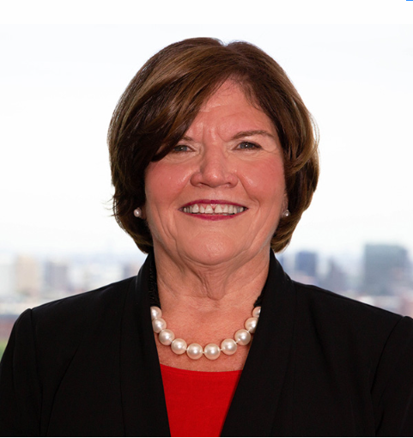


Stress First Aid Train the Trainer
Session II – November 16, 2022
Presenters
Susan Salmond
EdD, RN, ANEF, FAAN
Jennifer Polakowski
MPA
Funding for this program provided by the Healthcare Foundation of NJ

Slide 5

Welcome / Brief Overview

Slide 6
Feedback Form
Presentation Format
8 Virtually
9 In-person
Participants Roles
N2NCaregivers Support Group/ Crisis Counselors
Administrators/Managers/Directors/Coordinators
Clinical Nurses/ Educators/Support Staff
Successes
Liked the Visuals/ Powerpoint & Script was helpful
Challenges
Hesitation to openly discussion stress level
Stop working & acknowledging this was a critical need
Productive Conversation
Gained interest implementing & research project
Tech issues
A lot of information short period of time
Understanding of manager/supervisor roles

Slide 7
Breakout Groups Session I
Group I / Facilitator – Shannon
Lynda Bern
Geraldine Cebedo
Angela Daly
Sapna Dhaliwala
Ruth Dileo
Stephanie Dove-Tieku
Megan Flynn
Lois Greene
Beth Henderson
Stacy Horowitz
Ashley Mickel
Alison Norberg
Karen Nunn
Marcella O’Herlihy
Rose Polasky
Cathlyn Robinson
Krystle Sica
Leila Tiles-Lasanta
Jonathan Yaung
Group II / Facilitator – Susan
Sandra Baker
Nawatti Bhagwandat
Margaret Daingerfield
Donna Gaffney
Ellen Giarellli
Tassoni Ginn
Kathleen Horan
Cynthia Samuels
Marcia Lewis
Jeannette Manchester
Lucia Otti
Elizabeth Rata
Stephanie Simone
Lauren Stroh
Andrea Webb
Mary Velardi-Stoffel

Slide 8
Breakout Group Questions
How comfortable were you presenting the material?
What other resources do you need to increase comfort?
What was the general feedback from the participants and their interest in learning more?

Slide 9

Facilitator Summaries

Slide 10


Slide 11
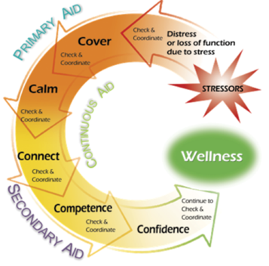
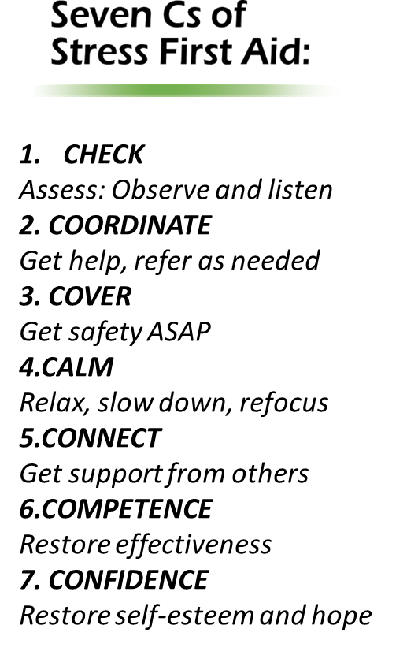
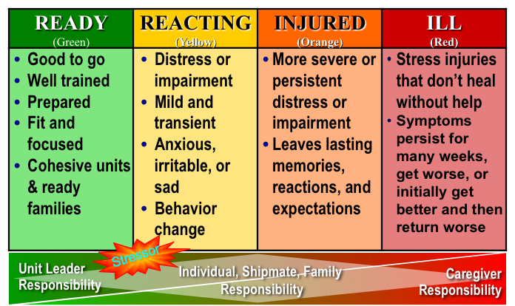
Implementation Strategies
Notes:
How nurses and other health care workers are supported during a time of acute stress impacts whether they are able to cope and then recover from the crisis, or alternatively, whether they will adopt unhealthy coping mechanisms and show signs of stress injury (eg, burnout, insomnia, dysphoria) or even worse, chronic stress illness (eg, depression, anxiety, post-traumatic stress disorder [PTSD], substance abuse).
Fortunately, progression from a stress reaction to stress injury to a chronic stress illness is not inevitable. Proactive institutional supports initiated before a crisis, “stress first aid” delivered during the crisis, and “recovery aid” provided after the crisis will each increase the odds that individuals will recover and thrive. SFA normalizes assessment of stress along with proactive management of stress---it provides a non-stigmatizing model that enhances dialogs about stress challenges within the workplace.
Successful organizations take a systems approach and focus on becoming a resilient organization prior to times of crisis, rather than limiting their efforts to a focus on individual resilience or only attending to the well-being of health care workers after crisis develops. Furthermore, resilient organizations need to rapidly reconfigure their well-being priorities to meet the biggest new drivers of stress in a crisis setting.

Slide 12
Learning Objectives
Articulate the importance of SFA to obtain organizational/unit buy-in
Create a plan for implementing SFA with the workplace
Propose process and outcome metrics to evaluate SFA

Slide 13
SFA Implementation: Expected Goals and Outcomes
GOALS
Improved peer and leader abilities to recognize stress reactions and injuries using the stress continuum model
Enhanced peer and leader ability to tailor continuous, primary, and secondary aid approaches to individual and unit needs
Enhanced individual and team ability to have conversations about work stressors
Compassionate and restorative support demonstrated by leaders and peers to stress challenges
OUTCOMES
Increased resilience (individual and unit)
Increased well-being
Enhanced work environments
Enhanced team culture that improves engagement, retention and meaningful work

Slide 14
SFA Focus
Enhance individual resilience and interpersonal communication
Identify and reduce unnecessary stressors
Recognize caregiver stress and know how to respond
Improve individual and team well-being
Notes:
Green: Aims to enhance individual and unit resilience, enhance interpersonal communication…Grow the Green
Yellow: Identify and reduce unnecessary stressors in the workplace so that team members can function optimally
Green and Yellow: Represent opportunities to address system issues and enhance team engagement… by tackling the yellow it necessitates conversations about work stressors and leads to solving of some recurring stressors
Orange: Recognize stress and employ stress first aid strategies to mitigate the negative effects of stress… identify team and individual behaviors that indicate the potential for role and performance dysfunction and the need for peer and leadership support through coaching and stress first-aid interventions.

Slide 15
SFA Activities
SFA Approaches
Assessment
Self Check
Resources
Stress Checks
Enhance Resilience
Positive Practices Workshops
Intervention
Comm. Skills
SFA
7 Cs
Team Development
Department/ Unit/team Level Interventions
1:1 Coaching
Notes:
Assessment
Use of the stress continuum thermometer is integrated into at least per shift assessment.
Individual assessment; check you, check two; unit assessment
Peer Support Components
System wide awareness training to enhance peer support
Team building to develop internal capacity to recognize and address system-based and individual occupational stress exposure
Team based occupational stress assessment and facilitated dialog upon request
Using the stress continuum to decide what stress and coping supports would best fit the needs of a team or individual
Coaching support for leaders to navigate conflict communication, address stress-related interpersonal behaviors, and address system issues
Improve teams abilities to engage in important and difficult systems issues
Promote the early use of restorative practices

Slide 16
Assessment
Assessment
Self Check
Resources
Stress Checks
Notes:
What we have seen with this is that even when organizations don’t fully deploy SFA, if they just start an awareness training and having a team use SFA and start having dialogues around the stress continuum, the environment of care, and how to support each other, it’s transformative.
Ex: If something is going wrong on a unit, someone will say “orange huddle”…that means everyone takes a breath, we are coming together, it’s not blaming or shaming, there’s an issue, we feel it, someone saw it, something is happening, it’s tense, let’s all take a brith, this is the shift from hell, we’ll make it through
Put up a dry erase board with space for green, yellow or orange zones and each person can put their name in a category—if they are in the green zone, it means they are okay and are a good person to talk to that day. Some would erase their name or move it to a different zone as the day goes by
If have only assessment without other activities may not advance the resilience.

Slide 17
Take Action on Assessment
Enhance Resilience
Intervention
Positive Practices Workshops
Comm. Skills
SFA 7 Cs
Team Development
Department/ Unit/team Level Interventions
1:1 Coaching
Notes:
SFA creates an improved ability to identify issues, come together and problem solve solutions. The SFA process calls attention to systems level issues that are problematic for the workforce
Managers get nervous about this sometimes, worrying, “If I ask what’s going wrong, they will tell me and expect me to fix it.” However, it’s more about having dialogue: there are activities or issues that are putting us into the orange. Then those issuers are able to float up. Oncology is orange because….
The hospital is orange because….
It’s not the old model of sucking it up, taking two breaths, and going back to work. Taking breaths helps the team if it helps them to effectively address issues. It also helps if leadership takes a SFA focus on work issues. For instance, if there are individuals who are behaving in problematic way, the first step is to ask, if someone is acting out, what is the issue with the environment? It also involves helping people to restore or move if they are not well-suited for the job, but it is really important to first ask what are the system challenges here.

Slide 18
Making the Case for SFA
Step 1: Know the resiliency resources in your organization and their
effectiveness
Step 2: Explore how SFA can be used as another resource and how it can
be integrated with other programs
Step 3: Articulate the need for SFA in your organization to key
stakeholders
Step 4: Read SFA resources, Become comfortable with the material
Notes:
Articulate the Need:
At this step you are having critical conversations about the impact of a high stress work environment on employee wellbeing, turnover, and on quality of care. The SFA program should be presented as a tool to deal with stress and to improve individual and unit resiliency. During these conversations, provide an overview of SFA (NJ New has provided a 1 page and 3 page summary), how it can change the way healthcare providers deal with stress, and the goals and outcomes of a SFA program (see box on first page). The aim of these meetings is to win the organization’s commitment to the program, so that it can be implemented with all staff, organization-wide in the coming months.
Stakeholder with whom you might want to talk to during this step might include:
NWESC Councils
Nurse educators
Nursing management teams
Both hospital and unit administrative teams
Human Resources
Any other organizational influencers or organizational resource programs, e.g., employee assistance program, behavioral health support teams)

Slide 19
SFA Team Leaders
Two leaders to coordinate the roll out of SFA in the organization (training and implementation)
  Professional Background
  Awareness of organizational/unit stressors
  Passionate about SFA as an approach
  Team Leader Attributes
  Team Leader Roll Out Plan
  Protected Time
Notes:
Two nurses from the organization should be selected to participate.
The selected individuals will serve as the SFA Team Leaders for the Organization and coordinate the training and roll out of the program within the organization.
Suggest at least one be a nurse.
These individuals should understand the pressurized context in which nurses work and how this can affect wellbeing and in turn quality of care and turnover and see the value of stress first aid as an intervention to improve individual and unit level wellbeing.
If you are the only one from your organization who has become a SFA trainer, you may want to discuss getting a partner and getting the partner trained. This can be done by you or via other TT workshops.
Recommended attributes for the Team Leaders should include:
Effective teaching skills
Strong therapeutic communication, coaching, and conflict resolution skills
Non-judgmental, good counselors, politically astute (able to avoid blaming individuals and organizations)
Able to facilitate small and large groups
Adheres to expectations around confidentiality
It is recommended that Team Leaders be provided 4-8 hours per week of protected time for SFA activities and coordination if the roll out is for the organization…. Protected time amount based on roll out plan

Slide 20
SFA Leadership/Advisory Team
Recognizes Emotional Well-Being as a Pillar
Guides the rollout and support of the program within the organization
Participants
  Influential
  Across Disciplines
Roles
  Build enthusiasm
  Plan rollout strategy (have a written plan)
  Elevator speech and communication plan
  Collaborate with other well-being programs/resources
  Decide on evaluation metrics
  Oversee implementation and evaluation plan
  Creating a central online repository of SFA materials
Requirements
  Participate in 90-minute training provided by Team Leaders
  Monthly meetings and then quarterly
Notes:
However, the team leader does not roll out this initiative alone. He or she is backed by a leadership or advisory team.
The Leadership Team should be responsible for the rollout and support of the program within the organization. Each organization selects leadership team members appropriate to their organization.
The Leadership Team should include individuals who are influential; however that power may or may not come from the position they hold, it could be conferred based on their status, expertise or political importance.
Recommended participants include the co-chairs of the NWESC council (CNO and staff nurse), the two team leaders, and other nurse influencers and educators. A representative from Employee Assistance and/or employee health that has counseling experience could be valuable. The team may include inter-professional representatives such as human resources, social workers, physicians and chaplains who can explain and champion the program.
The role of the Leadership Team includes:
Building enthusiasm for SFA.
Taking the lead in setting the overall SFA rollout strategy.
Developing a short summary or elevator speech that summarizes how SFA helps to ensure that the vision for the organization is realized.
Developing the overall communication plan.
Collaborating with existing personnel support programs (e.g., provider wellness programs, health promotion and wellness programs, pastoral care) to integrate strategies and maximize coordination strategies to promote employee well-being.
Creating a central online depositary (internal website) of SFA materials and guides, so that these resources are available across the organization.
Overseeing an evaluation plan to assess the overall effectiveness of the SFA program.
Program evaluations will measure the extent to which the components of the SFA Peer Support program were implemented to assess the fidelity of the program.
Implement the NJNI research and evaluation protocol. This will measure perceived stress, resiliency, and sense of belonging.
Determining if additional hospital metrics should be tracked, for example:
Increase in quality and frequency of nurse-physician communication around safety issues
Reduction in stress-related turnover
Reduction in staff call outs
Increase in staff level of confidence
Leadership Team members should participate in an initial 90-minute training session provided by the Team Leaders to become more familiar with the components of the program. The Leadership Team will meet monthly (initially) and then quarterly to guide rollout.

Slide 21
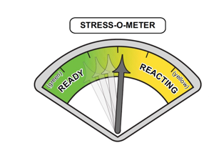
Organizational Roll Out: Baseline Metrics
Existing Data Sources
  Turnover Rate
    Stress Turnover/Growth Turnover
    3 times the annual salary (+ fringe) to replace one nurse
  Absenteeism/Call outs
    Consider costs related to travelers, shift incentives, burnout burden
  Engagement Surveys
    Sufficient unit staffing
    Few sleep disturbances related to work
    Staff satisfaction
    Intent to stay with the organization
    Interdisciplinary collaboration
Notes:
Make sure the metrics are work stress sensitive and relevant
In units where this is actually rolled out, have less stress-related turnover, and call outs go down
Turnover costs: 3x the salary of a new nurse to replace a nurse (Melnyk)
Avoid
Patient Satisfaction
Length of Stay
Infection Rates
Consider
A stress thermometer

Slide 22
Organizational Roll Out: Baseline Metrics
Focused Assessment
  Burnout Scales: ProQOL, Maslach
  AMA Covid-19 Coping Survey
  Cohen’s Perceived Stress Scale
  Connor-Davidson Resilience Scale
  Emotional Well-Being
  PTSD Checklist-Civilian (PCL-C)
  PHQ-9
  Focus Group: The 3 Questions and 2 Values Check questions for example

Slide 23
Prepare Marketing & Educational Materials
Develop unit-based tools and reminders about Stress Continuum, 7 Cs
  One Page Handout
  Three Page Handout
Develop educational calendar
  You Tube Awareness Sessions
  In person Awareness Sessions
Marketing messages with display screens
Stress continuum dashboards
Organizational repository of education programs and other resources
  NJ NEW
  Schwartz Center (https://www.theschwartzcenter.org/stress-first-aid-private/)
  National Center for PTSD (https://www.ptsd.va.gov/professional/treat/type/stress_first_aid.asp)
Notes:
You might consider posting/sending an email of resources available to them within your workplace (e.g., occupational health, support groups, webinars).
Consider pre-packaging some of the peer support trainings
Breath work and relaxation strategies
OSCAR Communication
STOP Technique
Gratitude Exercise

Slide 24
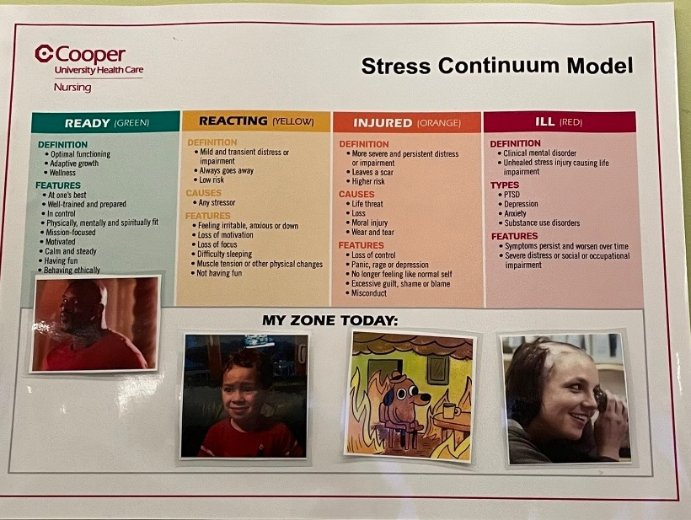
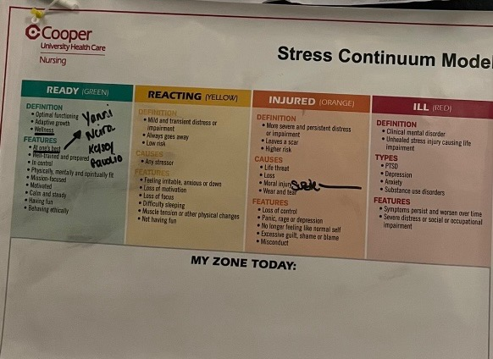
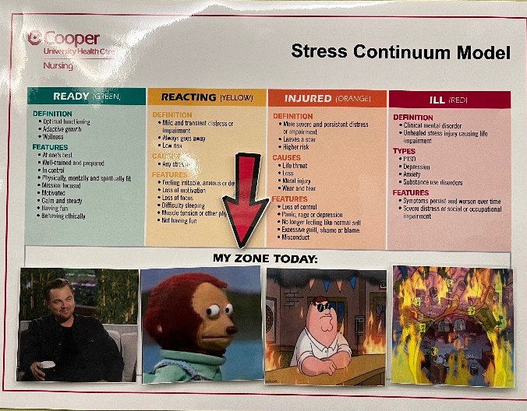
Examples of Materials

Slide 25
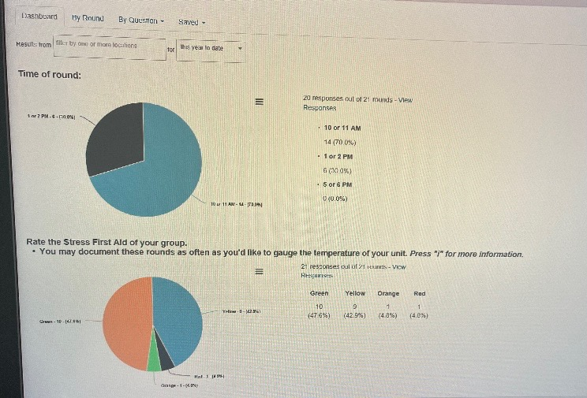
Cooper University Health Care SFA Dashboard

Slide 26
Organizational Roll Out
Conduct Awareness Briefs
  100% of Organization (1 Year)
  Mini-Briefings
    Need for peer support and use of stress continuum
  Awareness Briefings
    In-person and/or computer based
Select units with High Interest for Initial Rollout
  Awareness Brief to Councils or Units
  Interest and commitment: Train with 90 Minute program
  Avoid caustic units
  Select Units Interested in Roll Out to Start—and Have Staff Interested in Being SFA Champions
Notes:
Often pressure is put on for the peer support team to go into caustic work environments where they aren’t acting nice to each others…leadership often wants the team to “fix” the dysfunction… but that usually does not work well
Better to start with units that want this or are doing something like this already….it is a set of tools to enhance what they are already doing. Then that team will see an outreach to sister units.
There are a number of ways to do this:
Train everyone in the organization
Find a group of employees who can champion the model within the organization and roll the model out individually to interested teams
Train existing peer support teams, mental health support staff, or EAP providers to roll the model out to interested departments or teams

Slide 27
Unit/Department Roll Out Using Champions
Unit Based SFA Champions
At least 2 peers support champions per unit
    Some referent authority of being looked up to by team
    Has an appreciation of system thinking and how to effect change
Leader buy in
4 hour Training for peer champions & leaders
Champion Support
Biweekly call/check in, discuss successes, challenges, concerns, and questions that the team leads may have about implementation of the model
    Listen empathically and help the team problem solve. You do not have to---and likely cannot---solve their problems, but you can help them brainstorm solutions and consider alternatives
Additional training sessions for Champions re: growing the green, problem-solving recurring stressors
Notes:
Unit Level Peer Support Champions/Leaders: 2-3 team members per unit that guide SFA peer support activities, serve as peer support advisors to the unit manager, participate in department or service line level activities with other unit champions
Coaches will participate in a 4-hour training program given by the organizational Team Leaders that describes factors in resilience, the stress continuum model and identifying high risk factors for stress illness. The training includes presentation on evidence-based strategies for supporting staff during stress, enhancing resilient environments, and recognizing and responding to stress injury.
Additional 30-60 minute SFA development for coaches may be planned based on individual and unit needs. These may include: evidence-based measures and exercises that address psychological readiness, coping, burnout, satisfaction, resilience, and well-being; individual peer stress and coping assessment; peer-to-peer support intervention to address occupational fatigue, compassion fatigue, caregiver stress, and burnout.
Coaches implement peer-to-peer support: This is the backbone of the entire SFA program. Once the coaches on one, two or more innovator units have been trained, they will be responsible for providing training and support — in collaboration with the Team Leaders — to unit employees.
In an effort to evaluate the outcomes of the SFA peer-to-peer support program, the coaches will be asked to administer the program evaluation tool before they provide any training on SFA. The tool will be administered after scale up and then approximately a year later to determine effectiveness.
Unit-based trainings cover the SFA continuum model and interventions. Interventions may take the form of a lunch and learn, or it might be included as a part of routine unit activities, such as staff meeting, debriefings, supervision meetings, or special meetings.
The coaches should be provided with least 2 hours/week of protected time. This makes it clear that the organization values SFA and it gives these coaches time to prepare for and conduct their classes. These 2 hours/week will give them the time they need to implement this peer-to-peer support.
Train champions/team leads who are implementing the SFA model with their teams.
Use the 4-hour slide deck and instructor’s manual and distribute or send an email with resources (manual, workbook, handouts)
The teams can also watch the NCPTSD or Schwartz Center SFA trainings together
Use some of the Peer Support “tools” for focused skill development
Grow the Green
This model is akin to the “train-the-trainer” model.
Team leads become trainers to their teams, disseminating the model more widely throughout the organization

Slide 28
Unit/Department Roll Out of SFA Education
SFA Champions Implement Training
  Awareness Briefs
  Monthly peer support training (SFA, Unit Stress and Resiliency)
  Service line level activities with other unit champions
  Dedicated time

Slide 29
Unit/Department SFA Operationalization
Use of Stress Continuum
Daily Checks
Huddles
Unit poster/board/team meetings
Stress Continuum Dialog
  Focusing on the Yellow and Orange Zones:
    What does a yellow zone shift look like here?
      Behaviors, senses, feelings
      How do you know when it is increasing
      Is this a normal and desired space for the team
    What does an orange zone shift look like here?
      Behaviors, senses, feelings
      How do you know when it is increasing
      What are your concerns when you see orange zone behaviors/activity
    What helps to get back to the yellow zone

Slide 30
Unit Level Check Approaches Beyond Colors
The 3 question assessment
  Over the past (time frame)
    What has been your greatest challenges, hassles, or frustrations?
    What has been your greatest reward, success, or positive experience?
    What does it meant to be a (name role) in this unit?
  Follow-up assessment determines next set of actions. Offer support, provide coping information, refer for next level of service
Notes:
Listening Sessions: uncover stress, anxiety. Also listen for concerns about ethical compromises voiced by members of the workforce
Leadership walk-rounds: gather information, identify concerns, and identify unmet information needs. Walk-rounds can also help identify and resolve operational problems
We are starting to use the Stress First Aid Model to talk about the work we do. You will be hearing more about stress on a continuum and a way to support each other.
To help me understand your team I am going to ask three questions.
Over the past (time frame):
What has been your greatest challenges, hassles, or frustrations?
What has been your greatest reward, success, or positive experience?
What does it mean to be a (name role) in this unit?
Follow-up assessment determines next set of actions. Offer support, provide coping information, refer for next level of service

Slide 31
Unit Level Check Approaches Beyond Colors
The 2 question Check in: Provides quick insight into top frustrations and top values
  Is an interactive qualitative quick assessment
  First ask about the unit then the individual
  2 core questions
    What 3 things need to change immediately to make this a better work place?
      Would you add anything to specifically meet your needs
    What 3 things should never change on this unit
      Would you add anything to specifically meet your needs
Notes:
Listening Sessions: uncover stress, anxiety. Also listen for concerns about ethical compromises voiced by members of the workforce
Leadership walk-rounds: gather information, identify concerns, and identify unmet information needs. Walk-rounds can also help identify and resolve operational problems

Slide 32
Unit/Department SFA Operationalization
Use of 7 Cs
Focused Training
Case Studies
Debriefings
Role model using the Language
Development to Grow the Green and Manage the Yellow
Positive Practices
Problem Solving based on Unit Level Check
Notes:
Creating a learning organization
Consider creating a wellbeing space in regular leadership or team huddles
Thankful Thursday
Wellness Wednesday
Thankful Thursdays…gratitude focus
Other green zone positive practices
Peer Rx: Buddy programs to address distress, resignation, burnout and isolation
Encourage workforce to consider:
Crisis support group
Moral resiliency rounds
Grief group
Spiritual practices group
Group mediation
Parent support group
Facilitated group reflection sessions
Connectivity or social group sessions (i.e., Mayo COMPASS dinners(
“No One Cares Alone™.” PeerRx is a free, peer-to-peer program for physicians and others working in health care designed to provide support, connection, encouragement, resources, and skill- building in order to help participants advance along the Burnout to Thriving Index (Burnout —> Surviving —> Fine —> Well —> Thriving) toward optimal well-being, however you would define that state for yourself.
The foundation of the PeerRxMed™ program is PeerRx90, also known as PRx90™, which is structured to support paired clinicians through a “buddy system” and provide a platform to facilitate encouragement, accountability, and mutual support/growth. Such a system has precedent in the United States Armed Forces (“wingmen” in the Air Force, "battle buddies" in the Army, "shipmates" in the Navy), the Boy Scouts of America, the Girl Scouts of the USA, and the YMCA swimming programs. The time has come for you to Strive to Thrive and join the PeerRx Movement.
https://www.peerrxmed.com/process

Slide 33
Remove Obstacles, Build on the Change
Address Barriers to Implementation
Unit Based
System-Wide
Action Planning to Navigate Barriers
Ongoing Support to Team Leaders and Coaches
Bi-Weekly check ins of Champions and Team Leaders
Quarterly reporting to Leadership Team
Organizational Support
Contingency Plans
Additional Roll Out
Public recognition of champions, leaders, progress
NJ NEW Support
Notes:
Communicate the change: Throughout this phase, continue to discuss SFA and the successes of SFA. In addition, continue to use the SFA terminology and language so that SFA continue to be a part of the organizational culture.
Address barriers to implementation. An important part of this step is to address any barriers to implementation. These barriers might be unit level (e.g., identifying time for huddles, identifying time for training, staff turnover, staff who are resisting implementation of the SFA culture) or they may be system-wide (e.g., funding for coaches, slow rollout, inaccurate myths about the program). The unit coaches will meet with the Team Leaders at least biweekly. Unit coaches will report to the Leadership Team quarterly to report on their unit’s implementation status and to hear program updates. These meetings will be used to identify barriers and to develop an action plan that states who will take the lead to address each issue and by what date.
Provide ongoing support to Team Leaders and Coaches. The Team Leaders and coaches, particularly in their first year, will need ongoing support to excel in this role and to ensure that they do not become victims of burnout. There are a variety of ways that coaches can be supported:
NJNI Coordinator will check in with Team Leaders biweekly to problem solve and provide support.
Quarterly development of Team Leaders with continued SFA training or consultation.
Provide coaches with ongoing development and support. During routine biweekly check-ins, the coach and team leader should discuss successes, challenges, concerns, and questions.
Consider hosting 4-monthly (three times/year) 4-hour workshop where the unit coaches are brought together to process their barriers and successes and what it means to be a team member. The meetings should focus on where each coach needs assistance. The workshops should include training.
Build on the change. Continue to implement SFA terminology and practices. For example:
Make SFA language part of the corporate culture. In meetings focus on the problem, not on the people. Get discussion going by asking what the situation looks like when it is going well or green? What does it look like when it is yellow/orange?
At least once/month do something to keep the narrative going. Maybe a lunch and learn (for all shifts). Maybe it is a simple as placing a laminated sign in the lunchroom with messages that spark discussions.
Incorporate SFA into orientation.
Publicly recognize key members of your original change coalition, and make sure the rest of the staff — new and old — remembers their contributions.
Develop contingency plans. Should there be staff turnover in coaches, ensure that there is a contingency plan and that someone else is appointed in the coach role and provided with training. Ideally, there should be overlap between the outgoing and incoming coaches.
NJ NEW:
At least twice a year have an ongoing 4- hour workshop where champions come together to discuss and process their experiences, to discuss their challenges/frustrations, rewards, what it means to be an SFA champion, where they need the most help (i.e., training in conflict communication).

Slide 34
Tracking Roll Out
Process Evaluation
Comparison to Strategic Roll Out Plan
  Numbers Trained (Departments, % from Department, % from Shift)
  Tracking/Stories of How Used*
    Continuum
    7 Cs
    Growing the Green/Managing the Yellow
Evaluations after Training
Impact Evaluation

Slide 35
Thoughts
Comments
Discussion
Questions

Slide 37
Breakout Session II
Use SFA Workbook to begin an implementation plan

Slide 38
Facilitator Summaries

Slide 39

Wrap- Up/ Questions
Questions
Additional Information Needed?
Webinars:
Topics / Themes
What other Support or Development Needed?
THANK YOU
Final Thoughts

