Slide 1

Stress First Aid Train the Trainer
October 26, 2022
CE Certified Live Activity
Provided by:
Rutgers, The State University of New Jersey, School of Nursing, Center for Professional Development
Activity Overview and Description
SFA is a set of supportive and practical actions to assist nurses experiencing stress. SFA helps team members identify and address early signs of stress reactions in themselves and others in an ongoing way (not just after “critical incidents”). During the three sessions via zoom participants will learn the SFA model, training techniques and implementation strategies as a Trainer lens.
Learning Objectives: Upon completion of this activity, participants will be better able to:
Describe approaches for reducing stigma and normalizing the assessment and management of stress
Identify how to recognize stress injuries in health care professionals
Describe how to administer Stress First Aid (SFA) at the individual, unit, and organizational level
Describe strategies to maintain healthy stress and resilience
Target Audience
This activity is designed for professional Registered Nurses.
Accreditation
In support of improving patient care, this activity has been planned and implemented by Rutgers Biomedical and Health Sciences and NJ-NEW.
Rutgers Biomedical and Health Sciences is jointly accredited by the Accreditation Council for Continuing Medical Education (ACCME), the Accreditation Council for Pharmacy Education (ACPE), and the American Nurses Credentialing Center (ANCC), to provide continuing education for the healthcare team.
Nurses
This activity is awarded 14 contact hours.

Slide 2
Stress First Aid Train the Trainer
October 26, 2022
Method of Participation
In order to meet the learning objectives and receive continuing education credits, participants are expected to attend 100% of the program, and complete an online evaluation form at the conclusion of the activity. A letter certifying attendance and credit verification will be emailed to participants upon completion of the online evaluation survey.
Activity Director -Susan Salmond, EdD, RN, ANEF, FAAN Planning Committee -Edna Cadmus, PhD, RN, NEA-BC, FAAN & Jennifer Polakowski, MPA
Guest Faculty
Susan Salmond, EdD, RN, ANEF, FAAN
Disclosure Declarations
In accordance with the disclosure policies of RBHS and to conform with Joint Accreditation requirements and FDA guidelines, individuals in a position to control the content of this educational activity are required to disclose to the activity participants: 1) the existence of any relevant financial relationship with any entity producing, marketing, re-selling, or distributing health care goods or services consumed by, or used on, patients, with the exemption of non-profit or government organizations and non-health care related companies, within the past 12 months; and 2) the identification of a commercial product/device that is unlabeled for use or an investigational use of a product/device not yet approved.
Faculty Financial Disclosures
The following faculty have no relevant financial relations to disclose:
  Susan Salmond, EdD, RN, ANEF, FAAN
The following faculty have relevant financial relations to disclose: N/A
CE Content Peer Reviewers
In order to help ensure content objectivity, independence, and fair balance, and to ensure that the content is aligned with the interest of the public, CPD has resolved all potential and
real conflicts of interest through content review by non-conflicted, qualified reviewers. This activity was peer-reviewed for relevance, accuracy of content, and balance of presentation
by: Jeannette Manchester, DNP, MBA,RN, who has no financial relevant relationships to disclose.

Slide 3
Stress First Aid Train the Trainer
October 26, 2022
Rutgers Biomedical and Health Sciences Center for Professional Development
Jeannette Manchester, DNP, MBA, RN, Assistant Professor, Assistant Dean, Center for Professional Development, Rutgers, the State University of New Jersey School of Nursing. Mariely Rosario, BS, Program Assistant, Center for Professional Development Rutgers, the State University of New Jersey School of Nursing.
Off-Label/Investigational Use
This activity does not contain information on commercial products/devices that are unlabeled for use or investigational uses of products not yet approved.
Disclaimer
The views expressed in this activity are those of the faculty. It should not be inferred or assumed that they are expressing the views of any manufacturer of pharmaceuticals and/or medical devices or Rutgers.
It should be noted that the recommendations made herein with regard to the use of therapeutic agents, varying disease states, and assessments of risk, are based upon a combination of clinical trials, current guidelines, and the clinical practice experience of the participating presenters. The drug selection and dosage information presented in this activity are believed to be accurate. However, participants are urged to consult all available data on products or procedures before using them in clinical practice. Rutgers reserves the right to modify the program contents and faculty if necessary.
Questions
For questions or concerns regarding nursing contact hours for this activity, please call the Center for Professional Development at 973-972-6655 or email cpdn@rutgers.edu
INSTRUCTIONS FOR EVALUATION AND
CE CERTIFICATES AND ATTENDANCE LETTERS
Following the program, please take a few moments to complete the online evaluation survey that will be provided in the zoom chat and emailed. Completion will assist us in
assessing the effectiveness of this activity and to make recommendations for future educational offerings. Your response will help ensure that future programs are informative
and meet the educational needs of all participants. All surveys must be completed 4 weeks after the course.
In order to obtain a CE certificate/attendance letter for this activity, you must complete the online evaluation survey after the activity has concluded.

Slide 4
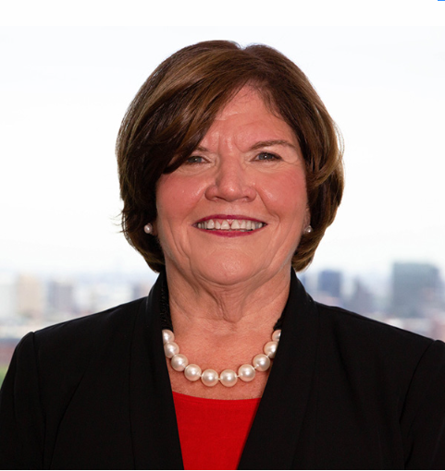


Stress First Aid Train the Trainer
Session I - October 26, 2022
Presenters
Susan Salmond
EdD, RN, ANEF, FAAN
Jennifer Polakowski
MPA
Funding for this program provided by the Healthcare Foundation of NJ

Slide 5
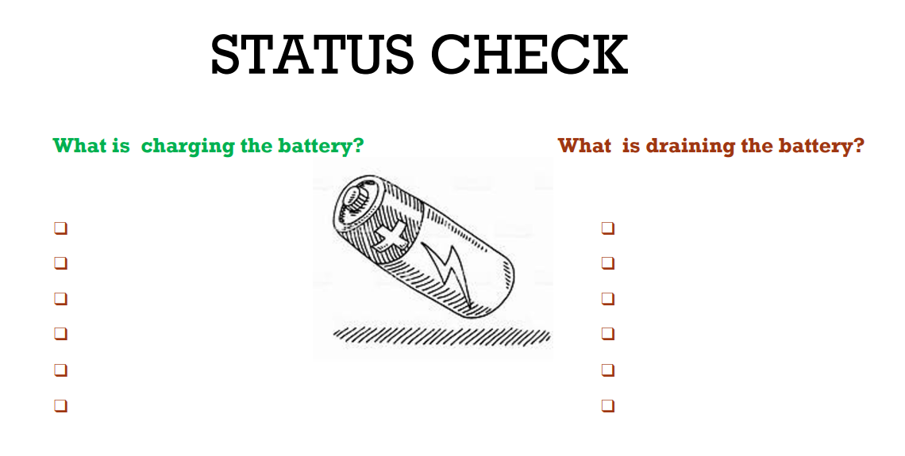
Introductions
Name
Work
Notes:
I would like to welcome you to Our Train the Trainer Session for Stress First Aid. To get started, I would like you to introduce yourself and tell us your position and where you work and share an answer to the question:
What is Charging Your Battery?
And What is Draining Your Battery?

Slide 6
Learning Objectives
Describe approaches for reducing stigma and normalizing the assessment and management of stress
Identify how to recognize stress injuries in health care professionals
Describe how to administer Stress First Aid (SFA) at the individual, unit, and organizational level
Describe strategies to maintain healthy stress and resilience
Notes:
Our objectives for these three days are to:

Slide 7


Background of Stress First Aid
Background
Stress First Aid was adapted from the Navy/Marine Corps
The Stress Continuum Model, the foundation of SFA, was developed as a visual tool for assessing an individual's stress response
SFA Model
The Stress First Aid (SFA) model is a self-care, leadership, and peer support model developed for those in high-risk occupations.
It includes seven actions that will help you to identify and address early signs of stress reactions in yourself and others in an ongoing way (not just after “critical incidents”).
NJ SFA Work
150 Trainers & 61 organizations (Acute, Community, Academia & LTC)
Expansion of the SFA Model to Enhance Resilience
Notes:
The format for today’s program begins with the background to the model, including the reasons for addressing stress, the stress response, what SFA is, the evidence underlying the model and key principles of the model.
We will then move in to a discussion of the SFA techniques.
Stress First Aid was initially developed for the Navy/Marine Corps and was called Combat Operational Stress First Aid (COSFA). The stress continuum model, the foundation for SFA was developed as a visual tool for assessing an individual’s stress response. All materials are open access and can be individualized for your organization.
The Stress First Aid (SFA) model is a self-care, leadership, and peer support model developed for those in high-risk occupations like military, fire and rescue, and health care
It includes 7 actions (the 7 C’s) that can be used to identify and address early signs of stress reaction in an ongoing way—not just after critical incidents.
Our SFA trainings to date have been to 82 trainers and 39 organizations. We have expanded the model to also provide a focus on proactive approaches to building and maintaining resilience.

Slide 8


Why SFA?
The Work of Nursing is Stressful
Healthcare Systems are Stressful
Occupational stress creates challenges and risks for individuals and teams
Occupational Stress Injury is a manageable risk—counteract with resilience, effective coping and healthy work environments
Notes:
The work of nursing is stressful that creates challenges for individuals and teams and puts them at risk for stress related problems. Moreover, the organizations in which nurses work are stressful.
Occupational stress can put individuals and teams at risk for occupational stress injury. This risk can be counteracted when there is individual and unit based resilience, effective coping and healthy work environments. Stress First Aid is an evidence-based framework and set of supportive actions designed to promote recovery from stress reactions by attending to individual, peer and organizational strategies to facilitate resilience.

Slide 9
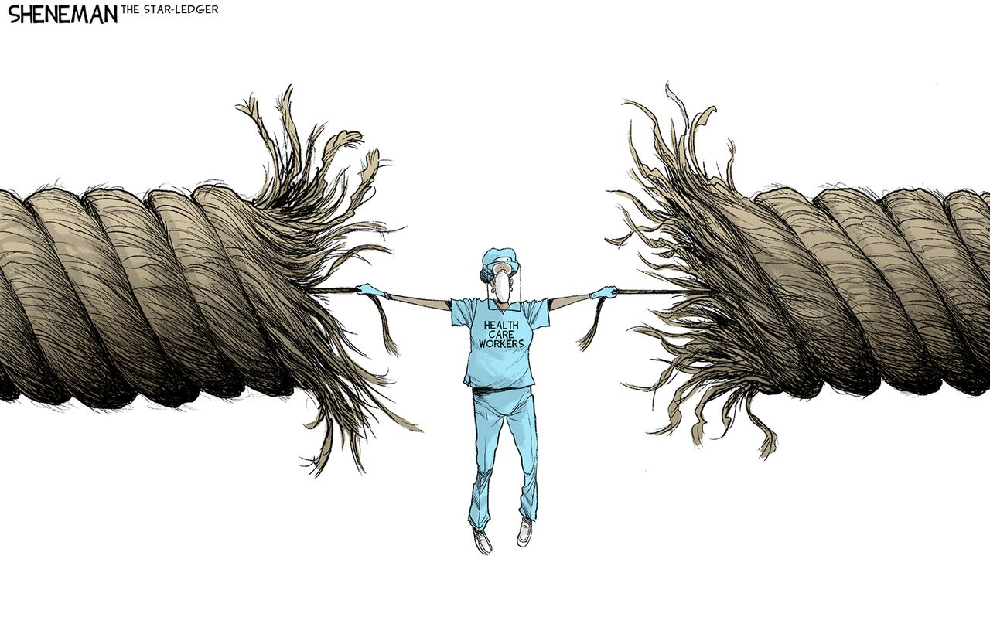
And Needed More Than Ever Before
Notes:
Although the work of nursing has always been stressful, COVID intensified this stress. Some nurses have successfully coped with the stressors of COVID, others are currently dealing with stress reactions to the situation and we know that for some their stress reaction may come years from now.
We have left the COVID surge and now are confronting growing nursing shortages, increases in workplace violence. The reality is that many are barely hanging on making them very vulnerable to stress injury. Finding ways to manage the stress is critical.

Slide 10
What is SFA?
Peer-Support & Self-Care Model
Parallels first-responder approaches to physical first aid
Stress First Aid is an evidence-based set of knowledge and skill tools to manage stress at an individual, unit and organizational level
The principles of SFA can be used in a preventive mode to build individual and unit resilience
Notes:
Stress First Aid (SFA) is a framework for peer support and self-care.
The SFA framework is parallel to how a clinician or first-responder approaches physical first aid—intervening when needed to remove the stressor, prevent further harm, and promote recovery for those who have been strongly affected by significant stress.
Individuals may use SFA for ongoing self check and management of their stress. It can be used at a unit level to check and support ones co-workers and can be applied at the organizational level---with the goal to maximize individual and unit resilience.
The overarching aim of SFA is to identify and mitigate the negative impacts of stress before they can impair workers’ health and wellbeing and to provide an array of recommendations for proactively building resilience and managing stress.

Slide 11
Evidence Supporting Stress First Aid Model
Sense of Safety
Hope
Calming
Self Efficacy
Connect
Notes:
The Core Actions of SFA are derived from an exhaustive literature review and international expert panel (Hobfoll, et al. 2007) There are five essential elements of immediate and mid-term intervention that are related to better recovery from stress:
The SFA framework addresses these 5 essential intervention elements and together they are lined with increased resilience and recovery during a variety of adverse circumstances:
Promote a sense of safety—Although total safety may not be achievable, the extent to which safety can be enhanced will facilitate people’s coping.
Promote calming—some anxiety is normal and healthy and under acute stress you anticipate some heightened levels of arousal or numbing responses that provide some insulation to the threat. However, extended high levels of stress results in psychophysiological and neurobiological reactions—leading to persistent arousal of heart rate, blood pressure and respiration, disruption of sleep, lack of hydration, poor decision-making and long-term health problems. Such disruptions of normal life rhythms are not only impairing, but potential precipitants of incapacitating anxiety that may lead to anxiety disorders.
Therapeutic grounding is used to remind individuals that they are no longer in the threat–trauma condition and that their thoughts and feelings are not dangerous in the way the disaster or terrorist attack was.
Deep breathing counters anxious emotionality. I
Deep muscle relaxation
“Normalization” of stress reactions (You are not going crazy, this is a normal reaction to stress. You are going through a crisis, and you are reacting in a normal way to an abnormal situation.
Problem solving appraisal
Promote connectedness—social connectedness is one of the strongest protective factors against stress injury and is linked to emotional well-being and recovery following traumatic stress.
Promote sense of self and collective efficacy—people who believe that they can overcome adversity and/or threat can handle stressful events, solve their problems and show greater recovery in stressful times.
Promote a sense of hope —hope maps onto optimism, faith, spirituality, and the belief that things will work out in the best possible way.
Hobfoll SE, Watson P, Bell CC, Bryant RA, Brymer MJ, Friedman MJ, Friedman M, Gersons BP, de Jong JT, Layne CM, Maguen S, Neria Y, Norwood AE, Pynoos RS, Reissman D, Ruzek JI, Shalev AY, Solomon Z, Steinberg AM, Ursano RJ. Five essential elements of immediate and mid-term mass trauma intervention: empirical evidence. Psychiatry. 2007 Winter;70(4):283-315; discussion 316-69. doi: 10.1521/psyc.2007.70.4.283. PMID: 18181708.
Dückers, M. L. (2013). Five essential principles of post-disaster psychosocial care: looking back and forward with Stevan Hobfoll. European journal of psychotraumatology, 4(1), 21914.

Slide 12

Stress
Is different for different individuals
Many are oblivious to the effects of stress
Those injured by stress may be the last to recognize it
Those that recognize it may not seek formal help—stigma and “otherness” is a big barrier
Evidence suggests that early treatment of reactions is effective
Peers are more likely to seek help from, and listen to peers…those with shared experiences
Growing body of research shows that persistently high levels of stress can cause physical and mental illness
Keith Negley, NYT, 2019
Notes:
Dampen the immune system
Promote inflammation
Promote heart disease
Promote premature aging

Slide 13
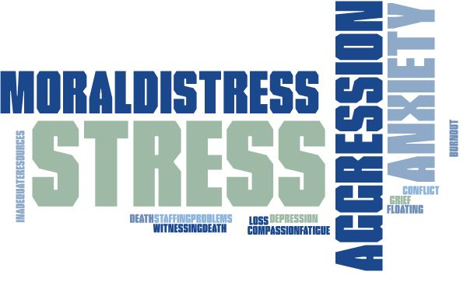
Notes:
Nurses are the most trusted — yet most abused — profession. The data prove that nurses have a much higher risk of experiencing workplace violence than other professions.
According to our 2021 survey,
30% of nurses had experienced verbal or nonverbal aggression from a peer.
24% had experienced verbal or nonverbal aggression from a person in a higher level of authority at work
14% had been assaulted by a patient or family member of a patient while at work
This abuse isn’t always as pronounced as physical assaults like punching or slapping. It’s also incivility, bullying, and sexual and verbal abuse. And while the problem has existed in the health care industry for decades, it’s not getting better or going away. Some would argue that it’s getting worse.
During the first lockdown, almost half of the adult population (49.6%) reported ‘high anxiety” Anxiety levels have dropped but remain elevated compared with before the pandemic.
Similarly, depression is more prevalent since the pandemic hit, with around one in five (21%) of adults experiencing some form of depression in early 2021—more than double that observed before the pandemic)
(https://pharmaceutical-journal.com/article/feature/in-figures-the-science-of-stress#main-content)

Slide 14
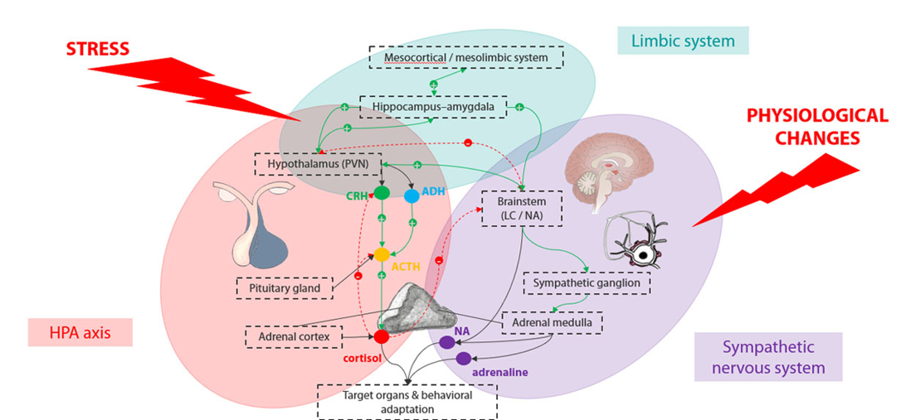
Impact of Stress from a Neurophysiologic Perspective
  Dampen the immune system
  Promote inflammation
  Promote heart disease
  Promote premature aging
  Promote diabetes
  Increase likelihood of mental illness
SAM axis
The Pharmaceutical Journal, PJ, July 2021, Vol 307, No 7951;307(7951)::DOI:10:1211/PJ.2021.1.95709
Notes:
One of the simplest ways to see the impact of stress, trauma, and moral distress is through the lens of the nervous system response. Our brains are constantly assessing our environment for threats and then responding with and without our conscious awareness based on that evaluation.
Sensory information gets sent to the Limbic system and the amygdala, the part of the brain where emotions are processed. The amygdala interprets the messages and if it senses danger, sends a distress signal to the hypothalamus, the brain’s command center, which communicates with the rest of the body through the autonomic nervous system, triggering the fight or flight mechanism.
Two systems are activated: the sympathetic-adrenal medullary axis (SAM) and the hypothalamic pituitary adrenal axis (HPA). The amygdala and hypothalamus start this cascade even before the brain's visual centers have had a chance to fully process what is happening. That's why people are able to jump out of the path of an oncoming car even before they think about what they are doing
Sympathetic-adrenal medullary axis (SAM AXIS)
The SAM axis functions like a gas pedal in a car. It activates the sympathetic nervous system which triggers the fight-or-flight response. In this response adrenalin and noradrenalin are released from the adrenal glands triggering the release of glucose and fats from temporary storage sites in the body. Release of adrenalin causes the heart and respiratory rate to increase, pupils to dilate, peripheral blood vessels to constrict and digestive processes to decrease to allow more energy to go to the muscles. Together there is a burst of energy so that the body can respond to perceived dangers.
When the acute stress is over, the parasympathetic nervous system, which acts like a brake becomes activated and promotes the "rest and digest" response that calms the body down and helps the body return to normal
If stress becomes chronic, the sympathetic nervous system continues to be activated which can cause wear and tear on the body
Hypothalamic pituitary adrenal axis (HPA AXIS)
The hypothalamus signals the pituitary gland to produce adrenocorticotropic hormone, which signals the adrenal glands to increase production of cortisol
Cortisol helps the body cope with stress by increasing access to energy stores, increasing protein and fat mobilization, and decreasing inflammation and digestive processes.
The body thus stays revved up and on high alert. When the threat passes, cortisol levels fall. The fall in cortisol levels triggers the parasympathetic nervous system — the "brake" — then dampens the stress response.
Chronic low-level stress keeps the HPA axis activated, much like a motor that is idling too high for too long. Cortisol secretion becomes dysregulated, leading to persistently high or low cortisol levels, resulting in impaired communication with the immune system and impacting almost every cell in the body. Prolonged stress also leads to glucocorticoid receptor resistance which can further cause dysregulated HPA axis function.
After a while this has an effect on the body that contributes to health problems associated with chronic stress
The impact of a prolonged sympathetic nervous system response is dampening of the immune system, promotion of inflammation, heart disease, diabetes, premature aging and an increase likelihood of mental illnesses including PTSD, depression, and anxiety.
Key interventions to prevent stress reactions are to stimulate a parasympathetic response. Research data shows a strong relationship between interventions to induce the relaxation approach and resilience o the ability to manage stress.

Slide 15
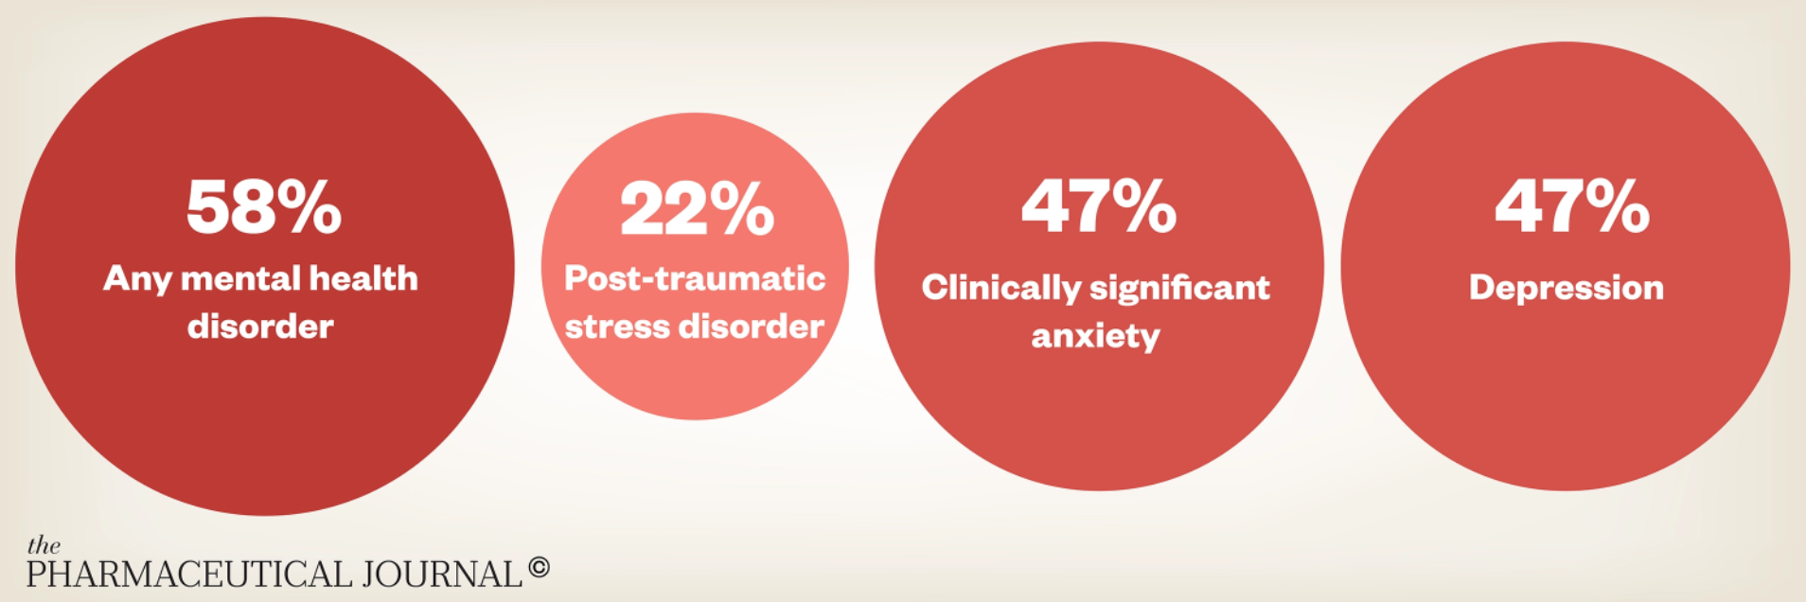
Mental Health Problems
Among Frontline Healthcare Workers
https://pharmaceutical-journal.com/wp-content/uploads/2021/07/Figure-6-mental-health-01.png
Notes:
Another way to see the impact of stress, trauma, and moral distress is by looking at the incidence of mental health problems.
There have been multiple studies which examined mental health problems among nurses and frontline healthcare workers. Reported in 2021, we see that just under half reported clinically significant anxiety and depression. When compare these 2021 figures to the general population you had about 21% of adults experiencing some form of depression which was actually double pre-pandemic rates.
According to the American Nurses Association, more than 50% of all nurses feel emotionally overwhelmed, with 30% reporting feelings of depression. In New Jersey, 64% of nurses reported feeling burned out, with 37% who work in hospitals intending to leave within the next 12 months.
Clearly there is an urgent need to address this stress.
Additional Info but not to be used now
During the first lockdown, almost half of the adult population (49.6%) reported ‘high anxiety” Anxiety levels have dropped but remain elevated compared with before the pandemic.
Similarly, depression is more prevalent since the pandemic hit, with around one in five (21%) of adults experiencing some form of depression in early 2021—more than double that observed before the pandemic)
(https://pharmaceutical-journal.com/article/feature/in-figures-the-science-of-stress#main-content
Nurses are the most trusted — yet most abused — profession. The data prove that nurses have a much higher risk of experiencing workplace violence than other professions.
According to our 2021 survey,
30% of nurses had experienced verbal or nonverbal aggression from a peer.
24% had experienced verbal or nonverbal aggression from a person in a higher level of authority at work
14% had been assaulted by a patient or family member of a patient while at work
This abuse isn’t always as pronounced as physical assaults like punching or slapping. It’s also incivility, bullying, and sexual and verbal abuse. And while the problem has existed in the health care industry for decades, it’s not getting better or going away. Some would argue that it’s getting worse.

Slide 16

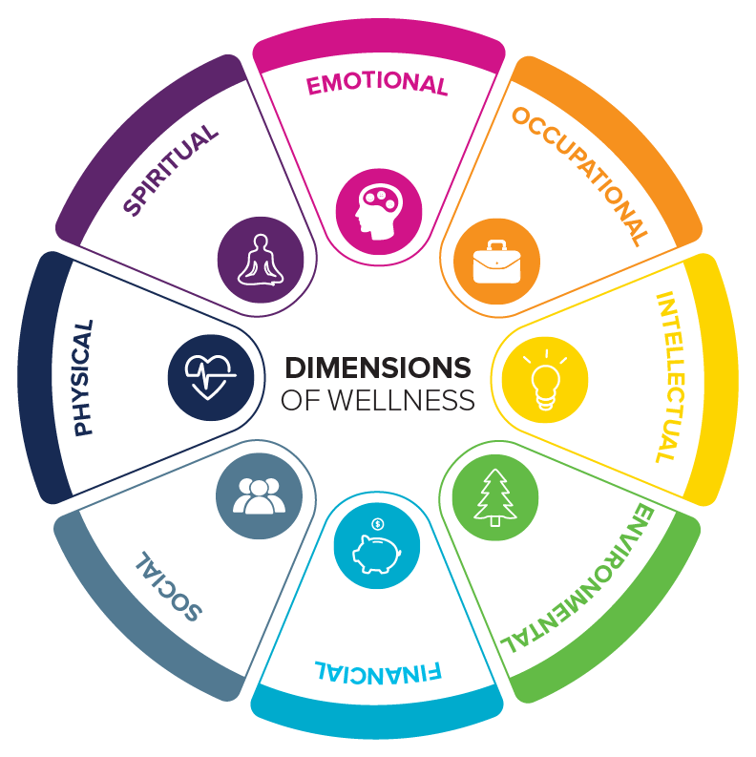
Promoting Resilience & Decreasing Stress
Mind-Body Skills
Notes:
“Resilience,” describes the mental elasticity of rebounding from adversity.
Stress resilience is the ability to recover quickly and easily from stress, upsets and set-backs. Resilience is a composite skill-set that can be learned and developed with the right tools and training. Tools include Mind-body skills --managing the mind-body connection or the relationship between experience and biological processes in the body, so that it works for you rather than against you. These mind-body skills are aimed at stopping the sympathetic response by applying the brake of the parasympathetic nervous system, and inducing a relaxation response, which can change your physical and emotional responses to stress.
The response can reduce stress and counteract effects of stress such as anxiety, diabetes, hypertension
Studies show that the relaxation response also alters genes involved in immune function, insulin secretion & energy metabolism
While also suppressing pathways that control the activation of the protein that plays a role in stress, inflammation and cancer.
Other skills promoting resilience will be discussed within this SFA training include cognitive reframing, early problem solving, developing competence
Enhancing resilience is an individual, unit and organizational responsibility. Although SFA targets awareness of stress injury as the primary concern, our approach is also to emphasize growing resilience so that stress can be managed.

Slide 17
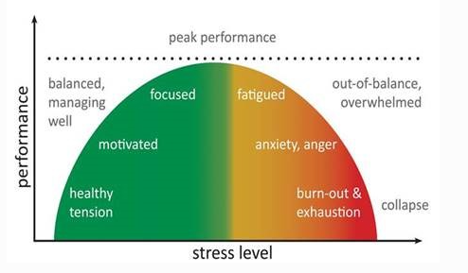
Stress and Stress Injury
Excessive stress can overwhelm compensatory systems and precipitate debilitating psychopathology
A STRESS INJURY is any severe and persistent distress or loss of ability to function caused by damage to the brain, mind, or spirit after exposure to overwhelming stressors
In this respect, the stressed brain is not unlike an exercised muscle: manageable doses can fortify the system, whereas an overload can cause permanent damage
STRESS INJURIES are invisible. You notice them in behaviors and words.
View stress on a continuum
Stress can be positive
Stress is part of our everyday work environment
Sometimes we function better under stress
But we must prevent stress injury
Notes:
So lets talk about stress and stress injury. Stress occurs on a continuum. Stress is part of our every day life and certainly our everyday work environment. Some stress can be positive and may actually help us be at our best. However too much stress can overwhelm compensatory systems and lead to stress injury or more severe psychopathology such as clinical depression or PTSD.
A STRESS INJURY is any severe and persistent distress or loss of ability to function caused by damage to the brain, mind, or spirit after exposure to overwhelming stressors
In this respect, the stressed brain is not unlike an exercised muscle: manageable doses can fortify the system, whereas an overload can cause permanent damage
STRESS INJURIES are invisible. You notice them in behaviors and words.
The goal of SFA is prevention or early recognition and response to stress injury before it becomes a psychological injury.

Slide 18
Stress First Aid
Acute Stress
Short-lived
Chronic Stress
Long-term burnout
Cost / Longevity
Lowered morale or absenteeism/presenteeism
Might interfere with safety or functioning in the moment
What you feel after a fatal or other difficult case
Once the situation is resolved, it diminishes
Might be the result of trauma or loss events or other ongoing situations
Feelings may not have been dealt with and chronic stress remains
Chronic physical health conditions linked to stress
Increased turnover of employees due to burn out
Increased costs associated with hiring and training new employees due to turnover
Notes:
Stress First Aid is designed to address both acute and chronic stress, as well as stress that can reduce employee morale, increase turnover due to burnout, and increase organizational costs associated with recruiting and training new employees. Differentiating between acute and chronic stress we see that….
Acute Stress:
Short-lived
Might interfere with safety or functioning in the moment
What you feel after a fatal or other difficult case
Once the situation is resolved, it diminishes
Chronic Stress:
Long-term
Might be the result of a series of traumatic or loss events, or ongoing stressful situation
Feelings may not have been dealt with and chronic stress remains
Chronic physical health conditions linked to stress
Cost/Longevity:
We know that in the presence of chronic stress there are costs to the organization including
Lowered morale or absenteeism/presenteeism (being at work physically but not fully engaged)
Increased turnover of employees due to burnout
And associated with turnover are Increased costs associated with hiring and training new employees due to turnover
We know that the cost of hiring and training 1 new RN is approximately $20,000…the cost savings from incorporating SFA into the culture of the unit clearly have positive cost implications.
SFA aims to interrupt behavior

Slide 19
Double Edged Sword of Values and Ideals
Strength | Guiding Ideal | Vulnerability
Placing the welfare of others above one’s own welfare | Selflessness | Not seeking help for health problems because personal health is not a priority
Commitment to helping patients heal and supporting their families | Loyalty | Guilt and complicated bereavement after perceived failure or loss
Toughness and ability to endure hardships without complaint | Stoicism | Not aware of / acknowledging significant symptoms /suffering
Following an internal moral compass to choose “right” over “wrong” | Moral Code | Feeling frustrated and betrayed when others fail to follow a moral code
Becoming the best and most effective professional possible | Excellence | Feeling ashamed / denial or minimization of imperfections
Notes:
Stress First Aid is particularly well-suited for health care settings because those who are drawn to work in these settings often live according to strong values and ideals. These values and ideals often give people the strength to persevere through very stressful situations. However, these ideals can create challenges as well that can contribute to poor self care and stress injury.
Taking a look at these we see:
Selflessness’s positive side is that one places the welfare of others above one’s own welfare—however, the vulnerability this creates may be not taking care of oneself when it is necessary, such as not making medical appointments for oneself in a timely fashion.
Loyalty’s strength, is a commitment to helping patients heal and supporting their families but also creates a vulnerability to greater guilt when someone feels like they couldn’t do enough for others who need help.
Stoicism’s strength is it gives one toughness and ability to endure hardships without complaint but the downside is it can often result in not attending to one’s own needs and red flags and can therefore be at odds with personal problem identification and help seeking.
Having a strong inner moral code can guide us in patient care situations assisting us to choose “right” over “wrong” but at the other end can result in frustration when others don’t have the same values and can also lead to moral injury when we are placed in situations where we must practice outside of what we perceive to be “right”. It can also mean a person’s social support network is limited to those who they feel can understand their experiences.
The value of excellence influences one to become the best and most effective professional possible but it’s vulnerability is that it can predispose a person to feeling ashamed when they don’t live up to their own high ideals and can reduce the likelihood of reaching out for mentoring.
It is important to understand how elements of guiding ideals can be both sources of strength for personnel as well as acknowledging that these elements can create additional challenges or vulnerabilities in seeking help.

Slide 20
Self Obstacles: Attitudinal
“It would be selfish to take a break from this work.”
“I’m okay, I’m fine, I’m not even tired.”
“The needs of those I’m supporting are more important than my own needs.”
“I’m not doing enough.”
“I can contribute the most by working all the time.”
“I don’t want anyone to know how affected I am.”
“Only I can do x, y, and z.”
Notes:
Stress First Aid has been designed to address both stigma and common obstacles to self-care in high stress jobs. One important component of self-care is attitudinal. Health care workers are often focused on other’s welfare before their own and have a tendency to get caught in self-talk that contributes to less self-care, such as making the following assumptions:
“It would be selfish to take a break from this work.”
“I’m okay, I’m fine, I’m not even tired.”
“The needs of those I’m supporting are more important than my own needs.”
“I’m not doing enough.”
“I can contribute the most by working all the time.”
“I don’t want anyone to know how affected I am.”
“Only I can do x, y, and z.”

Slide 21
Self Obstacles: Behavioral
Working too long by yourself without checking in
Keeping stress to oneself
Ignoring drops in functioning
Underestimating needs
Relying only on alcohol / substances to relax for extended periods of time
Becoming more disengaged / isolated
Overdoing without balance
Underdoing what is needed
Not seeking help / expertise
Notes:
Attitudinal assumptions and beliefs can often reduce self-care by affecting a person’s behavior. Here are some common behaviors that can increase risk for stress reactions:
Working too long by oneself without checking in with colleagues
Keeping stress to oneself
Ignoring declines in functioning
Underestimating needs
Relying only on alcohol/substances to relax for extended periods of time
Becoming more disengaged/isolated
Overworking
Not doing enough self-care to balance out the demands of work
Not seeking help/expertise
While it may not be possible or preferred to avoid these behaviors entirely, SFA recommends increasing awareness of how these actions might impede self-care and work, in order to make whatever changes can be made to reduce their frequency.

Slide 22
Promoting Resilience, Self
Balance Skills (universal):
  Finding shifts that fit lifestyle
  Consciously making time for meals, sleep and social activities
  Being able to set boundaries, able to ‘switch off’ after work
  ‘Professional shielding’
  Able to seek out social support
Varied Coping Strategies (individually tailored):
  Self-reflection through journaling, prayer, and faith
  Processing emotions
  Being able to accept that you cannot fix everything
  Being aware of the potential adversities
  Focusing on purpose and meaning
  Delegation of work
  Basic time management
Huey & Palaganas (2020)
Notes:
A synthesis of systematic reviews on resilience in health care organizations concluded that the following personal self-care factors were related to greater resilience in health care workers:
Balance skills:
Finding work shifts that fit one’s lifestyle
Consciously making time for meals, sleep and social activities
Being able to set boundaries; able to “switch off” after work
“Professional shielding,” or establishing internal mental/emotional boundaries to intense work
Being able to seek out social support
Varied coping strategies, that worked depending on a person’s preferred modes of coping:
Self-reflection through journaling, prayer, and faith
Processing emotions
Being able to accept that they cannot fix everything
Being aware of the potential adversities
Focusing on purpose and meaning
Delegation of work
Basic time management
The review noted that, while the balance skills seemed to be more uniformly related to resilience in health care workers, preferred self-care strategies were highly individualized. The SFA model recognizes the need for individualized tailoring of self-care strategies and highlights the need for more disciplined attempts at incorporating the balance skills that have received broad research support, such as social support and setting boundaries.
Cheong Wei Terence Huey & Janice C. Palaganas (2020): What are the factors affecting resilience in health professionals? A synthesis of systematic reviews, Medical Teacher, DOI: 10.1080/0142159X.2020.1714020

Slide 23

Promoting Resilience, Peer Support
Most people experiencing significant stress will cope, but some will become ill
Those that do become ill often do not seek formal help
Peers have shared experiences which promotes understanding and connection
Peers can decrease stigma and normalize stress/vulnerability
Peers can give informal support to prevent more significant problems
They can also be a bridge to more formal treatment
There is evidence that early treatment for significant stress is effective
Notes:
Coworker support is important in health care settings because:
Health care workers are often focused on others’ welfare before their own
Most people experiencing significant stress will cope, but some will become ill
Those that do become ill often do not seek formal help
Co-workers have shared experiences which promotes understanding and connection
Co-workers can decrease stigma and normalize stress/vulnerability
Co-workers can give informal support to prevent more significant problems
They can also be a bridge to more formal treatment
There is evidence that early treatment for significant stress is effective

Slide 24

Key Component: Organizational Support
Healthcare Research: Organizational Factors
Related to Resilience
Related to Resilience
A genuine interest in the wellbeing of staff
Accessibility to support without being judged as ‘not coping’
Enhance peer support and social support
Safe discussions of events and sharing
Provide opportunities for peers to work collaboratively
Recognize the importance of boundaries between work
and home life
Greater autonomy over time and content of work
Regulated working hours and adequate staffing
Meaningful recognition
Huey & Palaganas (2020)

Slide 25
Enhancing Resilience
Individual, Unit, Organization
Prevent Getting to the Red
Positive Practices
Optimize the work environment
Recognize Stress & Reduce Injury
X

Slide 26
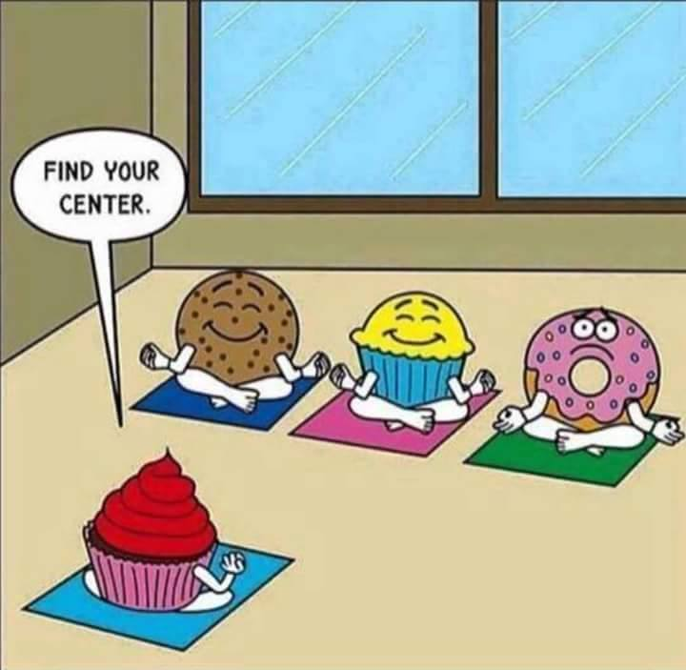
Why is it Hard to Implement Solutions
Stress
Burnout
Time Resources
Notes:
One strategy is not enough. What works for one individual may not for the next. What works in one unit may not work in another and the same for the organization.

Slide 27
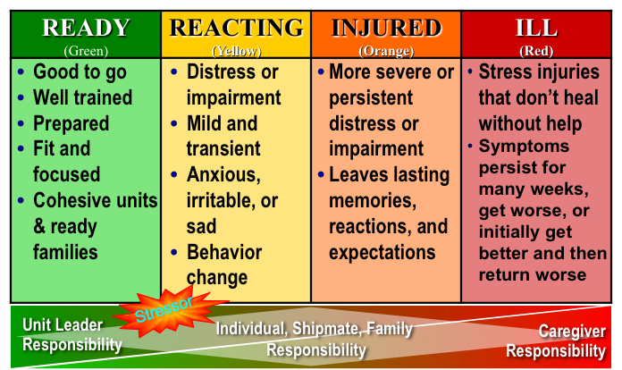
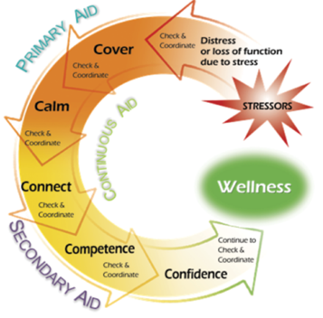
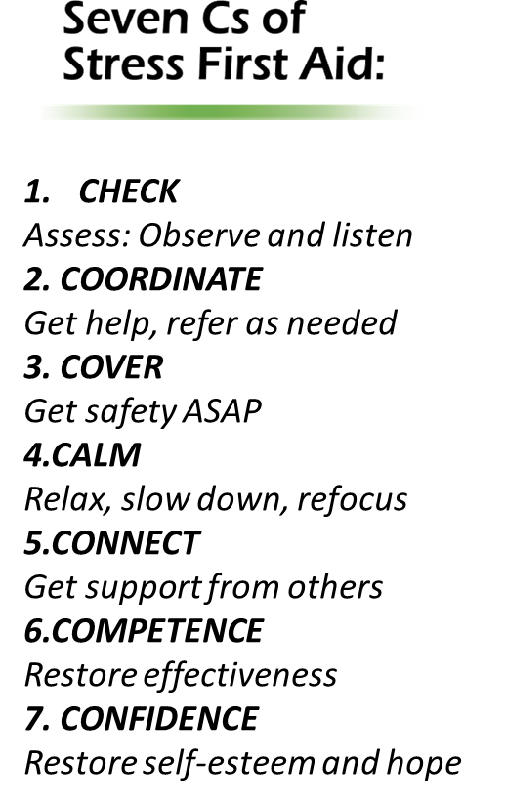
Major Concepts
Stress Continuum
Stress Injury
Stress First-Aid
Notes:
SFA offers a variety of approaches to managing stress and preventing stress injury. The 3 major concepts of stress first aid include the stress continuum, the types of stress most commonly associated with stress injury and the stress first aid 7 Cs which are actions that individuals, co-workers, leaders and organizations can take to address stress and stress injury.

Slide 28
Four Sources of Stress Injury
Intense or Prolonged Stress
Life Threat
Loss
Inner Conflict
Wear & Tear
A traumatic injury
Due to an experience of death-provoking terror, horror, or helplessness
A grief injury
Due to the loss of cherished people, things or parts of oneself
A moral injury
Due to behaviors or the witnessing of behaviors that violate moral values
A fatigue injury
Due to the accumulation of stress from all sources over time without sufficient rest and recovery
Notes:
While there are hundreds of different types of stressors that can move us into the yellow zone there are four types of exposures that have the potential to cause stress injury. These are also called Potential Traumatic Events (PTE).
The first one is obvious…
Life Threat—due to traumatic life-threatening or other situations that provoke terror, horror or helplessness. This type of injury can include experiencing a near-miss or close call. In law enforcement work, trauma is not the only harmful exposure.
Loss—grief due to the loss of close comrades, leaders, family members or other cared-for individuals. In many ways, Loss is the prototypical stress injury; where the meaning of the loss can change emotional, cognitive, and physical abilities.
Inner Conflict—a “beliefs” injury due to conflict between one's moral/ethical beliefs and current experiences. Inner conflict stress injuries can include acting outside of internal, self-imposed morals or values, an inability to prevent harm to others or somehow contributing to or not preventing harm to a fellow officer. Indications for inner conflict are the includes the words: “could’ve, should’ve, ought’of, only’if”
Wear and Tear—the result of fatigue and accumulation of prolonged stress, including from non-operational sources, without sufficient sleep, rest and restoration.
Overwhelming stressors OF FATIGUE (BURNOUT), TRAUMA, LOSS, OR MORAL INJURY.
Four Causes of Stress Injury
In high stress settings like health care services, trauma is not the only potentially harmful exposure. Stress injuries can arise from four possible mechanisms or causes:
Examples of Potentially Traumatic Events:
Exposure to very difficult cases
Exposure to extreme violence, murder, or suicide
Exposure to life-threatening infectious agents
Sexual assault or offenses
Working with families who have seriously ill or injured children
Dealing with hostility/resistance/violence from patients
Exposure to similar potentially traumatic events in one’s personal life
Examples of Loss:
Death or significant illness in patients, coworkers, family, or friends
Working with families who have lost their child
Loss of ideals
Loss of time
Loss of personal wellbeing
Loss of innocence
Examples of Inner Conflict:
Conflicts with personal values and the job
Finding time to satisfy work and personal responsibilities
Second guessing what could have been done differently to prevent a negative outcome
Concerns about the impact of one’s job on family or friends
Examples of Wear and Tear:
Long hours and rotating shifts
Working when ill or injured
Dealing with different personalities
Addressing substance abuse
Working through personal illness
Lack of supervisor support
Personnel turnover
More record keeping and accountability in records
More attention to things done wrong than things done right
Balancing homelife with job duties
Trying to manage a growing caseload
Extra duty assignments
Pressures from supervisors
Multiple updates in patient care, insurance policies, and programs
Multiple stressors in one’s personal life over extended periods

Slide 29
Four Causes of Stress Injury
Trauma
A traumatic injury
Loss
A grief injury
Inner Conflict
A moral injury
Wear and Tear
A fatigue injury
Due to the experience of or exposure to intense injury, horrific or gruesome experiences, or death.
Due to the loss of people, things or parts of oneself.
Due to behaviors or the witnessing of behaviors that violate moral values.
Due to the accumulation of stress from all sources over time without sufficient rest and recovery.
Notes:
Overwhelming stressors OF FATIGUE (BURNOUT), TRAUMA, LOSS, OR MORAL INJURY.
Four Causes of Stress Injury
In high stress settings like health care services, trauma is not the only potentially harmful exposure. Stress injuries can arise from four possible mechanisms or causes:
Examples of Potentially Traumatic Events:
Exposure to very difficult cases
Exposure to extreme violence, murder, or suicide
Exposure to life-threatening infectious agents
Sexual assault or offenses
Working with families who have seriously ill or injured children
Dealing with hostility/resistance/violence from patients
Exposure to similar potentially traumatic events in one’s personal life
Examples of Loss:
Death or significant illness in patients, coworkers, family, or friends
Working with families who have lost their child
Loss of ideals
Loss of time
Loss of personal wellbeing
Loss of innocence
Examples of Inner Conflict:
Conflicts with personal values and the job
Finding time to satisfy work and personal responsibilities
Second guessing what could have been done differently to prevent a negative outcome
Concerns about the impact of one’s job on family or friends
Examples of Wear and Tear:
Long hours and rotating shifts
Working when ill or injured
Dealing with different personalities
Addressing substance abuse
Working through personal illness
Lack of supervisor support
Personnel turnover
More record keeping and accountability in records
More attention to things done wrong than things done right
Balancing homelife with job duties
Trying to manage a growing caseload
Extra duty assignments
Pressures from supervisors
Multiple updates in patient care, insurance policies, and programs
Multiple stressors in one’s personal life over extended periods

Slide 30
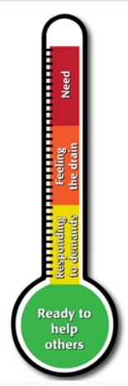
Stress Continuum/Thermometer
READY (Green) | REACTING (Yellow) | INJURED (Orange) | ILL (Red)
DEFINITION Optimal functioning Adaptive growth Wellness FEATURES At one’s best Well-trained and prepared In control Physically, mentally and spiritually fit Mission-focused Motivated Calm and steady Having fun Behaving ethically | DEFINITION Mild and transient distress or impairment Always goes away Low risk CAUSES Any stressor FEATURES Feeling irritable, anxious or down Loss of motivation Loss of focus Difficulty sleeping Muscle tension or other physical changes Not having fun | DEFINITION More severe and persistent distress or impairment Leaves a scar Higher risk CAUSES Life threat Loss Moral injury Wear and tear FEATURES Loss of control Panic, rage or depression No longer feeling like normal self Excessive guilt, shame or blame Misconduct | DEFINITION Clinical mental disorder Unhealed stress injury causing life impairment TYPES PTSD Depression Anxiety Substance use disorders FEATURES Symptoms persist and worsen over time Severe distress or social or occupational impairment
Notes:
Stress Continuum Model
The Stress Continuum Model was developed as a visual tool for assessing an individual's stress experiences, zones of stress, and stress responses. It forms the foundation for Stress First Aid. A person with a stress injury---whether from trauma, loss, inner conflict/moral injury, and long-term chronic stress, or “wear and tear” ---might move a person from the Yellow Zone of stress to the Orange or Red Zones.
Stress responses lie along a spectrum of severity and type — from transient and mild to chronic and debilitating. The continuum has four zones: Ready (Green), Reacting (Yellow), Injured (Orange) and Ill (Red). It is important to note that 100% of people will react when faced with significantly stressful experiences. However, the way in which they respond will depend on many factors, including how prepared they are for the stressor, how they interpret it, and the resources within the unit or organization to draw on to manage the stress.
A person can go from being in optimal functioning---feeling good, mentally and physically fit, mission focused, calm, and motivated---into the Yellow Zone. In the Yellow Zone a person can feel irritable, anxious or down, lack motivation, lose focus, have trouble sleeping, or have muscle tension or other physical changes, but these are transient reactions.
Movement into the Orange Zone is usually caused by an accumulation of different types of stressors or a pretty severe stressor. In the Orange Zone you start to see more severe and persistent distress or impairment, the person doesn't feel like themselves, or they have a loss of control of their stress reactions. They might feel strong panic or depression, rage, guilt, or blame. In this zone it starts to feel like the stress "leaves a scar,” and the person is at high risk for having trouble functioning and strong or persistent distress.
The Red Zone is usually reserved for diagnoses like PTSD, depression, anxiety, or substance use disorders. What signifies a person being Red Zone is that their symptoms are very persistent or worsen over time, the person experiences severe distress, or has significant difficulty functioning at work or in their home life.
Stress First Aid was designed to help people move themselves or their coworkers from the Red and Orange Zones back to the Yellow or Green Zones.
The norm in many high stress work cultures has been that after a difficult event, one should be able to “tough it out.” This is still the case in many settings, where the stigma associated with reacting to stress or stress injury behaviors is still very real and people will try to conceal stress reactions from supervisors to avoid medical or psychological intervention.
However, it is usually not possible to keep these behaviors hidden for long from family members, coworkers, and friends. When a coworker recognizes that someone is in trouble, it is important to try to assist in some way.
Getting this individual connected with the next level of help as soon as possible may help prevent their reaction from progressing into the Red Zone. And once an individual has moved into the Red Zone, the goal is to help get them into treatment as soon as possible.

Slide 31
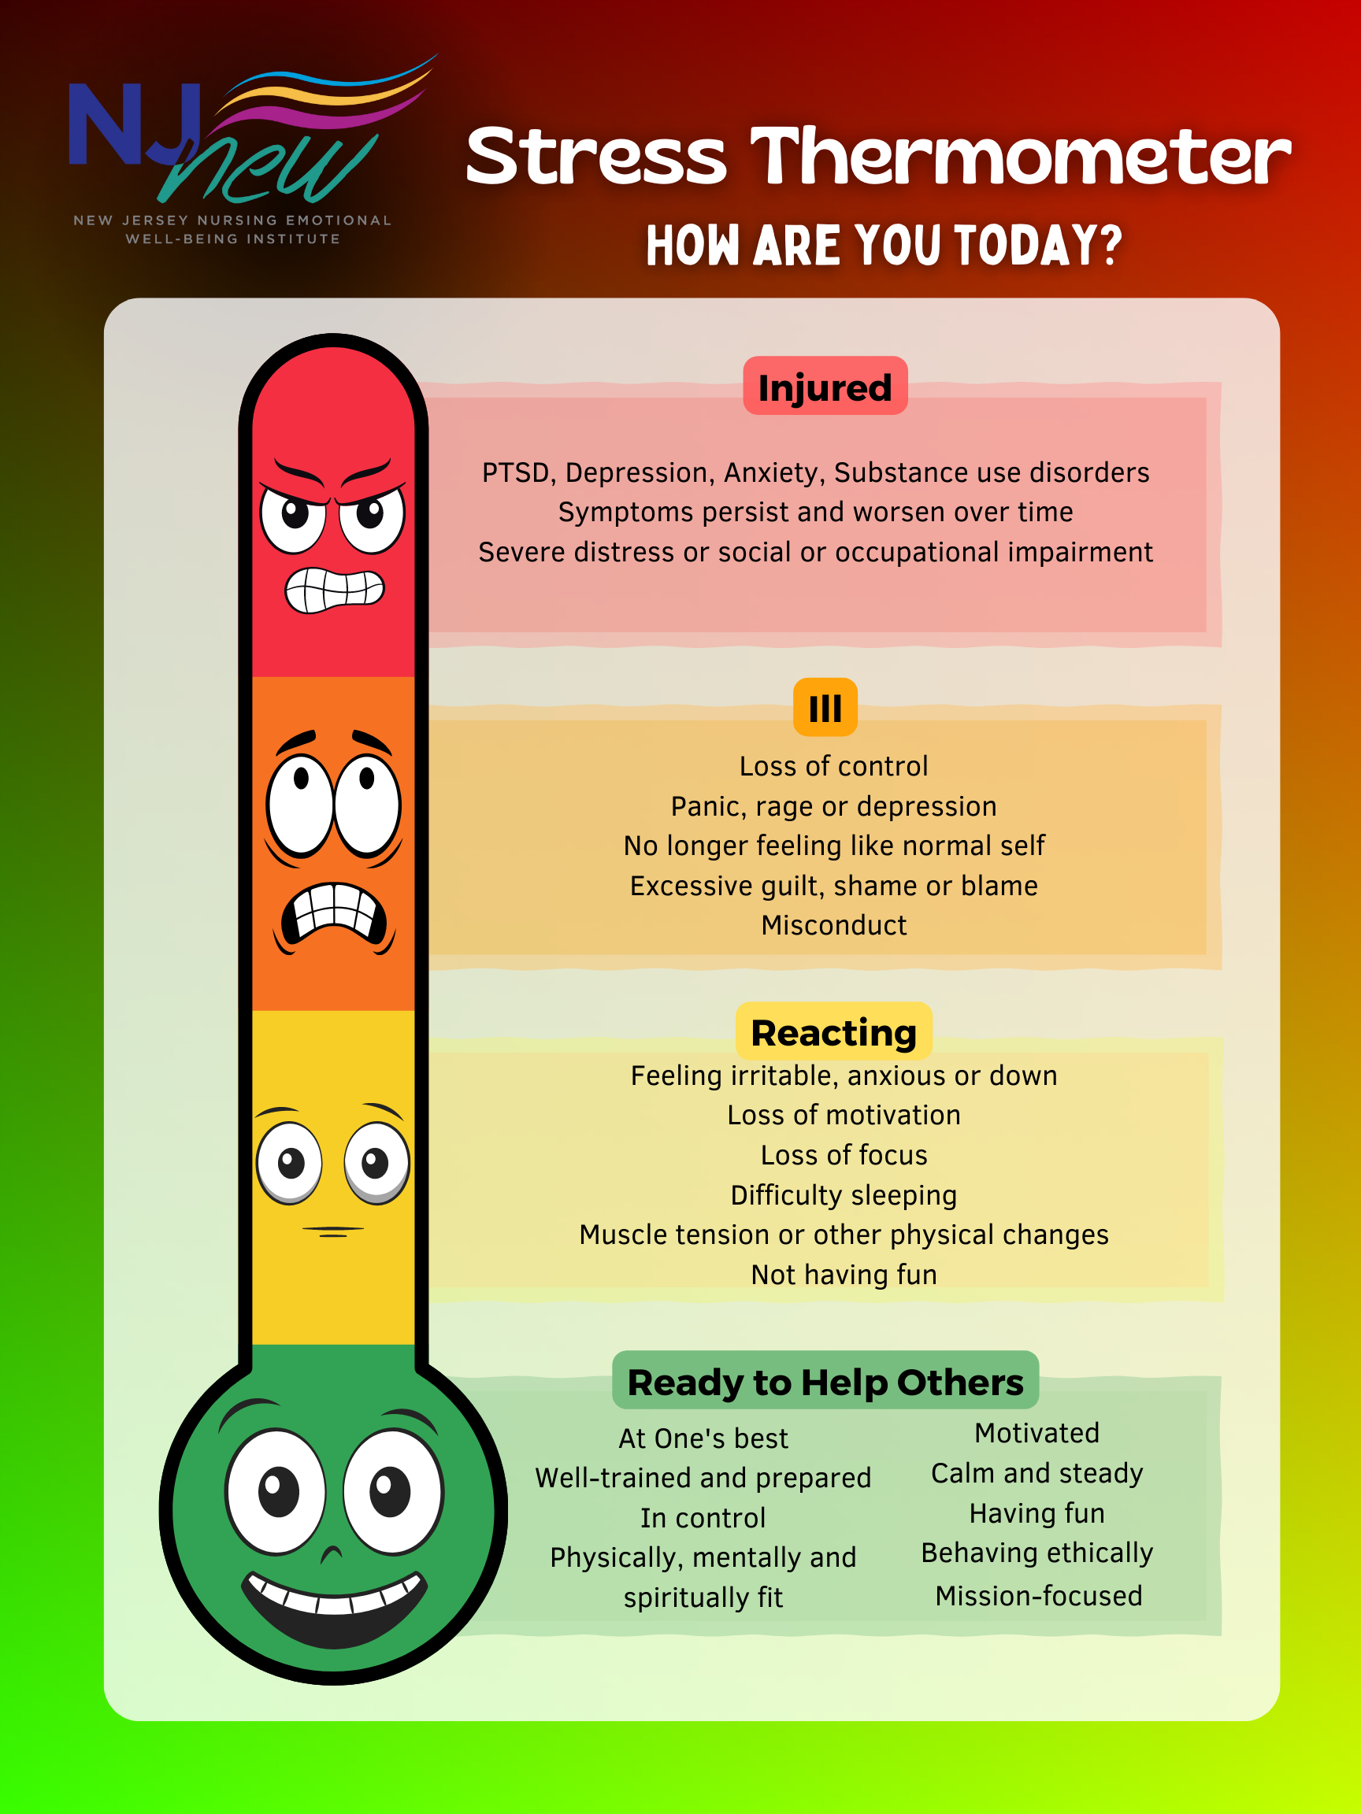
Poll Group Stress Level

Slide 32
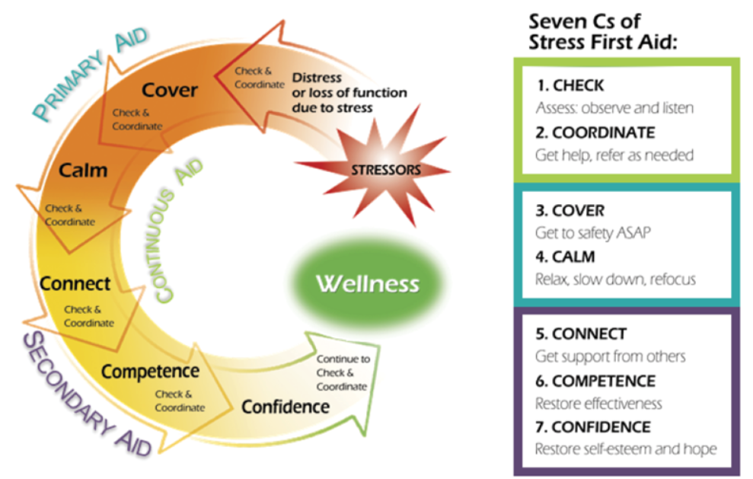
STRESS FIRST AID MODEL
Notes:
Three STEPS to Provide Stress First Aid
Recognize a Stress Injury (Check & Coordinate)
Provide Primary Aid (Cover & Calm)
Provide Secondary Aid (Connect, Competence, & Confidence)

Slide 33




Stress First Aid is NOT:
An event only intervention
A one-time only intervention
A replacement for medical or behavioral health interventions
A replacement for prevention efforts
Notes:
Stress First Aid is NOT
The following points describe what SFA is NOT:
An event-only intervention. SFA focuses on people and behaviors instead of focusing on events.
A one-time only intervention. SFA is a way to identify people in distress and provide long-term emotional support.
A replacement for needed medical or behavioral health interventions.
A replacement for prevention efforts.

Slide 34
Stress First Aid Core Principles
SFA fosters strong peer and leadership support
SFA is fluid, not one-size-fits all
SFA is both preventive and reactive
SFA bridges individuals to higher levels of care
SFA is an ongoing process best integrated into unit culture
SFA provides a common language to normalize discussion of stress

Slide 35
Stress First Aid Essentials
Recognize
Recognizing Stress levels as part of everyday assessment
Act
Know
Know at least 2 trusted resources you would offer to a stressed peer to make a connection or provide assistance
Monitor ongoing stress levels so you can notice changes
Be aware of signs of Stress injury
Integrate resilience strategies as part on-going practice
All adopt empathic stance
If you see something, say something
Notes:
Stress First Aid Essentials
There are three essential Stress First Aid skills.
Recognize when a peer has a stress injury
Act: If you see something, say something:
to the peer you’re concerned about (Always try to communicate with the peer first)
to a trusted support (If communicating with the coworker is not ideal because of circumstances or because of your roles, coordinate with a trusted other)
Know at least 2 trusted resources to offer to a stressed coworker. Knowing organization and community resources can come in handy when a person needs referral to other forms of support.

Slide 36


Slide 37

Group Discussion: SFA Model
What overall impressions do you have of the model?
To what extent do you think the people in your organization would agree that responsibility of managing stress includes unit peers and the organization?
To what extent is stress normalize within your organization?
Notes:
Breakout leader to summarize the group discussion when return to full group

Slide 38
Recognize Stress Zone Transitions:
Demand: Resource Balance
Green “Ready” | Yellow “Reacting” | Orange “Injured” | Red “Ill”
100%
35%
5%
Healthy
Well
Fit
Safe
Connected
Capable
Confident
Drained
Sore
Irritable
Anxious
Down
Routine Stressors
Cumulative stress without sufficient resources
Resilience
Hurt
Out of control
Symptomatic
Distressed
Dysfunctional
Clinically symptomatic
Impaired
Worsening
Disordered
?
Toxic Stressors
Recovery
Recovery

Slide 39
Stress Continuum Support Strategies
“Grow the Green”
Ready
Reacting
Injured
Ill
Intention
Awareness
Self-mastery
Fostering Positive Mindset
Compassion/ Empathy
Communication
Highlighting purpose and meaning of work
Being Present
Huddles
Active Problem Solving Strategies
Unit Mitigation Strategies
Peer Support
Stress Communication Skills
Stress Reduction Skills
Engage Additional Coping Resources
EAP Proactive & Interventional Resources
Peer Support
Leader Support
Mentoring and
Self-care Coaching
Early Referrals
Encourage Time Management
Individualize Resources for Specific Injury Behaviors (i.e. EAP, emotional support)
Ethics Consults
Voluntary and Mandatory Referrals
EAP Support Programs
Treatment Resources

Slide 40


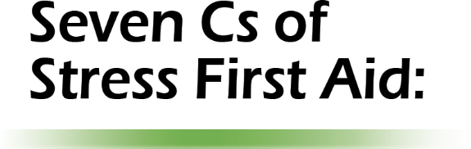


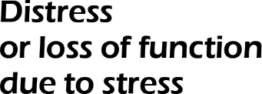
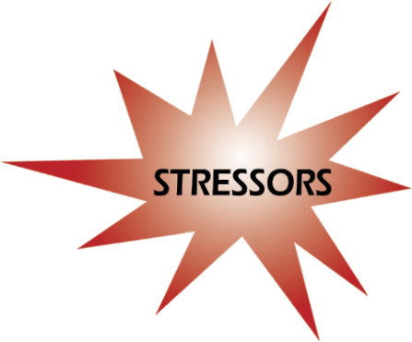

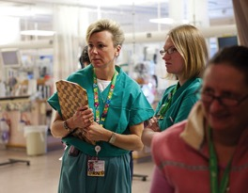



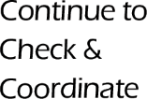

Stress First Aid Action: Check
CHECK
Assess: Observe and listen
2. COORDINATE
Get help, refer as needed
3. COVER
Get safety ASAP
4.CALM
Relax, slow down, refocus
5.CONNECT
Get support from others
6.COMPETENCE
Restore effectiveness
7. CONFIDENCE
Restore self-esteem and hope

Slide 41
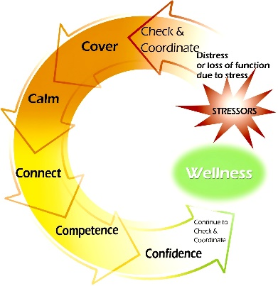
Check Actions
Observe
Look
Keep Track
Stressors
Examine
One-to-one interactions
Collateral information
Decide
Dangerousness
Listen
Distress
Changes in functioning
Response to SFA Actions
Stress zone
Needs
Notes:
The action of Check is different from other SFA actions in that it is not triggered by stressful events or signs of distress, but rather is an ongoing process. It can mean having greater awareness of one’s own “red flags,” or indicators of more significant stress. It can also mean checking on coworkers regularly to have a better sense of when they are experiencing significant stress. This slide primarily describes the functions of Check with others.
The first Check action is to observe: to see and hear what is going on with a coworker, noting how they are being affected and by what. This is not meant to be an intrusive process, but one of awareness and caring.
Depending on your relationship with the person, you can also keep track of potentially stressful events (both at work and on the home front) and any signs of distress or changes in functioning. If SFA actions have already been used, keep track of whether or not they have been effective.
Examine the information that you have gathered by talking one-on-one to the person and, when appropriate, asking about how they are feeling and functioning. You can also gather information from other sources that might be helpful, including from coworkers or, if possible, family members.
The final Check action is to decide on helpful SFA actions based on this information. This includes determining whether anyone is in danger and making decisions about the need for further care.
While Check should be an ongoing action, in practice Check may also begin with the awareness that an individual has been exposed to specific stressors. These stressors may be work events or challenges to the individual’s value system. They can also arise from personal challenges, such as family life difficulties or financial strains. Sometimes these stressors may also be an accumulation of small and seemingly insignificant challenges that can add up over time and have a sizable impact on a person’s stress level.
However, exposure to stressors is not enough to warrant SFA or other direct aid. Most people who experience even intense stressors don’t need help. What triggers SFA are not the events themselves but indications that someone who has been exposed to these events is operating in the Orange or Red Zone.
If there is evidence of Orange or Red Zone stress, with Check one asks, “What are the person’s physical, mental, social, and spiritual needs?” Depending on the answer, it may be appropriate to use SFA and to identify what resources to mobilize on this person’s behalf, as well as who else may need to know about a coworker’s problems.

Slide 42

Check: Why is it Needed?
Those injured by stress may be the last to recognize it
Stigma can be an obstacle to asking for help
Stress zones and needs change over time
Risks from stress injuries may last a long time
Notes:
Check is an ongoing process in part because most people are unaware of their stress zones and needs, and often don’t pay attention to such things when focusing on work and the demands of daily life.
When people have been significantly changed by stress, or injured by it, they may not recognize the ways that it has impacted their lives. Those around them may be more likely to notice the impact if they are paying attention and know what to look for.
Even if the person affected by stress recognizes distress or changes in functioning, the stigma that surrounds such problems can be a powerful barrier to seeking help. Telling others about our problems and asking for assistance is very difficult for most of us.
Both the stress zones of individuals and the resources available to help can change drastically over time. A continuous process of assessment is often the only way to match needs with appropriate levels of help each step of the way.
It is also important to remember that the after-effects of stress injuries can be delayed by weeks, months or even years. Those who have been seriously affected by stress will need to be periodically followed up with and reassessed.

Slide 43
Check: In the Green & Yellow
CHECK: Building Resilience, Growing the Green
CHECK: Proactively Manage Stress
Calm
Steady
Focus
Enjoying what you are doing
Having Fun
Productive
Getting anxious
Irritable
Not having fun
Hard to focus

Slide 44

Check: In the Orange or Red
CHECK: Stress Moving into an Urgent Zone
CHECK: In Danger Zone—Take Immediate Action
Becoming more isolated from others
Uncharacteristic behavior
Making mistakes
Compulsive behavior
Sleep changes or nightmares
Loss of focus, memory, or the ability to think rationally
Intense feelings
Inability to engage in or enjoy things you usually like
Feeling unusually numb or uncaring
Compulsive behavior
Wanting to avoid situations or reminders
Feeling anxiety, sleep, unable to focus, muscle tension
Having fun, enjoying what you are doing, control
Notes:
In order to Check in with oneself and others, it is helpful to be aware of the experiences, behaviors and symptoms that characterize stress reactions. They include:
Signs that you can use to check on both yourself and others.
Symptoms that you can use to check on yourself.
Signs are significant and persistent negative changes in behavior or habits
Becoming more isolated from others
Uncharacteristic negative behavior
Making mistakes
Compulsive behavior
Symptoms are internal feelings and less public reactions. Orange zone reactions are generally characterized by not feeling in control of one’s body, emotions or thinking
Sleep changes or nightmares
Loss of focus, memory, or the ability to think rationally
Intense feelings
Inability to engage in or enjoy things you usually like
Feeling unusually numb or uncaring
Compulsive behavior
Wanting to avoid situations or reminders
CHECK: Stress moving into an urgent zone: Negative changes in behavior / habits

Slide 45
Check Skill: OSCAR
Observe
Observe:
Actively observe behaviors; look for patterns that vary from baseline
State
State Observations:
State your observations of the behaviors; just the facts without interpretations or judgments
Clarify
Clarify Role:
State why you are concerned about the behavior to validate why you are addressing the issue
Ask
Ask why:
Seek clarification; try to understand the other person's perception of the behaviors
Respond
Respond:
Let person respond to your concerns and discuss potential next steps or plans
Notes:
Many people feel uncomfortable asking others about their stress reactions. They know how to have casual conversations with coworkers, but when it comes to discussing personal issues or emotions, people often don’t know where or how to start. Another common barrier to accurate assessment is the almost automatic denial of experiencing any stressors, distress, or changes in functioning.
The OSCAR model of communications is another easy to remember tool that can be a useful for talking to someone about stress reactions:
Observe: actively observe behaviors; look for patterns that are different from baseline. Be on the lookout for colleagues in need by observing their behaviors (e.,g., they are more sullen or withdrawn than usual)
State Observations: focus attention on the behavior; state just the facts without interpretations or judgments. “I have noticed over the past few days that you seem lost in thought and really quiet (frustrated/irritated).
Clarify Role: state why you are concerned about the behavior and validate why you are addressing the issue. “As a coworker (friend, supervisor), I am concerned) (What was your role—job/task/goal and what was the other person’s role—job/task/goal).
Ask Why: seek clarification; try to understand the other person’s perception of their own behavior. “Help me understand what’s going on. I would like to help if I can.”
Knowing what you know now; would you do anything differently?
Respond: Let the person respond to your concerns, clarify concern if indicated and discuss desired behaviors—state options in behavioral terms and/or discuss potential next steps or plans. Thank you for trusting me enough to share that (issue). I really do want for you to be comfortable in working together. I respect that you have al lot going on. I also respect your privacy. If not me, would be willing to talk with (name two trusted resources)
What would resolution look like to you
May want to ask group, what are some additional ways you could check in with yourself for better self care and with your peers?

Slide 46
Check Skill: OSCAR Examples
Observe
Observe:
You notice your peer has been less and less talkative, and more isolated from others over the last few weeks
State
State Observation: “Hey Joe, I haven’t been seeing you around as much lately, and you seem to be really quiet the last few weeks.”
Clarify
Ask
Ask:
“Am I right in my guess that something might be going on with you?”
Respond
Respond:
Joe says yes, and you say, “Why don’t we go get some coffee so we can talk away from others. Does that sound okay to you?”
Clarify Role:
“I’m only bringing this up because I care about you and want to make sure that you’re okay.”
Notes:
Check Skill: OSCAR Example
Here is an example of how OSCAR might be enacted in a work setting. There are many other ways that OSCAR could be used, but this gives an example of how a conversation might proceed using this strategy.
Observe: You notice your coworker has been less and less talkative and more isolated from others over the last few weeks
State observations: “Hey Joe, I haven’t been seeing you around as much lately, and you seem to be really quiet the last few weeks.”
Clarify Role: “I’m only bringing this up because I care about you and want to make sure that you’re okay.”
Ask: “Am I right in my guess that something might be going on with you?”
Respond: Joe says yes, and you say, “Why don’t we go get some coffee so we can talk away from others? Does that sound okay to you?”
OPTIONAL: If time allows, have trainees split into pairs and role-play an OSCAR scenario based on the observed behaviors in the example on this slide, but using their own language and personality style.

Slide 47


Self Check Actions
Give yourself permission to take care of yourself
Make a conscious effort to keep tabs on yourself
Become aware of personal red flags
Pay attention to red flags sooner rather than later
When red flags occur, take steps to mitigate them
Inform key family, friends, or peers about your personal red flags and make a plan as to what to do when they occur

Slide 48

Peer Check Actions
Build a foundation based on good relationships
Unit culture: values the importance of looking out for each other
Pay attention to social withdrawal and other changes in behavior, emotional tone, and diminished work performance—know each other’s red flags
Monitor/check regularly— “Check you, check two”
Check in more than once, especially on anniversaries, following difficult events, or when noticing signs of distress
Be approachable and authentic
Have a plan for how to approach concerns
Notes:
Potential Peer Check Actions
Here are a few potential Check actions that can be used with others:
Build a foundation based on good relationships.
It is the team’s responsibility, guided by the leader to build a unit culture that values the importance of looking out for each other
Pay attention to social withdrawal and other changes in behavior, emotional tone, and diminished work performance—know each other’s red flags
Monitor/check on staff needs regularly—Check me, check three
Check in more than once, especially after other stressful events which might cause cumulative wear and tear, or on anniversaries of particularly stressful events, which can be a reminder of the event and cause a person to feel worse.
Be approachable and authentic, so employees are more likely to share experiences and reactions.
Have a plan for how to approach concerns
Begin with a casual two-way communication to get the person talking. Use active listening and look for words, non-verbal signs, and cues as to how they are doing.
Find the right way to check on someone without annoying them (e.g., email/texting versus calling).
“Is everything all right? I’m checking on you. I’ve noticed ….”
Offer basics---like food, water, coffee…to make a connection that can open a conversation
Start a general conversation to get the person talking. Then look for verbal and nonverbal signs as to how they are doing
Start with something positive then reference specific concerns you have
Reference the colors of the stress continuum model
Use opportunities where there is safety, privacy and time to open conversations

Slide 49
Organization/Leader Check Actions
Creating a culture that encourages employees to receive support or to reach out to help will make it easier for employees to most effectively check in on one another.
  Well-being pillar, People First, Caring is Contagious
  Rounds inclusive of stress
Be authentic and approachable
Monitor and Make Public Data
  Turnover Rate
  Absenteeism/Call Outs
  Engagement Surveys
Focused Assessments as needed

Slide 50
Stress First Aid Action: Coordinate
CHECK
Assess: Observe and listen
2. COORDINATE
Get help, refer as needed
3. COVER
Get safety ASAP
4.CALM
Relax, slow down, refocus
5.CONNECT
Get support from others
6.COMPETENCE
Restore effectiveness
7. CONFIDENCE
Restore self-esteem and hope

Slide 51
Coordinate Actions
Collaborate
To promote recovery
Inform
Supervisor(s)
Refer
Recommend resources
To ensure safety
To get more information
Peers
Family
Consultation
Direct hand-off
Notes:
Coordinate Actions
The next core action of SFA is Coordinate. This action sometimes includes consulting and/or collaborating with others for more help for oneself or coworkers. It can also involve informing those who may need to know about the situation. The key components of the Coordinate action are:
To collaborate with those who have a stake in the well-being and future of the stressed individual.
To get assistance from others at any step in the process in which help is needed to assess and care for a stressed individual.
To inform the leaders, supervisors or key individuals who have a need to know, to the extent that they need to know.
To refer individuals who may need more intensive help to those who can help, either in a direct hand-off or through a more gradual consultation process.

Slide 52

Coordinate: Why Needed?
If you have checked and don’t follow through, establish distrust
Need resources available following check and resources may not be clearly coordinated
To plan so check needs are followed through with:
  SMART coordinated goals
Notes:
Examples of SMART Goals: Specific, measurable, action-oriented, realistic, on a timetable.
I will talk with at least one EAP or HR person this month to find out what they have to offer. I will ask a coworker if they know of any good resources for stress.

Slide 53
Coordinate: In the Green & Yellow
COORDINATE: Building Resilience, Growing the Green
COORDINATE: Proactively Manage Stress
Narrating actions that will be taken to manage the stressors
Debriefing
Plan a recheck
Asking for help
Uncertainty regarding stress level, dangerousness or level of impairment
No immediate need for coordination
Think proactively: what other approaches, services can build resiliency
Coordinate to advance prevention and resilience efforts– the goal is you are making it part of the culture…gratitude sharing, self-care coaching, mindfulness, proactive resourcing to prevent stress injury
Notes:
Narrating actions that will be taken to manage the stressors

Slide 54
Coordinate: In the Orange or Red
COORDINATE: Stress Moving into an Urgent Zone
COORDINATE: In Danger Zone—Take Immediate Action
Know resources available for referral
Poses a threat to self or others
OSCAR. Refer based on SMART goals
Trusted colleague, EAP, Family
Plan an ongoing check plan monitoring for mistakes, behavioral changes—worsening or improvement?
Mentorship plan
Urgent intervention
Escalation to leadership
Navigate and escort to resources
Notes:
In order to Check in with oneself and others, it is helpful to be aware of the experiences, behaviors and symptoms that characterize stress reactions. They include:
Signs that you can use to check on both yourself and others.
Symptoms that you can use to check on yourself.
Signs are significant and persistent negative changes in behavior or habits
Becoming more isolated from others
Uncharacteristic negative behavior
Making mistakes
Compulsive behavior
Symptoms are internal feelings and less public reactions. Orange zone reactions are generally characterized by not feeling in control of one’s body, emotions or thinking
Sleep changes or nightmares
Loss of focus, memory, or the ability to think rationally
Intense feelings
Inability to engage in or enjoy things you usually like
Feeling unusually numb or uncaring
Compulsive behavior
Wanting to avoid situations or reminders

Slide 55


Example: Self-Check and Coordinate
Check Self: the day before her first of three 12 hour days in a row, Alison noticed she was breathing fast and unable to focus on preparing herself for the upcoming days. She recognized that she was starting to feel anxious about her readiness for the upcoming workload.
Coordinate Self: Allison considered whether resources were needed—why was she feeling that way? She chose to discuss this with her trusted mentor/colleague.

Slide 56
Example: Peer/Leader-Check and Coordinate
Check: A nursing unit suffered the loss of a long time pediatric cancer patient. During rounds on the unit you see the staff is visibly shaken and upset. Some of the team members are crying.
Coordinate Debriefing: After seeing team members upset after the recent loss of a long time cancer patient, the peer emotional support team is contacted to schedule a group talk therapy session. The meeting is held that day and many of the staff attend. The team members are given the numbers to the employee assistance program & the 24/7 team member support and navigation line.

Slide 57
Example: Leader Check and Coordinate
Check: “I try to get to know each of my staff individually, so I know their baselines and what could potentially be a red flag. I make a point to sit and talk with them during breaks and at other times when there is down time.”
Coordinate: That helped when one of my staff members had a pregnant wife, and we responded to a stillborn birth.
Recognizing that he may identify with the situation, after that call I took a little extra time to sit and talk with him, to make sure that he was okay.

Slide 58
Example: Leader/Organization Check and Coordinate
Check: We decided that with many changes occurring in our organization, we would try to check with all employees about their concerns and brainstorm possible ways to improve conditions in the organization. We asked about what’s needed, and staff’s biggest challenges, but also asked about what’s working. We communicated that although everything might not be able to be fixed or address, our goal was to work together as a team to creatively mitigate challenges
Coordinate: We had workshops, blogs, and an online platform to gather concerns and collect information on approaches to problems. We made sure that all employees were given different ways to give input and assigned a team to sort and make sense of that input in a way that respected all employee input.
We reported the aggregate and unit based findings back to staff and together prioritized challenges. Leadership worked to identify and develop resources responsive to needs.
Notes:
What has been your greatest challenges, hassles, or frustrations?
What has been your greatest reward, success, or positive experience?
What does it mean to be a (name role) in what you do?

Slide 59
Group Discussion: Check/ Coordinate
Is check part of your cultural now?
What are ways you have successfully integrated check?
What gets in the ways in checking?
What are some check strategies not mentioned?

Slide 60

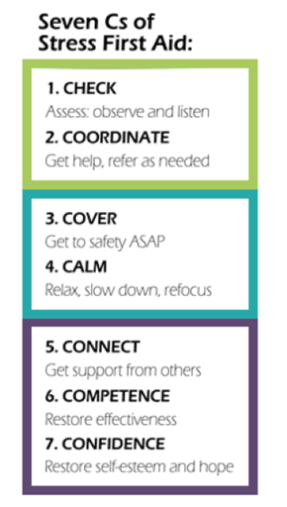
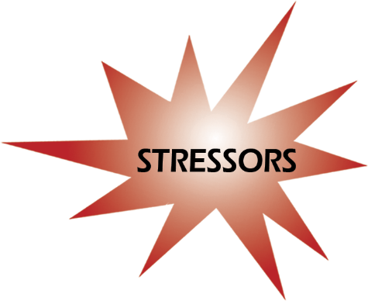

Primary Aid Strategies: Cover and Calm
Primary Aid
Notes:
Three STEPS to Provide Stress First Aid
Recognize a Stress Injury (Check & Coordinate)
Provide Primary Aid (Cover & Calm)
Provide Secondary Aid (Connect, Competence, & Confidence)

Slide 61
Stress First Aid Action: Cover
CHECK
Assess: Observe and listen
2. COORDINATE
Get help, refer as needed
3. COVER
Get safety ASAP
4.CALM
Relax, slow down, refocus
5.CONNECT
Get support from others
6.COMPETENCE
Restore effectiveness
7. CONFIDENCE
Restore self-esteem and hope
Notes:
To provide Cover means to ensure ongoing safety for oneself or others.

Slide 62
Cover Actions
Stand By
Ready to assist
Make / Others Safe
In charge presence
Encourage Perception of Safety
Caring presence
Watch and listen
Hold attention
Communicate safety concerns
Protect
Assist
Interventional Resources
Initiation Safety Resources
Listen and communicate
Reduce chaos
Reduce danger
Caring & nurturing presence
Notes:
Standing by a coworker and remaining available and ready to assist as needed, watching and listening for ways to intervene if needed, or holding the person’s attention if they are overwhelmed or panicky.
Making the person safe in any way possible, including by being an authoritative presence, by warning the person, by protecting the person physically or psychologically, or by assisting the person.
When necessary, Cover may also involve making others safe from the coworker if they are not functioning well because of stress reactions, by protecting them physically or warning them about possible dangers that might result via the stressed individual’s actions.
Encouraging a perception of safety occurs in the long term for both affected coworkers and their families via the provision of a caring presence, listening to feedback, and communicating about safety. It involves greater commitment to organizational safety and order via maintenance of equipment, attention to worker fatigue and burnout, and reduction of chaos and rumors.

Slide 63
COVER: Why/When Needed?
Violence
Security precaution not working
Someone in a life-threatening situation is not thinking clearly or not making good decisions because of stress
Someone has frozen or panicked in an intense situation
Someone has threatened others
Someone expresses serious thoughts of suicide
Notes:
Examples of a Need for Cover
Here are a few examples of a need for Cover:
Someone in a life-threatening situation is not thinking clearly or making good decisions because of stress
Someone has frozen or panicked in an intense situation
Someone feels guilty because their family has concerns about their safety following the death of a co-worker from an infectious disease
Someone has threatened others
Someone expresses serious thoughts of suicide
Facilitate a discussion with trainees by asking something like, “What actions have you noticed in yourself or others that indicated a need for Cover?” The goal is to have them start to reflect upon their own experiences with Cover and identify behaviors or situations that they think would indicate a need for Cover.

Slide 64
COVER: In the Green & Yellow
COVER: Building Resilience, Growing the Green
COVER: Proactively Manage Stress
Proactively identify safety alert mechanisms– install and use
Know the exit strategies
De-escalation training
Educate about stress reactions, what to expect, how to feel safer
Shifting ways of thinking so culture values self-care
Seeking or providing information
Communicate concerns, request help, communicate with those who need to know
Prioritize, Problem solve with group
Set boundaries
Call on those people, places, or actions that feel safe to you
Distraction
Educate about stress reactions, what to expect, how to feel safer
Brief staff about changes in practice/strategies/resources/events
Notes:
Know how to activate your safety interventions
Exit strategies (ex. panic buttons)
Shifting thoughts can foster healthy changes in behaviors. Here are a few examples of common thoughts that health care workers often have, along with potentially more helpful thoughts:

Slide 65
COVER: In the Orange or Red
COVER: Stress Moving into an Urgent Zone
COVER: In Danger Zone—Take Immediate Action
Activating safety alert
Urgent intervention
Shelter in place
Escalation to leadership and use of outside resources
Reduce anything that makes the person feel unsafe
Remind them that they are safe here and now
Provide an authoritative, accurate voice to limit perceived threat
Brief staff about changes in practice/strategies/resources/events
Navigate and escort to resources

Slide 66
Self Cover Actions
When you feel unsafe, distract yourself by focusing on something near you or your own breath or thought (e.g., counting).
Call on those people, places, or actions that feel safe to you
Get help with personal responsibilities
Actively seek information that can help you feel safer
Request help from peers or supervisors
Get an accurate understanding of risks in order to better plan
Get help with personal responsibilities
Self-monitor for stress reactions
Give yourself permission to take care of yourself and set boundaries for yourself
Notes:
Set boundaries for self
Turn off your phone at times
Take regular breaks
Say no if something is going to interfere with your priorities or health
Reconfirm your value, priorities and rights regularly
Tell yourself it’s not your responsibility to:
Make sure others are responsible
Rescue others from habitual drama
Protect others from getting angry
Always say yes when it doesn’t work for you
Think, feel. Or live for others
Stay in contact with those who are draining, abusive, or disrespectful
Make everything okay for everyone all the time

Slide 67
Self Cover Actions
Avoid negaholics
Realize that no one is perfect, and everyone is going to have strengths and vulnerabilities – be aware of your own.
Tell your family about work-related situations that might occur
Educate your family/colleagues about potential red flags that you might demonstrate if you are overly stressed, so they know when to support you so they don’t take them personally
Talk with family/colleagues about the best ways you can keep each other safe
Practice more helpful ways of thinking to foster healthy changes in behaviors

Slide 68
Potential Ways of Thinking to Enhance Cover
Original Thought | More Helpful Thought
“It would be selfish to take a break from this work.” | “Taking an occasional break from this work will help me be more effective.”
“I’m okay, I’m fine, I’m not even tired.” | “Even though I feel fine I need to pace myself.”
“The needs of those I’m supporting are more important than my own needs.” | “I can better care for others if I also attend to my own needs.”
“I’m not doing enough.” | “I’m doing enough.”
“I can contribute the most by working all the time.” | “I can contribute the most by pacing myself.”
“I don’t want anyone to know how affected I am.” | “Letting someone know know how affected I am can help me.”
“Only I can do x, y, and z.” | “I can trust that others can fill in when it’s necessary.”
Notes:
Slide 50: Potential Cover Thoughts: Self-Care
One of the ways a person can make themselves safer is through practicing more helpful ways of thinking. Shifting thoughts can foster healthy changes in behaviors. Here are a few examples of common thoughts that health care workers often have, along with potentially more helpful thoughts:
Original Thoughts
“It would be selfish to take a break from this work.”.”
“I’m okay, I’m fine, I’m not even tired.”
“The needs of those I’m supporting are more important than my own needs.”
“I’m not doing enough.”
“I can contribute the most by working all the time.”
“I don’t want anyone to know how affected I am.”
“Only I can do x, y, and z.”
More Helpful Thoughts
“Taking a break from this work will help me be more effective.”
“Even though I feel fine I need to pace myself.”
“I can better care for others if I also attend to my needs.”
“I’m doing enough.”
“I can contribute the most by pacing myself.”
“Letting someone know how affected I am can help me.”
“I can trust that others can fill in when it’s necessary.”
Ask trainees if they can think of any other helpful thoughts to use in their self-care.

Slide 69
Peer/Leader Cover Actions
Stand by ready to assist. Know your colleagues; support one another through challenging or threatening situations
Cover one another for personal issues
  Become more aware of and supportive during times when there are significant issues at home, in order to provide a safety net
  Check in and reduce high-risk behavior
Reduce anything that makes the person feel unsafe
Get an accurate understanding of specific risks in order to better plan and guide others
Reassure that they are safe in the moment
Educate the person about how to be or feel safer

Slide 70
Peer/Leader Cover Actions
Make others safe
Check in via text, offer time to chat
Gather as a group if patient is aggressive or violent
Focus the person on what to do rather than what not to do
Work to make situations safer by focusing on lessons learned, preparing and training personnel, and reducing threatening situations
Slowly implement SFA actions into the organization so it is normal to check in and discuss things well in advance of anything happening

Slide 71
Organizational/Leadership Cover Actions
Debrief, (huddle) give people chance to review after incidents (lessons learned approach)
  What could have been done differently
  What do you need?
  Ask each person individually
  Call and say sorry after incident
  Can’t always promise safety and that it won’t happen again
  Need to be careful because sometimes nothing could’ve been done better
Work to make situations safer
  Learn which situations feel unsafe to employees and work to improve their safety
  Have peers work in partnership
  Train personnel on situational awareness
  Give briefings before workers are involved in potentially unsafe situations
  Reduce anxiety by taking a team approach to difficult cases
Notes:
Leadership meetings to debrief and moving problems further up the line for action
Full transparency, lots of communication
Workplace for Safety
Workforce Improvement Committee
Put up plexiglass

Slide 72
Organizational/Leadership Cover Actions
Improve boundaries
  Mentor individuals who feel overwhelmed or overworked because of their trouble setting work boundaries
  Give time off for those needing a break
  Be more abrupt or directive if it is necessary to keep a staff member safe
  Be a good role model for setting boundaries for yourself or your peers
  Give permission and guidance about how to set boundaries and limits
  Allow people to go home if needed
  Find out what boundaries work best for staff
  Help workers make decisions at times when they may not make the best decisions for themselves
  Show vulnerability yourself
  Help people problem-solve solutions to situations in which they don’t feel safe

Slide 73

Cover Example:
“I recently had a realization that I have to set boundaries for myself to keep myself safe and healthy. At the end of the day work is important, certainly, but not so important that we can’t take care of ourselves.”

Slide 74

Cover Example: Self and Peer Support
When a nurse is over-whelmed after an exceptionally busy shift many leaders and experienced nurses will remind the nurse that "healthcare is a 24 hour business for a reason, if there are things that can't get done during one shift will be addressed by the oncoming shift"
Notes:
Slide 55: OPTIONAL SLIDE
Cover Example: Coworker Support
Here is a real example of how Cover can be incorporated into work in a seamless and natural way:
“I had an old supervisor tell me our work is like sweeping sand. No matter how much you sweep, it’s going to be there. That helped me realize I can put my work down and go home, because I can come back tomorrow and start sweeping some more.”
Ask trainees if they can think of any other examples where Cover actions have been helpful.
74

Slide 75
Cover Example: Self and Peer Support
I had an experienced supervisor tell me our work is like sweeping sand. No matter how much you sweep, its going to be there. That helped me realize I can put my work down and go home, because I can come back tomorrow and start sweeping some. I use that to talk with peers about needing to disconnect.
Notes:
Slide 55: OPTIONAL SLIDE
Cover Example: Coworker Support
Here is a real example of how Cover can be incorporated into work in a seamless and natural way:
“I had an old supervisor tell me our work is like sweeping sand. No matter how much you sweep, it’s going to be there. That helped me realize I can put my work down and go home, because I can come back tomorrow and start sweeping some more.”
Ask trainees if they can think of any other examples where Cover actions have been helpful.
75

Slide 76
Cover Example: Leader
At the beginning of the shift, we realized that we were short a nurse and had two patients that might switch to 1:1s because of complexity. We did up the assignment and got to work. The supervisor was present almost every hour—she was willing to stand by and take action if it was needed. This is providing cover and support. Knowing she was there and willing to help even though we didn’t need her intervention was really comforting.

Slide 77
Group Discussion: Cover
What are some ways that you have seen that cover might be needed in your work?
What are some ways that you find cover for yourself?
What are some ways that you have offered or been offered cover?
Notes:
Facilitate a discussion with trainees. The goal is to have them start to reflect upon their own experiences with Cover and identify some of the experiences that they have already had or have seen related to Cover:
What are some ways that you have seen that Cover might be needed in your work?
What are some ways that you find Cover for yourself?
What are some ways that you have offered or been offered Cover?

Slide 78
Cover Scenario
A respected member of your staff has had a hard couple of years. He had an injury, financial problems, and lost a close friend to a motor vehicle accident. Recently, he separated from his spouse and had to move out of the family home.
He has been drinking a lot and often appears to be under the influence of alcohol when not at work.
He is distracted and expresses a sense of hopelessness that things will improve.
Today, he arrives to work late.
When you begin to talk with him about your observations he says, “what difference does it make? Nothing really matters anyway. It doesn’t matter if I’m here or not.”
What kind of stress injury may be present?
What SFA action(s) would you use?
What is your plan for approaching the situation?
What other information would you want to know?
Outline the exact words/sentences you would use.
Notes:
Slide 57: OPTIONAL GROUP DISCUSSION
Cover Scenario
If time allows, introduce a small group discussion to discuss this scenario:
A respected member of your staff has had a hard couple of years. He had an injury, financial problems, and lost a close friend to a motor vehicle accident. Recently, he separated from his spouse and had to move out of the family home.
He has been drinking a lot and often appears to be under the influence of alcohol when not at work.
He is distracted and expresses a sense of hopelessness that things will improve.
Today, he arrives to work late.
When you begin to talk with him about your observations he says, “What difference does it make? Nothing really matters anyway. It doesn’t matter if I’m here or not.”
Ask each small group to discuss the scenario and answer the following questions:
What kind of stress injury may be present?
What SFA action(s) would you use?
What is your plan for approaching the situation?
What other information would you want to know?
Outline the exact words/sentences you would use.
Have the small groups report out to the larger group when they are done with their discussion. There are no absolutely “right” or “wrong” answers. Groups will come up with answers depending on how they interpret and discuss the scenario. Facilitate a discussion about how they arrived at their answers, focusing on both commonalities and on the range of creative possibilities that the groups generated.
While there are no “right” answers because each group will respond based on their interpretation of the scenario, for this first scenario of the training, potential answers are listed below to give an example of possible group responses:
What kind of stress injury may be present?
Loss, wear and tear, potential trauma.
What SFA action(s) would you use?
Check/OSCAR, especially for suicidal thoughts; Coordinate by referring to EAP, mentor, or counselor; Connect by offering to help with supporting him in any way necessary, or helping with any tasks that he needs help with; Calm by listening and having empathy; Confidence by reminding him of his value and helping him see that he matters.
What is your plan for approaching the situation?
Take him somewhere where you can talk confidentially without interruption; use OSCAR; be prepared to offer trusted resources with back-up plans for support if he is resistant to referral.
What other information would you want to know?
Potential suicidal thoughts and/or actions; how much he is drinking; what coping strategies have been helpful in the past; what he has tried to feel better; what would be helpful.
Outline the exact words/sentences you would use.
“I know you’ve had a hard year, and today you mentioned that nothing matters, and that it doesn’t make a difference if you’re here. I’ve also noticed that you have been drinking more and have come in late a few times. That’s not typical for you. Can you help me understand what’s been going on, because I worry when you make statements like that, and I care about you.”
“When people say things like that it is sometimes because they don’t want to live anymore. Have you had any thoughts like that?”
If he says yes: “Have you wanted to act upon them, made a plan to act upon, or acted upon them?”
If he indicates yes to any of these, “I am worried about you and I think you need to get some help. I don’t feel comfortable being the only one you tell this to, so I want you to go with me to our supervisor/EAP/a chaplain/a counselor. You’ve had a really tough time and we need to get you some help so you can get through this. And I’ll be here to support you too.”

Slide 79
Notes:
5 minute Break

Slide 80



Stress First Aid Action: Calm
CHECK
Assess: Observe and listen
2. COORDINATE
Get help, refer as needed
3. COVER
Get safety ASAP
4.CALM
Relax, slow down, refocus
5.CONNECT
Get support from others
6.COMPETENCE
Restore effectiveness
7. CONFIDENCE
Restore self-esteem and hope
Notes:
There is overlap between Cover and Calm. Procedures that promote one of these two actions often also help with the other.
The major difference is that while the goal of Cover is safety, Calm’s goal is to reduce the intensity of physiological, emotional and behavioral activation that is associated with stress reactions.
Calm is needed when intense stress has interfered with an individual’s ability to reduce their physiological arousal level. This can affect sleep, cognitive functioning, or healthy emotional expression (e.g. when someone is so overwhelmed with obligations or distractions that they “shut down”, rendering them incapable of doing their job, when an accumulation of stress causes a person to feel regularly agitated or anxious, or when the loss of a patient causes insomnia and nightmares.)

Slide 81
Calm Actions
Quiet
Stop physical exertion
Compose
Draw attention outwards
Recover
Recuperate
Soothe
Reduce hyper-alertness
Slow down heart rate
Relax
Distract
Re-focus
Grounding /Reappraisal/ Centering Techniques
Sleep
Time out
Breathing techniques
Setting intentions
Gratitude
Exercise
Virtual Schwartz Rounds
Listen empathically
Reduce emotional intensity
Aroma therapy
Guide mediation
Notes:
The first and most basic function of Calm is to stop, quiet, and cease physical exertion if possible. Some examples of this are to sit down or lie down and relax, with the goal of slowing heart rate.
Regaining composure will help to restore cognitive function. Calm involves helping yourself or others become more composed by drawing attention away from frightening and chaotic inner thoughts and feelings and refocusing in a calming way. (This can be helpful, even if only temporarily, before returning to a difficult situation that needs to be managed).
The next component of Calm is simply to rest—including sleep--for as long as is necessary to return to baseline levels of arousal and physical and emotional function. Sometimes a good night’s rest is the only thing that will restore a person to baseline mental and emotional functioning, so prioritize improving sleep.
The final component of Calm is soothing, which means to reduce the intensity of destructive emotions like fear and anger, by either seeking out or providing a calm, empathic, caring ear.

Slide 82
Examples of a Need for Calm
Someone returning from responding to a particularly violent domestic violence case is talking too fast and not reacting appropriately to commands or questions.
Someone is pacing and wringing their hands while on duty. They just heard that their son, an Army sergeant deployed overseas, has been seriously injured.
Alcohol is the only thing a person feels they can turn to calm themselves.
Someone is upset because one of his team took their own life.
Someone punches their locker after just returning from responding to a baby who is in a coma after being shaken by a parent.
An experienced worker begins to make careless mistakes and notices his adrenaline increase when several others gather to watch him perform an action.
Never in the history of calming down has anyone ever calmed down by being told to calm down
Notes:
59

Slide 83
CALM: In the Green & Yellow
CALM: Building Resilience, Growing the Green
CALM: Proactively Manage Stress
Implement policies and interventions to promote destressing behaviors
Promote coping and problem solving abilities
Focus on gratitude
Teach and role model about stress responses, coping, and relaxation strategies
Promote self care strategies
Take a break from stressful situations for a short time. Mandatory breaks/lunch
Taking actions to reduce stress reactions
Prioritize simple strategies to calm down: Breathing, mindfulness, Reflection, Prayer, Meditation. Make sure staff is aware of these self-calming strategies
Acknowledge possible stressors and the potential need for support in a matter of fact ahead of difficult events
Reduce gossip and negativity
Reframing
VSR type of rounds
Provide perspective by presenting the situation from an alternative vantage point
Notes:
Know how to activate your safety interventions
Exit strategies (ex. panic buttons)
Shifting thoughts can foster healthy changes in behaviors. Here are a few examples of common thoughts that health care workers often have, along with potentially more helpful thoughts:
“Focus on the value of nursing”

Slide 84
CALM: In the Orange or Red
CALM: Stress Moving into an Urgent Zone
CALM: In Danger Zone—Take Immediate Action
Reassure by authority and presence
Facilitate a break from the situation
Guide the person through relaxation technique i.e. box breathing, visualization, etc.
Do not leave person alone
Escalation to leadership and use of outside resources
Navigate and escort to resources
Show understanding
Ask for help to empower and distract the person
Get stressed person to look at you, then be very specific and detailed about what you want them to do
Use the person's name and communicate exactly what is needed din a calm, methodical voice
Find ways to make meaning and memorialize together after losses
Insist on a break
Connect with emotional support resources

Slide 85

Calm Self Actions
Focus on
Whatever helps you to keep focused on the present moment
Taking actions to reduce stress reactions
Acceptance
Gratitude
What you can control
Changing beliefs that don’t serve you
When or how pain temporarily eases
Prioritize simple strategies to calm down
Physical activity
Breathing more slowly, evenly
Meditation, mindfulness
Spend time with family and close friends (social support)
Listen to music, read, take a walk
Humor
Notes:
60 Calm Strategies: Self
Here are a few strategies for calming yourself, recommended by a focus group of public safety responders:
Engage in regular physical activity.
Spend time with family and close friends, and let them know what is calming for you ahead of time so they can better support you when needed.
Take a break from stressful situations for a short time.
Realize that there are cycles of adrenaline that may make you prone to depression at times, and build in rewarding activities to get energized during down cycles.
Try to see things from a higher vantage point and see a broader perspective, literally and figuratively.
Disciplining yourself to take care of yourself with small rewarding activities is called behavioral activation. It will not make you feel better the first time, but over time it will help give balance out and you a buffer for other stressful experiences. Like getting good nutrition, it makes you stronger, similar to how eating well and taking a good multivitamin can give you more energy over time. Eventually, it will start making you feel like there are some things in the world that can help you get replenished or energized.
Potential SFA Calm Actions: Self-Care
Here are a few potential strategies for helping oneself feel calmer. Most health care workers have some idea of calming strategies. The SFA Calm action is about prioritizing or focusing on strategies in a practical, realistic way, to help regain a sense of calm after becoming stressed.
Focus on:
Whatever helps you to keep focused on the present moment
Being realistic –– for instance, focusing on appraising situations, others, and yourself in terms of specific realistic descriptions such as “sometimes/lately” versus more polarized descriptions such as, “never/always”
Taking action to reduce stress reactions
Acceptance
What you’re grateful for
What you can control
Changing beliefs that don’t serve you
When/how pain temporarily eases
Prioritize simple strategies to calm down, such as:
Breathing
Exercise
Yoga
Social support
Reflection/meditation/yoga/prayer
Rewarding or pleasurable activities
NOTE: Engaging in rewarding or pleasurable activities regularly may not result in feeling better immediately, but over time it has been shown to be helpful in buffering stressful experiences. One analogy is that, like good nutrition, these activities can replenish or energize.
Ask trainees if they can think of any other actions for using Calm in self-care.
Ask for help
Get organized and problem-solve to tackle problems directly
Build in rewarding activities to get energized during down cycles
Try to see things from a higher vantage point
Gratitude
Visit rejuvenation cart or indoor tranquility space
ASK: Can you think of any other strategies for calming yourself?

Slide 86

STOP Technique
Stop: pause for a moment
Take a Breath: to calm
Observe: what am I feeling
What are my goals?
What are my choices?
Proceed with awareness
“Between stimulus and response there is a space” Viktor Frankl

Slide 87

Calm Peer/Leader Actions
Immediate Calm:
Ask for help to empower and distract the other person
Long Term Calm:
Emphasize the importance of personalized self-calming strategies
If the person can’t focus or make good decisions, calmly use their name and say exactly what is needed
Check in on each other regularly
Make every effort not to call attention to someone’s stress
Use light humor, positive reinforcement, validation of feelings
Talk to each other, vent, listen with empathy, have daily huddles
Set clear goals for each other, problem solve, provide alternative solutions
Encourage mindfulness, breaks
Acknowledge future stressors and possible need for support in a matter-of-fact way
STOP technique
Ask the person for help with something unrelated, to empower and distract them
Notes:
Potential SFA Calm Actions: Immediate
Here are a few potential Calm actions to use in the moment with someone who is highly stressed:
Reassure by authority and presence
Show understanding
Ask the person for help with something unrelated, to empower and distract them
If possible, get the stressed person to look at you for a minute, then be very specific and detailed about what you want them to do
Use the person’s name and communicate exactly what is needed in a calm, methodical way
Ask trainees if they can think of any other examples that they have seen where the Calm action has been used.
Potential SFA Calm Actions: Longer Term
Here are a few potential longer-term Calming actions to use with others:
Validate concerns.
Encourage taking regular brief breaks.
Praise and give positive feedback.
Allow the person to vent without judgment.
Invite the person to meet outside the workplace, to give them a more confidential opportunity to talk away from work.
Make meaning and memorialize losses.
Help to prioritize and tackle problems directly.
Ask trainees if they can think of any other examples that they have seen where the Calm action has been used.

Slide 88

Calm Organization Strategies
Lavender rooms
Resilience Carts
Flex Staffing
Additional support staff
After Actions Response
Stress Management programs
Notes:
The Lavender Lounge is painted in warm tones and includes a picture of a lavender field and a framed poem validating the grieving process. When caregivers enter, there is a Keurig machine with coffee, tea and mugs, as well as a small refrigerator with water. A sheer purple curtain divides the entry space from the larger, main room, which includes the following:
A chair and footrest next to a rejuvenation station with hairbrushes, hair ties, face wipes, rejuvenating face spritzers, and other items
A round table with chakra stones, a large journal to share thoughts with other caregivers and small journals to write in and take home
A charging station for phones
A full-body massage chair
A music station hooked up to Bluetooth® wireless technology, headphones and guided meditation CDs
A shelf with books on nursing, wellness and philosophy, as well as coloring books and origami
Yoga mats, blocks and CDs
A beanbag chair
An over-the-door basketball hoop
Smith’s goal was to add a variety of items in the room so caregivers can “be vulnerable and work through their feelings” in whatever way suits them best.
The Lavender Lounge is used daily, sometimes just for a quick quiet moment. The room is locked, and caregivers get the key from the health unit coordinator or a manager to access it. “If someone is in some sort of emotional distress, I wanted leadership to know so they could let the person in the Lavender Lounge, then check back on that person in a few hours to make sure they are OK,” says Smith.

Slide 89
Calm Actions for Aggressive Behavior
Distract:
  Suggest taking a break
  Let them know you will be there when they return
  Ask them for help with something
Defuse:
  Suggest looking at the situation in a different way or from another’s viewpoint
  Suggest talking to a friend or loved one
Distance:
  Separate those who are angry at each other, or keep them otherwise engaged
Deter:
  Ask for assistance if you feel uncomfortable or threatened
Notes:
Calm: Potential Actions for Angry Coworkers
This slide identifies some potential non-verbal and verbal actions for calming someone who is angry. Just as with the Cover function, it is recommended to start with the least intrusive and controlling techniques possible. This is first aid, so these are simple procedures.
Distract:
Suggest taking a break
Let them know you will be there when they return
Ask them for help with something
Defuse:
Suggest looking at the situation in a different way or from another’s viewpoint
Suggest talking to a friend or loved one
Distance:
Separate those who are angry at each other, or keep them otherwise engaged
Deter:
Ask for assistance if you feel uncomfortable or threatened
Ask trainees if they can think of any other examples that they have seen where the Calm action has been used.

Slide 90
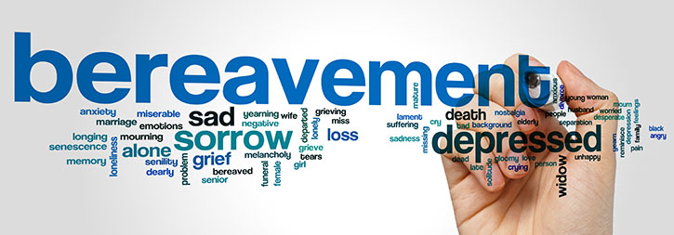
Calm Actions for Bereaved Peers
If you don’t know what to say, just stay present and listen; Let the person know you’re there for them
Don’t try to make a grieving person feel better, just be there to support them
If they want to talk about the loss, listen and provide support
Offer a menu of options for support
Be genuine and reliable
Be sensitive to unique factors that affect them
Check in over the next few months
Notes:
Slide 65: Calm: Potential Actions for Bereaved Coworkers
This slide lists some specific potential non-verbal and verbal actions for calming individuals who have suffered a loss, either on or off the job.
If you don’t know what to say, just stay present and listen
Let the person know you’re there for them
Don’t try to make a grieving person feel better, just be there to support them
If they want to talk about the loss, listen and provide support.
Offer a menu of options for support
Be genuine and reliable
Be sensitive to unique factors that affect them
Check in over the next few months
Leaders can play a particularly important role in supporting someone who is grieving. They can let the person know that they are concerned, that they believe in the person, and that they will support the person to take one step at a time.
Ask trainees the following questions to facilitate a discussion about these Calm actions:
Are these actions that you can see performing?
Can you conceive of any possible barriers to performing actions like this?
Can you think of any examples where the Calm action for loss has been used?

Slide 91
Making Friends With Uncertainty
Learn your own ‘uncertainty feeling’
Experiment with uncertainty (change a routine or experiment with something new).
Begin to find ways to distinguish ‘uncertain’ from ‘unsafe’.
Make changes to behaviors in ‘low stakes’ life areas to show that uncertainty can be safe (e.g. taking a new route to walk the dog).
Make changes to more resource-intensive uncertainty areas to increase ability to engage with ‘safe uncertainty’ (e.g. go on a day trip to somewhere totally new).
Experiment with behaviors linked to your area of concern
  Find routines that are feasible in the new context.
  Give help when you can and accept help when needed.
Mofrad, Tiplady, Payne, & Freeston

Slide 92
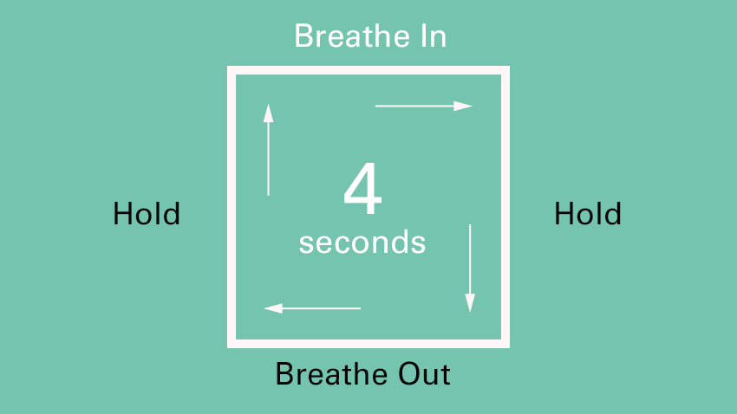
Examples of Techniques
Box Breathing

Slide 93
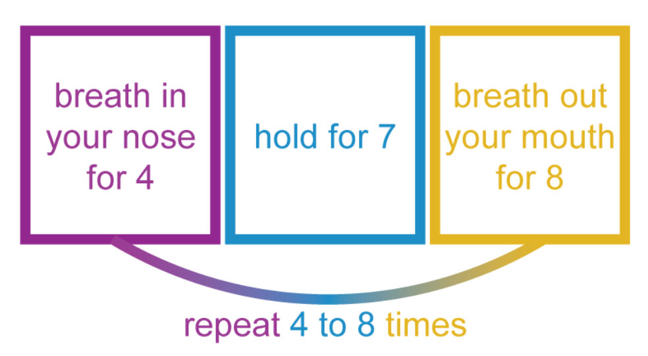
Examples of Techniques
4-7-8 Breathing
STEPS
Close your mouth and inhale quietly through your nose to a mental count of four.
Hold your breath for a count of seven.
Exhale completely through your mouth, making a whoosh sound to a count of eight.
Now inhale again and repeat the cycle three more times for a total of four breaths.
WHY?
Changing our breathing helps to reset (down regulate) the fight, flight, or freeze response
Improves ability to make critical decisions during periods of high stress
Can create "muscle memory" to reduce the physical demands of the stress response

Slide 94
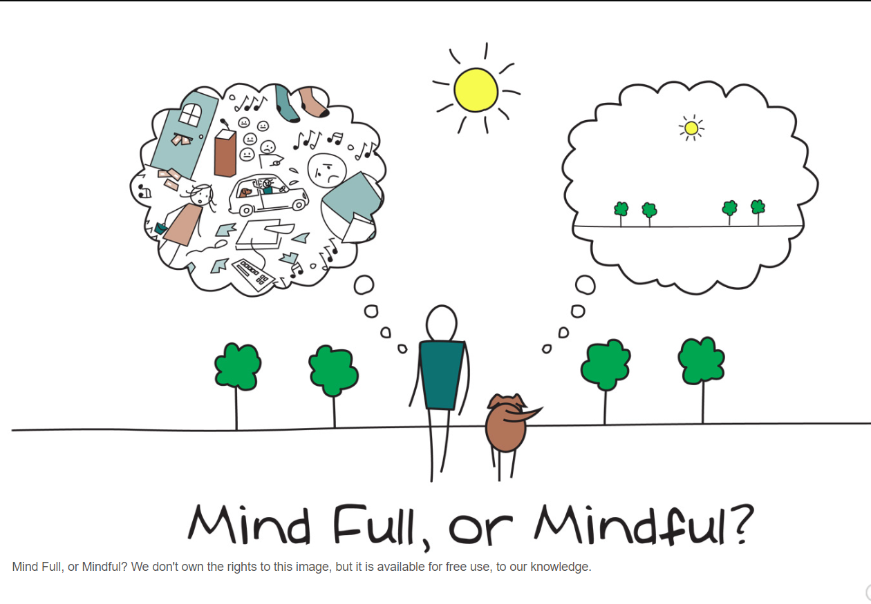
Examples of Techniques
Visualization Exercise (Body Scan / Autogenic Training)
Progressive Muscle Relaxation
Mindfulness Meditation
Guided Imagery
Yoga
Repetitive Prayer

Slide 95

Calm Examples: Self
“What helps calm me is breaking down responsibilities into manageable pieces, making lists and being organized.”’
“To reduce stress in myself at work, I try to refocus and take a deep breath. I remind myself that I am only one person and I am doing the best job that I can possibly do. I also try to step off the unit when there is adequate coverage just take get fresh air and regroup.”
Notes:
Slide 67: OPTIONAL SLIDE
Calm Examples: Self-Care
Here are some examples of how Calm actions can be incorporated into self-care:
“What helps calm me is breaking down responsibilities into manageable pieces, making lists and being organized.”’
“To reduce stress in myself at work, I try to refocus and take a deep breath. I remind myself that I am only one person and I am doing the best job that I can possibly do. I also try to step off the unit when there is adequate coverage just take get fresh air and regroup.”
Ask trainees if they can think of any other examples that they have seen where the Calm action has been used.

Slide 96

Calm Example: Peer /Leader Support
“If something is going wrong on a unit, someone will say “orange huddle.” That means, “everyone take a breath, we’re coming together. It’s not blaming or shaming, there’s an issue, we feel it, someone saw it, something is happening, it’s tense. Let’s all take a breath, this is the shift from hell, we’ll make it through.”
Notes:
Slide 69: OPTIONAL SLIDE
Calm Example: Coworker Support
Here is a real example of how Calm can be incorporated into work in a seamless and natural way:
“If something is going wrong on a unit, someone will say “orange huddle.” That means, “everyone take a breath, we’re coming together. It’s not blaming or shaming, there’s an issue, we feel it, someone saw it, something is happening, it’s tense. Let’s all take a breath, this is the shift from hell, we’ll make it through.””
Ask trainees if they can think of any other examples that they have seen where the Calm action has been used.

Slide 97
Group Discussion: Calm
What are some examples of how calm might be needed in your work?
What are some ways that you find calm for yourself?
What are some ways that you have offered or been offered calming actions?
Notes:
Facilitate a discussion with trainees. The goal is to have them start to reflect upon their own experiences with Cover and identify some of the experiences that they have already had or have seen related to Cover:
What are some ways that you have seen that Cover might be needed in your work?
What are some ways that you find Cover for yourself?
What are some ways that you have offered or been offered Cover?

Slide 98
CALM SCENARIO
A nurse who you know has been having marital issues has trouble with entering data into an electronic record and throws a stack of papers on the floor and runs to the bathroom.
What kind of stress injury may be present?
What SFA action(s) would you use?
What is your plan for approaching the situation?
What other information would you want to know?
Outline the exact words/sentences you would use.
Notes:
Slide 73: OPTIONAL GROUP DISCUSSION
Calm Scenario
If time allows, introduce a small group discussion to discuss this scenario:
A nurse who you know has been having marital issues has trouble with entering data into an electronic record. She throws a stack of papers on the floor and runs to the bathroom.
Ask each small group to discuss the scenario and answer the following questions:
What kind of stress injury may be present?
What SFA action(s) would you use?
What is your plan for approaching the situation?
What other information would you want to know?
Outline the exact words/sentences you would use.
Have the small groups report out to the larger group when they are done with their discussion. There are no absolutely “right” or “wrong” answers. Groups will come up with answers depending on how they interpret and discuss the scenario. Facilitate a discussion about how they arrived at their answers, focusing on both commonalities and the range of creative possibilities that the groups generated.

Slide 99

DAY 1 Summary
Understanding Stress
SFA Model / 1-4 C’s
Self, Peer & Organization Strategies

Slide 100
Next Steps
Implementation Guide Overview & Expectations
Awareness Brief Assignment
  Schedule a time to Present Awareness Brief
  Select Small Group (3-8 participants-unit, peers, council or committee)
  Handout to share with participants
  After Awareness Session Complete Feedback Form via link by November 14, 2022
Day III Session
Discuss/share: Awareness Brief Presentation Experience & Implementation/ Next Steps

Slide 101

Final Questions / Comments

