Slide 1


Stress First Aid Train the Trainer
Session II –Presenters
Your Picture Here
Presenter Name
& Credentials
*These materials have been provided by NJ-NEW, with the intention to educate Stress First Aid practices.

Slide 2

Welcome / Brief Overview

Slide 3
Feedback Form
Presentation Format
8 Virtually
9 In-person
Participants Roles
N2NCaregivers Support Group/ Crisis Counselors
Administrators/Managers/Directors/Coordinators
Clinical Nurses/ Educators/Support Staff
Successes
Liked the Visuals/ Powerpoint & Script was helpful
Challenges
Hesitation to openly discussion stress level
Stop working & acknowledging this was a critical need
Productive Conversation
Gained interest implementing & research project
Tech issues
A lot of information short period of time
Understanding of manager/supervisor roles

Slide 4
Breakout Groups Session I
Group I / Facilitator – Shannon
Lynda Bern
Geraldine Cebedo
Angela Daly
Sapna Dhaliwala
Ruth Dileo
Stephanie Dove-Tieku
Megan Flynn
Lois Greene
Beth Henderson
Stacy Horowitz
Ashley Mickel
Alison Norberg
Karen Nunn
Marcella O’Herlihy
Rose Polasky
Cathlyn Robinson
Krystle Sica
Leila Tiles-Lasanta
Jonathan Yaung
Group II / Facilitator – Susan
Sandra Baker
Nawatti Bhagwandat
Margaret Daingerfield
Donna Gaffney
Ellen Giarellli
Tassoni Ginn
Kathleen Horan
Cynthia Samuels
Marcia Lewis
Jeannette Manchester
Lucia Otti
Elizabeth Rata
Stephanie Simone
Lauren Stroh
Andrea Webb
Mary Velardi-Stoffel

Slide 5
Breakout Group Questions
How comfortable were you presenting the material?
What other resources do you need to increase comfort?
What was the general feedback from the participants and their interest in learning more?

Slide 6

Facilitator Summaries

Slide 7


Slide 8
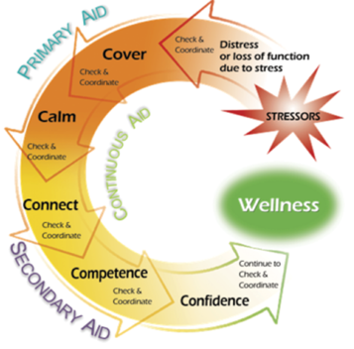
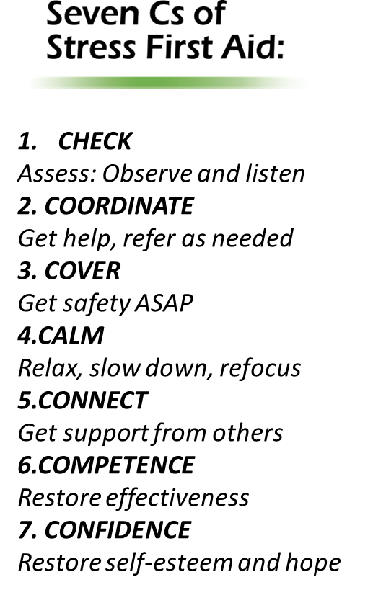
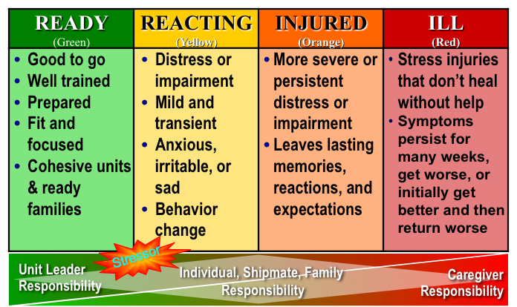
Implementation Strategies

Slide 9
Learning Objectives
Articulate the importance of SFA to obtain organizational/unit buy-in
Create a plan for implementing SFA with the workplace
Propose process and outcome metrics to evaluate SFA

Slide 10
SFA Implementation: Expected Goals and Outcomes
GOALS
Improved peer and leader abilities to recognize stress reactions and injuries using the stress continuum model
Enhanced peer and leader ability to tailor continuous, primary, and secondary aid approaches to individual and unit needs
Enhanced individual and team ability to have conversations about work stressors
Compassionate and restorative support demonstrated by leaders and peers to stress challenges
OUTCOMES
Increased resilience (individual and unit)
Increased well-being
Enhanced work environments
Enhanced team culture that improves engagement, retention and meaningful work

Slide 11
SFA Focus
Enhance individual resilience and interpersonal communication
Identify and reduce unnecessary stressors
Recognize caregiver stress and know how to respond
Improve individual and team well-being

Slide 12
SFA Activities
SFA Approaches
Assessment
Self Check
Resources
Stress Checks
Enhance Resilience
Positive Practices Workshops
Intervention
Comm. Skills
SFA
7 Cs
Team Development
Department/ Unit/team Level Interventions
1:1 Coaching

Slide 13
Assessment
Assessment
Self Check
Resources
Stress Checks

Slide 14
Take Action on Assessment
Enhance Resilience
Intervention
Positive Practices Workshops
Comm. Skills
SFA 7 Cs
Team Development
Department/ Unit/team Level Interventions
1:1 Coaching

Slide 15
Making the Case for SFA
Step 1: Know the resiliency resources in your organization and their
effectiveness
Step 2: Explore how SFA can be used as another resource and how it can
be integrated with other programs
Step 3: Articulate the need for SFA in your organization to key
stakeholders
Step 4: Read SFA resources, Become comfortable with the material

Slide 16
SFA Team Leaders
Two leaders to coordinate the roll out of SFA in the organization (training and implementation)
  Professional Background
  Awareness of organizational/unit stressors
  Passionate about SFA as an approach
  Team Leader Attributes
  Team Leader Roll Out Plan
  Protected Time

Slide 17
SFA Leadership/Advisory Team
Recognizes Emotional Well-Being as a Pillar
Guides the rollout and support of the program within the organization
Participants
  Influential
  Across Disciplines
Roles
  Build enthusiasm
  Plan rollout strategy (have a written plan)
  Elevator speech and communication plan
  Collaborate with other well-being programs/resources
  Decide on evaluation metrics
  Oversee implementation and evaluation plan
  Creating a central online repository of SFA materials
Requirements
  Participate in 90-minute training provided by Team Leaders
  Monthly meetings and then quarterly

Slide 18
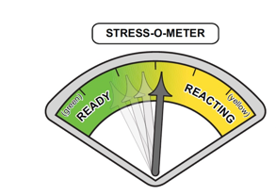
Organizational Roll Out: Baseline Metrics
Existing Data Sources
  Turnover Rate
    Stress Turnover/Growth Turnover
    3 times the annual salary (+ fringe) to replace one nurse
  Absenteeism/Call outs
    Consider costs related to travelers, shift incentives, burnout burden
  Engagement Surveys
    Sufficient unit staffing
    Few sleep disturbances related to work
    Staff satisfaction
    Intent to stay with the organization
    Interdisciplinary collaboration

Slide 19
Organizational Roll Out: Baseline Metrics
Focused Assessment
  Burnout Scales: ProQOL, Maslach
  AMA Covid-19 Coping Survey
  Cohen’s Perceived Stress Scale
  Connor-Davidson Resilience Scale
  Emotional Well-Being
  PTSD Checklist-Civilian (PCL-C)
  PHQ-9
  Focus Group: The 3 Questions and 2 Values Check questions for example

Slide 20
Prepare Marketing & Educational Materials
Develop unit-based tools and reminders about Stress Continuum, 7 Cs
  One Page Handout
  Three Page Handout
Develop educational calendar
  You Tube Awareness Sessions
  In person Awareness Sessions
Marketing messages with display screens
Stress continuum dashboards
Organizational repository of education programs and other resources
  NJ NEW
  Schwartz Center (https://www.theschwartzcenter.org/stress-first-aid-private/)
  National Center for PTSD (https://www.ptsd.va.gov/professional/treat/type/stress_first_aid.asp)

Slide 21
Organizational Roll Out
Conduct Awareness Briefs
  100% of Organization (1 Year)
  Mini-Briefings
    Need for peer support and use of stress continuum
  Awareness Briefings
    In-person and/or computer based
Select units with High Interest for Initial Rollout
  Awareness Brief to Councils or Units
  Interest and commitment: Train with 90 Minute program
  Avoid caustic units
  Select Units Interested in Roll Out to Start—and Have Staff Interested in Being SFA Champions

Slide 22
Unit/Department Roll Out Using Champions
Unit Based SFA Champions
At least 2 peers support champions per unit
    Some referent authority of being looked up to by team
    Has an appreciation of system thinking and how to effect change
Leader buy in
4 hour Training for peer champions & leaders
Champion Support
Biweekly call/check in, discuss successes, challenges, concerns, and questions that the team leads may have about implementation of the model
    Listen empathically and help the team problem solve. You do not have to---and likely cannot---solve their problems, but you can help them brainstorm solutions and consider alternatives
Additional training sessions for Champions re: growing the green, problem-solving recurring stressors

Slide 23
Unit/Department Roll Out of SFA Education
SFA Champions Implement Training
  Awareness Briefs
  Monthly peer support training (SFA, Unit Stress and Resiliency)
  Service line level activities with other unit champions
  Dedicated time

Slide 24
Unit/Department SFA Operationalization
Use of Stress Continuum
Daily Checks
Huddles
Unit poster/board/team meetings
Stress Continuum Dialog
  Focusing on the Yellow and Orange Zones:
    What does a yellow zone shift look like here?
      Behaviors, senses, feelings
      How do you know when it is increasing
      Is this a normal and desired space for the team
    What does an orange zone shift look like here?
      Behaviors, senses, feelings
      How do you know when it is increasing
      What are your concerns when you see orange zone behaviors/activity
    What helps to get back to the yellow zone

Slide 25
Unit Level Check Approaches Beyond Colors
The 3 question assessment
  Over the past (time frame)
    What has been your greatest challenges, hassles, or frustrations?
    What has been your greatest reward, success, or positive experience?
    What does it meant to be a (name role) in this unit?
  Follow-up assessment determines next set of actions. Offer support, provide coping information, refer for next level of service

Slide 26
Unit Level Check Approaches Beyond Colors
The 2 question Check in: Provides quick insight into top frustrations and top values
  Is an interactive qualitative quick assessment
  First ask about the unit then the individual
  2 core questions
    What 3 things need to change immediately to make this a better work place?
      Would you add anything to specifically meet your needs
    What 3 things should never change on this unit
      Would you add anything to specifically meet your needs

Slide 27
Unit/Department SFA Operationalization
Use of 7 Cs
Focused Training
Case Studies
Debriefings
Role model using the Language
Development to Grow the Green and Manage the Yellow
Positive Practices
Problem Solving based on Unit Level Check

Slide 28
Remove Obstacles, Build on the Change
Address Barriers to Implementation
Unit Based
System-Wide
Action Planning to Navigate Barriers
Ongoing Support to Team Leaders and Coaches
Bi-Weekly check ins of Champions and Team Leaders
Quarterly reporting to Leadership Team
Organizational Support
Contingency Plans
Additional Roll Out
Public recognition of champions, leaders, progress
NJ NEW Support

Slide 29
Tracking Roll Out
Process Evaluation
Comparison to Strategic Roll Out Plan
  Numbers Trained (Departments, % from Department, % from Shift)
  Tracking/Stories of How Used*
    Continuum
    7 Cs
    Growing the Green/Managing the Yellow
Evaluations after Training
Impact Evaluation

Slide 30
Thoughts
Comments
Discussion
Questions

Slide 32
Breakout Session II
Use SFA Workbook to begin an implementation plan

Slide 33
Facilitator Summaries

Slide 34

Wrap- Up/ Questions
Questions
Additional Information Needed?
Webinars:
Topics / Themes
What other Support or Development Needed?
THANK YOU
Final Thoughts

