Slide 1
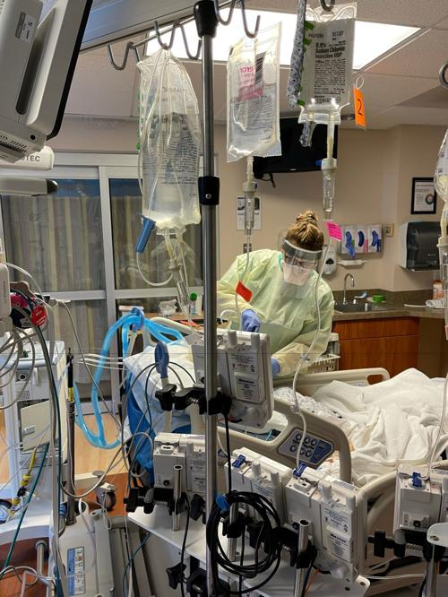
Stress First Aid Awareness Brief
INSERT DATE:
INSERT TIME:
INSERT ZOOM LINK:
Notes:
Start with a welcome and if needed, introductions:
Good morning (afternoon) . My name and I know most of you, but please introduce yourselves to each other.
Do you need to have group members introduce themselves or do they know everyone already
Today I’d like to tell you about a program called Stress First Aid or SFA, which can be a valuable resource to you —personally and professionally—wherever you work: acute care, in the community or in schools.
SFA has been implemented in 85 organizations (Acute, Community, Academia & LTC) and over 170 people have been trained, so far!

Slide 2
Objectives
Identify sources of stress and stress injury for
healthcare workers
Describe the purpose of Stress First Aid
Describe the Stress Continuum
Describe the core actions of SFA
Notes:
Over the next 20 or so minutes I’ll present an overview of the basics of SFA and if you’d like to learn more (and I hope you do!) I can provide other workshops to give more in depth information about the program, and help you operationalize it on your units.
The objectives of today’s session are to:
Identify sources of stress and stress injury for healthcare workers
Describe the purpose of Stress First Aid
Describe and use the Stress Continuum
Describe and use the core actions of SFA

Slide 3
Why SFA?
The Work of Nursing is Stressful
Healthcare Systems are Stressful
Occupational stress creates challenges and risks for individuals and teams
Occupational Stress Injury is a manageable risk—counteract with resilience, effective coping and healthy work environments
Notes:
The work of nursing has always been stressful and the systems we work in add to that stress.
OCCUPATIONAL STRESS creates challenges and risks for individuals and teams…workplace stress can accumulate and if not appropriately managed can lead to an occupational “stress injury”
Occupational stress injuries are not inevitable. In fact, we can counteract them by:
1) building resilience — for individuals and their workplace units.
2) Strengthening effective coping mechanisms and
3) building healthy work environments.
SFA or stress first aid is an approach to achieving these goals.

Slide 4
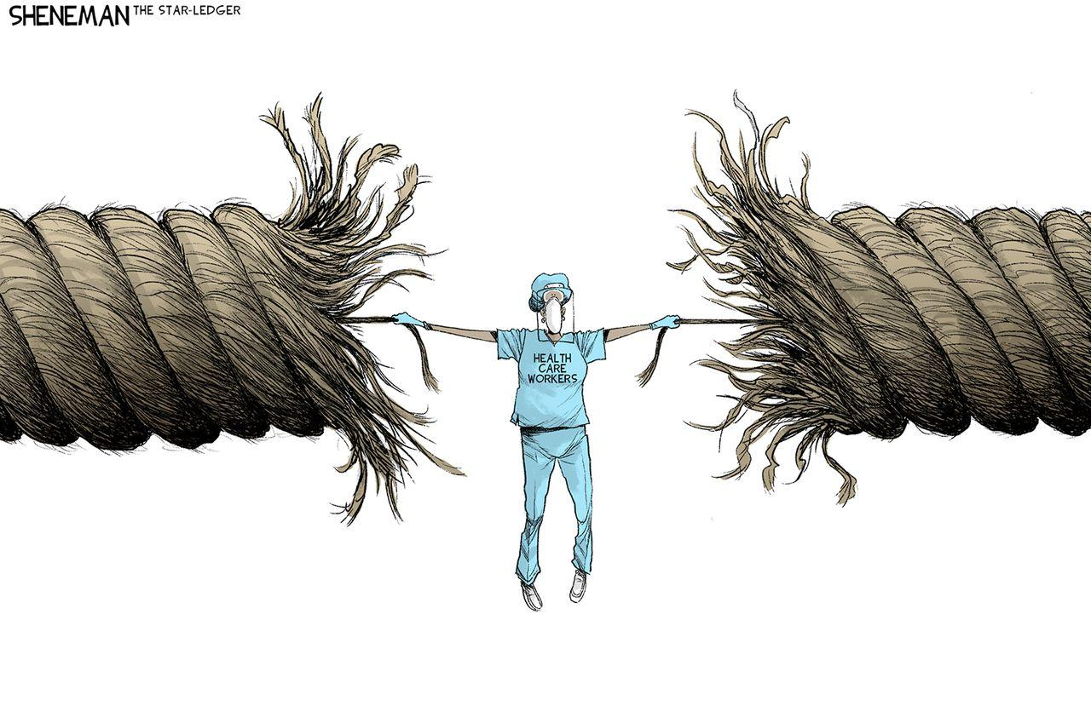
And Needed More Than Ever Before
Notes:
We need SFA now more than ever before.
COVID challenged us as individuals and systems like nothing we have witnessed in our lifetime.
Although the COVID surge has passed, we’re now confronting:
growing nursing shortages,
continued high levels of stress and
increases in workplace violence.
The reality is that many are hanging on by a thread, at their limit, increasing their vulnerability to stress injury.
So many nurses continue to experience high stress, frustration, and exhaustion.
Many feel overwhelmed and undervalued. We need approaches to proactively manage this stress,

Slide 5
What is SFA?
Peer-Support & Self-Care Model
Stress First Aid is an evidence-based set of knowledge and skill tools to manage stress at an individual, unit and organizational level
Proactive actions to promote individual and unit well-being and resilience
Early recognition and management of stress injury
Notes:
Stress First Aid (SFA) is an approach that counteracts
the demands of stress.
It is an evidence-based model of peer support and self-care.
It can be adopted at an individual, unit, or organizational levels
The goal is to build resilience.
The SFA program:
-is an ongoing process
-identifies and addresses early signs of stress reactions in you and your colleagues
-Is a set of supportive actions designed to help you and your colleagues mitigate the negative impacts of stress.
Organizations can take a proactive role in building and sustaining resilience in their workforce by committing to building an infrastructure where SFA becomes an integral pillar of each unit’s culture.
Stress and it’s consequences will be 1) destigmatized through open discussion by nurses and nurse leaders and then 2) followed by responses to enhance resilience.

Slide 6
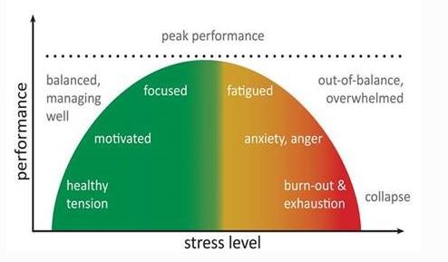
Stress and Stress Injury
Excessive stress can overwhelm compensatory systems and precipitate debilitating psychopathology
A STRESS INJURY is any severe and persistent distress or loss of ability to function caused by damage to the brain, mind, or spirit after exposure to overwhelming stressors
The stressed brain is like an exercised muscle. Manageable stresses can toughen us, but an overload can cause permanent injury.
STRESS INJURIES are invisible. You may only notice them in behaviors and words.
Stress exists on a continuum.
Stress can be positive
Stress is part of our everyday work environment
Sometimes we function better under stress
But we must prevent stress injury
Notes:
The SFA program is built on scientific evidence that:
Acknowledges that stress is part of our everyday work environment
Shows how stress occurs on a continuum (from green to red)
It can positively impact our performance as it may act to energize and focus our attention.
But ongoing or prolonged stress or intense stress can overwhelm our ability to cope leading to STRESS INJURY
The hallmark of a stress injury is LOSS of Ability to Function–which is brought about by severe and persistent distress that causes damage to the brain, mind or spirit and overwhelms the individual.
To build on “the brain is a group of muscles” metaphor, we can actually view stress as a form of brain exercise. Facing challenges makes us tougher, just as climbing a mountain makes us stronger. However, just as it’s not healthy to over exercise, since we’d injure ourselves, it’s not healthy to be stressed-out all the time. We need time for rest and recovery. We need real breaks. (Ben-Shahar, Tal. Psychology 1504: Positive Psychology. Harvard Open Course, 2009.)
It is important to remember that stress injuries are often invisible. You may notice changes in behaviors and communication patterns. if you are not looking for them you may miss them.

Slide 7
Stress Injuries and Peer Support
Most people exposed to high stress and chronic stress events will cope, but some will become ill
Those injured by stress may be the last to recognize it
Those who recognize stress may not seek formal help—stigma and “otherness” is a big barrier
Evidence suggests that early treatment/management of reactions is effective
Peers are more likely to seek help from, and listen to someone with a shared experience
Peers can also be a bridge to more formal treatment
Jones et al., 2012; Brailey et al., 2007; Pietrzak et al. Dickstein et al., 2010; McTeague et al., 2009
Notes:
SFA is grounded in some basic principles about stress injuries and peer support.
1) We know that most people exposed to high stress or chronic stress events, will cope—but some will become ill.
2) ironically those injured by stress may be the last to recognize it—YET, if units have a philosophy to be aware of stress injury, we will be better able to recognize it in ourselves and our peers.
3) The reality is that for those who do recognize a stress injury in themselves, they may choose not to seek help:
Why? There is stigma surrounding the belief that you (HCP) are unable to cope,
People may be embarrassed or ashamed, afraid to speak up and decide they can carry this burden alone….
SFA provides an approach where asking for help is encouraged, accepted and normalized
IMPORTANT: The evidence shows that early treatment and management of stress reactions can prevent stress injury and more serious clinically diagnosed mental illnesses.
SFA promotes peer support at times of stress. In fact, research shows that individuals are more likely to listen and seek help from peers, when they acknowledge that their peers have a shared or similar experience with them—this shared experience makes it easier to work together, to actively listen, and to ask for help.
Finally, the SFA model is founded on the Idea that peers can be the bridge to:
connect with the person or
encourage the person to seek other forms of support including formal treatment.

Slide 8
Double Edged Sword of Values and Ideals
Strength | Guiding Ideal | Vulnerability
Placing the welfare of others above one’s own welfare | Selflessness | Not seeking help for health problems because personal health is not a priority
Commitment to helping patients heal and supporting their families | Loyalty | Guilt and complicated bereavement after perceived failure or loss
Toughness and ability to endure hardships without complaint | Stoicism | Not aware of / acknowledging significant symptoms /suffering
Following an internal moral compass to choose “right” over “wrong” | Moral Code | Feeling frustrated and betrayed when others fail to follow a moral code
Becoming the best and most effective professional possible | Excellence | Feeling ashamed / denial or minimization of imperfections
Notes:
As we look at what makes us vulnerable to stress and consequently stress injury, it is important to reflect on the guiding ideals of our profession. These can be great strengths to the care we provide, but they can also expose nurses to stress injury and make them vulnerable.
Taking a look at these common guiding ideals we see:
Selflessness Strength: places the welfare of others above one’s own welfare
Selflessness Vulnerability: may not be taking care of oneself when it is necessary (making medical appointments etc)
Loyalty strength: Making a commitment to helping others (patients) heal and supporting their families
Loyalty vulnerability: greater guilt when someone feels that they couldn’t do enough for others who need help.
Stoicism Strength: Copes with challenges without complaint,
Stoicism Vulnerability: not attending to one’s own needs or seeing red flags, putting us at odds with personal problem identification and help seeking.
Moral code strength: can guide us in patient care situations assisting us to choose “right” over “wrong”
Moral code vulnerability: frustration when others don’t have the same values or when placed in situations where we must practice outside of what we perceive to be “right”. A person’s social support network is limited to those whose values align with theirs
Excellence Strength influences one to become the best and most effective professional possible
Excellence Vulnerability: predisposes a person to feeling ashamed when they don’t live up to their own high ideals and can reduce the likelihood of reaching out for mentoring.
It is important to understand how elements of guiding ideals can be both sources of strength for personnel as well as acknowledging that these elements can create additional challenges or vulnerabilities in seeking help.

Slide 9
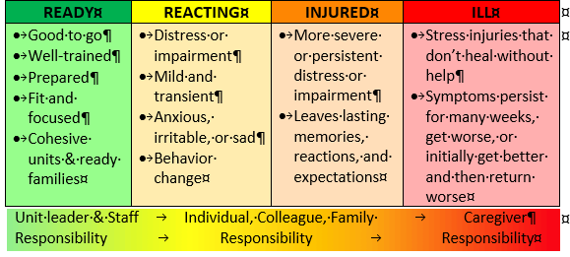
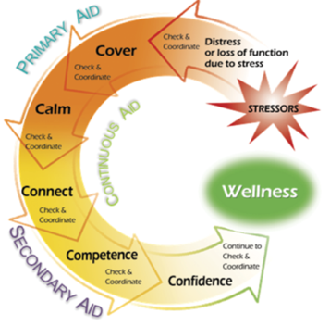
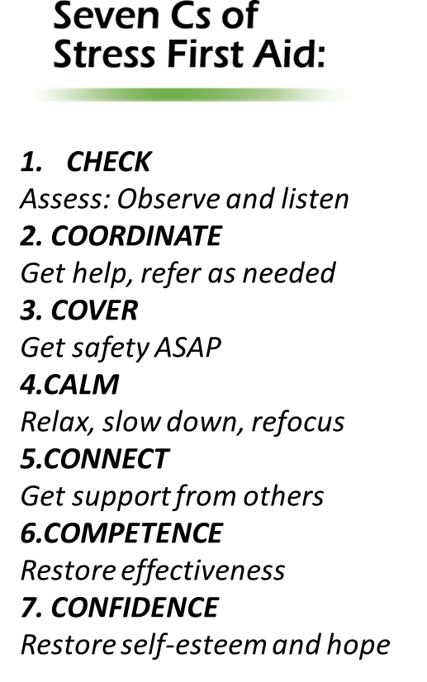
Major Concepts
Stress Injury
Stress Continuum
Stress First-Aid
Notes:
There are 3 major conceptual areas that support the SFA model:
1. The four sources of stress that are most likely to cause a stress injury
2. The stress continuum
3. The actions that peers and leaders can use to address stress injuries
Let’s take a look at each of these areas.

Slide 10
Four Sources of Stress Injury
Intense or Prolonged Stress
Life Threat
Loss
Inner Conflict
Wear & Tear
A traumatic injury
Due to an experience of death-provoking terror, horror, or helplessness
A grief injury
Due to the loss of cherished people, things or parts of oneself
A moral injury
Due to behaviors or the witnessing of behaviors that violate moral values
A fatigue injury
Due to the accumulation of stress from all sources over time without sufficient rest and recovery
Notes:
While there are many different types of stressors that can contribute to negative outcomes, there are four categories of exposures that have the potential to cause stress injury. These are also called Potential Traumatic Events (PTE).
Life Threat: or a traumatic event that precipitates fear, terror, horror or helplessness. This type of injury can include experiencing a near-miss or close call.
Examples of Potentially Traumatic Events include: (Note: you don’t have to read them all but give some examples, that may have occurred in your workplace)
Exposure to very difficult cases
Exposure to extreme violence, murder, or suicide
Exposure to life-threatening infectious agents
Sexual assault or offenses
Working with families who have seriously ill or injured children
Dealing with hostility/resistance/violence from patients
Exposure to similar potentially traumatic events in one’s personal life
Loss: is also known as grief injury. The loss can change emotional, social, cognitive, and physical aspects of life and the loss of your worldview
Examples of loss include: (Note: you don’t have to read them all but give some examples, that may have occurred in your workplace)
Examples of Loss:
Death or significant illness in patients, coworkers, family, or friends
Working with families who have lost their child
Loss of ideals
Loss of time
Loss of personal wellbeing
Loss of innocence
Inner Conflict—also known as “moral injury” and stems from conflict between one's moral/ethical beliefs/values and the witnessing or participation in events that are not consistent with what we believe is “right”.
These stress injuries can include: acting outside of internal, our own self-imposed morals/values, an inability to prevent harm to others, or somehow contributing to or not preventing harm to a patient or fellow colleague. Indications that someone is experiencing an inner conflict are the individual using words such as: “could’ve, should’ve, ought of, only if”
Examples of Inner Conflict include: (Note: you don’t have to read them all but give some examples, that may have occurred in your workplace)
Conflicts with personal values and the job
Finding time to satisfy work and personal responsibilities
Second guessing what could have been done differently to prevent a negative outcome
Concerns about the impact of one’s job on family or friends
Wear and Tear—is perhaps the most common stress injury and is known as fatigue injury. It occurs because multiple stressors accumulate over a long period of time, without sufficient time for rest and recovery.
Examples of Wear and Tear include: (Note: you don’t have to read them all but give some examples, that may have occurred in your workplace)
Long hours and rotating shifts
Working when ill or injured
Dealing with different personalities
Addressing substance abuse
Working through personal illness
Lack of supervisor support
Personnel turnover
More record keeping and accountability in records
More attention to things done wrong than things done right
Balancing home life with job duties
Trying to manage a growing caseload
Extra duty assignments
Pressures from supervisors
Multiple updates in patient care, insurance policies, and programs
Multiple stressors in one’s personal life over extended periods

Slide 11
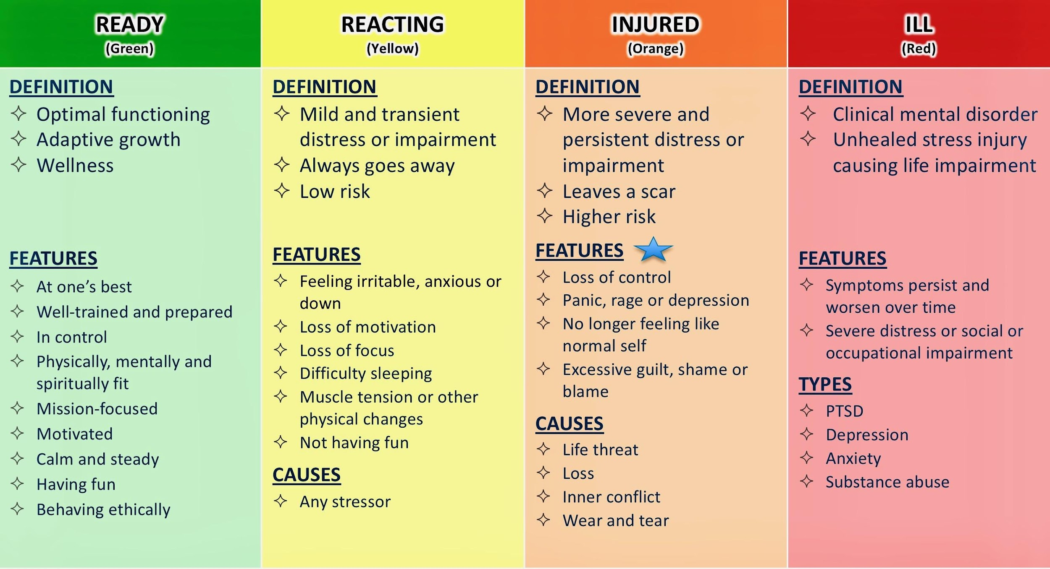
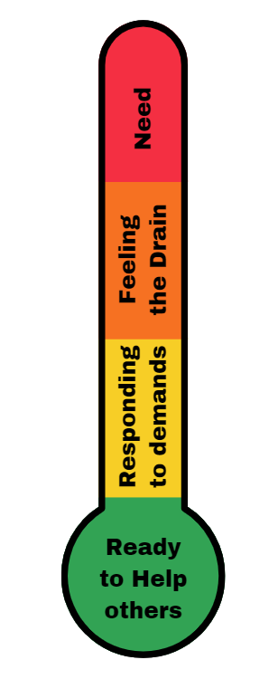
Stress Continuum/ Thermometer
Stress Continuum/ Thermometer
Notes:
The Stress Continuum is at the core of SFA. Stress occurs on a continuum from transient and mild to chronic and debilitating. The visual model is easy to use and understand. It depicts zones of stress and stress response. A person experiencing stress might move from the Green zone (of optimal functioning) to the Yellow Zone (of reacting to stress) to the Orange zone (of experiencing a stress injury) and to the red zone (of a unhealed stress injury) resulting in a clinical mental disorder.
It is important to note that 100% of those facing significant stress will react, it is a natural human response. However, the way people respond will depend on many factors, 1) how prepared they are for the stressor, 2) how they interpret it, 3) previous experience, and 4) the resources within the unit or organization to manage the stress.
The purpose of SFA is to provide a framework for enhancing and making accessible these resources at an individual, unit and organizational level.
So lets look at how the zones and their related behaviors differ.
Moving from Green to Yellow: A person can move from being in optimal functioning---feeling good, mentally and physically fit, mission focused, calm, and motivated---into the Yellow Zone. In the Yellow Zone a person can feel irritable, anxious or down, lack motivation, lose focus, have trouble sleeping, or have muscle tension or other physical changes, but these are transient reactions.
Movement into the Orange Zone is usually caused by an accumulation of different types of stressors or a severe stressor.
There is more significant and persistent distress or impairment, the person doesn't feel like themselves, or they are unable to manage or cope with stress. They might feel panic or depressed mood, rage, guilt, or blame. While in the orange zone one starts to feel like the stress "leaves a scar,” and the person is at high risk for having trouble functioning and strong or persistent distress.
Entering The Red Zone is usually reserved for diagnoses like depression, anxiety, substance use disorder, or PTSD. A person in the Red Zone experiences worsening symptoms, which are very persistent, and the person experiences severe distress, or has significant difficulty functioning at work or in their home life.
Stress First Aid was designed to help people move themselves or their coworkers from the Red and Orange Zones back to the Yellow or Green Zones. Once implemented, SFA normalizes discussion and assessment of stress and eliminates the expectation that nurses should “tough it out” and deal. Thus, SFA removes the stigma associated with recognizing stress injury and instead of encouraging concealing stress reactions, seeks to provide help and encourage the person to seek help. With a peer support model where all are familiar with SFA techniques, the stress injury is apparent to coworkers earlier and thus early intervention can be taken to respond to the individual early on rather than letting the injury fester and move into the red zone.
Awareness of the stress continuum and the behaviors associated with each zone, allows us to use the concept of taking a stress “temperature”– of the individual and of the team. Certainly some people have difficulty verbalizing their stressors but describing stress in terms of color--a green, yellow, orange or red is relatively nonthreatening and allows action to be taken even when we may not be fully aware of the underlying causes of the stress. Our goal is to move towards at least a daily check of our stress so we can all take actions to manage it.

Slide 12
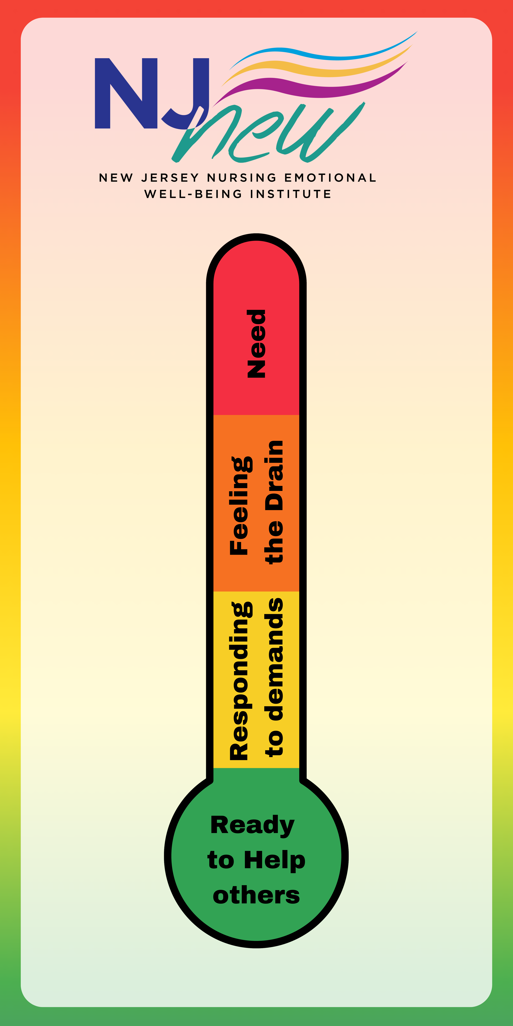
What is Your Stress Level?
Notes:
Stop and ask the individuals participating in the session,
“Let’s stop for a moment, How would you rate YOUR STRESS today, right now?”
Place the color into the chat.

Slide 13
Recognize Stress Zone Transitions: Demand: Resource Balance
Green “Ready” | Yellow “Reacting” | Orange “Injured” | Red “Ill”
100%
35%
5%
Healthy
Well
Fit
Safe
Connected
Capable
Confident
Drained
Sore
Irritable
Anxious
Down
Routine Stressors
Cumulative stress without sufficient resources
Resilience
Hurt
Out of control
Symptomatic
Distressed
Dysfunctional
Clinically symptomatic
Impaired
Worsening
Disordered
?
Toxic Stressors
Recovery
Recovery
Notes:
This graphic of the stress continuum illustrates how we move back and forth between the different zones which illustrates how some people rebound and others may become injured or ill. When people have the resources and skills to grow from stress experiences we call it resilience. And for most people, that is what happens.
While in the Green zone you have the resources needed to engage life’s challenges.
The Yellow zone represents reacting to stress. 100% of us react to stress. Stress reactions are temporary and we return to green when the stress stops or we apply more coping resources.
The Orange zone –When stressors are sufficiently toxic; such as life threat, loss, inner conflict; or when stress exhausts our skills and resources, a stress injury can occur. These stress injury behaviors require more time and resources for recovery than yellow zone stress reactions.
**It is important to understand that even very resilient people have limits to coping skills and resources. Most of us have experienced stress but fewer people experience stress injury. When stress injuries mix with genetics, brain chemistry, alcohol or drugs, people can develop stress related illnesses. Pre-covid it was estimated that about 1/3 of staff might be experiencing a stress injury at one point in time. We know that these numbers are higher post COVID.**
When in the Red zone people need more resources—professional help. The key for treating these illnesses is based on returning balance to the control centers in the brain and increasing coping skills and resources. The good news that we see from the red zone data is that we should be celebrating the 95% of us manage despite life events and can be supportive resources for the 5% that need a path of honor and dignity for recovery.

Slide 14
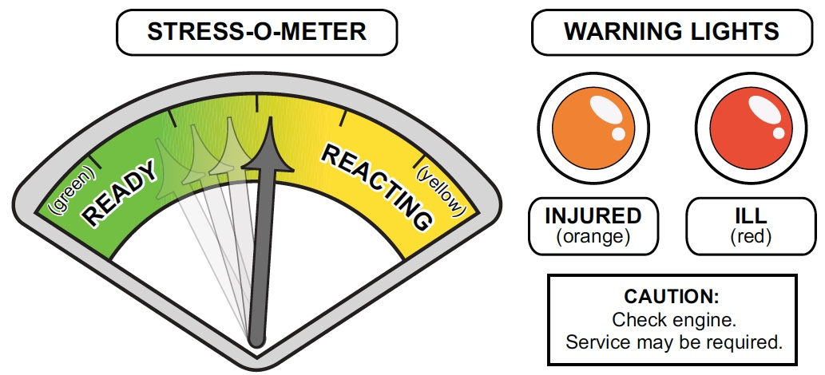
Use the Stress Continuum to Assess and Communicate Stress Zones
Notes:
This image is a reminder that most of the time we are bouncing back and forth between Ready and Reacting to stress.
And like the warning lights in our cars there are indicators that something needs additional attention. As we move from yellow to orange, we might experience a type of “amber alert”
When the orange stress injury light comes one we need to check in with our peers to see if there is an issue we can help with. When the red stress illness light comes on we need to take action to protect our peer, patients, ensure their safety.

Slide 15
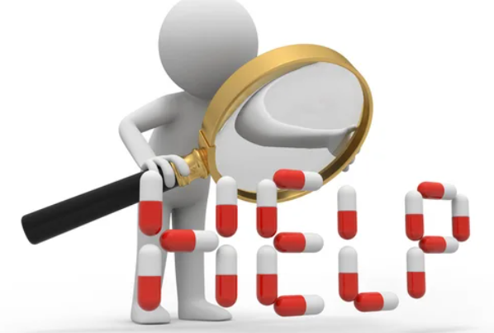
Essential SFA Skills
1. Recognize
2. Act
3. Know
Essential SFA Skills
Recognize the symptoms of stress and stress injuries in yourself and others
Notice signs of stress in yourself or others: say something to your co-worker and reach out for help for yourself
Know and share the resources available
Notes:
There are three essential SFA skills.
1. Recognizing
Paying more attention to signs of stress reactions in oneself and one’s coworkers
Recognizing when stress reactions are getting more pronounced so that action can be taken prior to injury
2. Acting
Acting early on in response to your own or a coworker’s stress. If you see something, do something, either for yourself or for the coworker. In acting in response to peer’s distress you may need to say something to the person themselves or to somebody they trust.
3. Knowing
Knowing at least two resources that you would either access yourself or offer to a coworker in distress. It is helpful to know a range of both organizational and community resources.

Slide 16
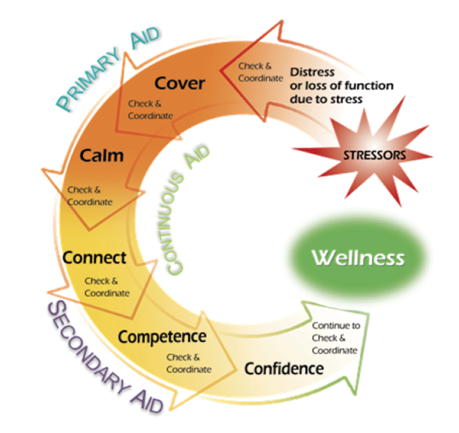
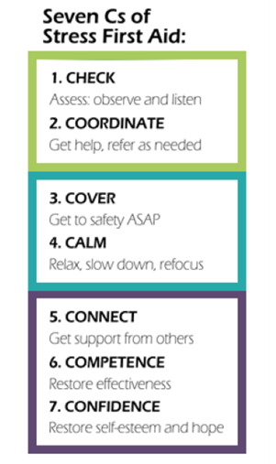
7 Cs Stress First Aid Core Actions
Notes:
The Final Component of SFA is the group of actions called the 7 Cs (the Core Actions for SFA)
The SFA 7Cs continuum is a framework for ongoing assessment and management or response to stressors. The 7 Cs are combined into 3 overall approaches.,
1. Continuous Aid is contained in the first box (green), the first 2 core actions are: check and coordinate. When SFA is part of your practice, part of the culture, Checking and Coordinating is an ongoing action.
Checking involves observing, paying attention to changes in behavior and communication patterns, and checking in on peers on a regular basis. If you know their baseline functioning and behavior, you are prepared to notice any changes and respond.
Coordinate involves always being aware of additional resources that you may need to refer to if your SFA actions aren’t sufficient to make a difference in alleviating stress reactions. This action sometimes includes consulting and/or collaborating with others for more help for oneself or coworkers. It can also involve informing those who may need to know about the situation.
It’s what nurses do best!
The next 5 actions are separated into primary aid and secondary aid.
2. Primary Aid (teal box) encompasses two actions where the goal is to ensure physical and psychological safety.
COVER ensures safety. If there is a physical safety risk or the person’s own perception of risk is endangering their well-being, you act to make sure the person is safe or feels safer. This may involve standing by a coworker and remaining available and ready to assist as needed, watching and listening for ways to intervene if needed, or holding the person’s attention if they are overwhelmed or panicky. In the presence of panic or being overwhelmed, actions are taken to make the person feel safe or encourage a perception of safety.
CALM actions reduce distress. Calming reduces the risk for further stress injury. The first and most basic function of Calm is to stop, quiet, and cease physical exertion if possible by sitting down, lying down or relaxing using another method. Calm involves helping yourself or others become more composed by drawing attention away from frightening and chaotic inner thoughts and feelings and refocusing in a calming way and soothing to reduce the intensity of destructive emotions like fear and anger, by either seeking out or providing a calm, empathic, caring ear.
3. Secondary Aid (purple box) assists people to use the tools and resources that work best for them to move toward a sense of well-being.
The 3 actions of secondary aid are:
Connect --facilitating connectedness is often the most important intervention needed to reduce stress. This involves being with the stressed person…being present, making eye contact, listening and/or mentoring and empathizing. It may also mean accepting the person and their reactions or encouraging them in a way that is acceptable to them. Leaders may be in a position to foster connection between others with projects or group gatherings or by encouraging the person to seek practical help or to engage in contact with others. And connecting the person also means decreasing their sense of isolation, which can often occur when Orange Zone reactions make them want to isolate. The message is that “you are not alone” and you are present.
Competence is the individual’s sense of self efficacy. Competence strategies focus on helping a person build or regain their competence for coping and functioning. In some situations, it may involve helping a person gain new skills or refresh previous training. It encompasses enhancing competency in occupational skills, well being, and social skills.
Confidence involves actions to build confidence that may have been lost in one’s self, peers, or leaders or in a belief or hope for a positive future.
I hope you join with me (and ______) to learn more about SFA. Please let me know if you have question and ideas, I would love to talk with you more about the strategies for each of these 7 action areas.

Slide 17
Enhancing Resilience
Individual, Unit, Organization
Prevent Getting to the Red
Positive Practices
Optimize the work environment
Recognize Stress & Reduce Injury
X
Notes:
Just to summarize. . .
The goal of SFA is to enhance resilience at the individual, work unit and/or organizational levels.
If we incorporate this framework into our organization we will focus on building positive individual practices to respond to stress, building strategies and processes that optimize the work environment and allow individuals practicing in our environments to care for themselves, as well as others and to recognize signs of stress injury early so that we can prevent stress injury in red zone.

Slide 18
Final Questions / Comments
Notes:
Please let me know your thoughts and questions. I’m happy to talk now and stay a few minutes later of you can reach me by email ____________ and phone_______!
Looking forward to hearing from you!

