Slide 1

Stress First Aid Train the Trainer
February 23, 2024
CE Certified Live Activity
Provided by:
Rutgers, The State University of New Jersey, School of Nursing, Center for Professional Development
Activity Overview and Description
SFA is a set of supportive and practical actions to assist nurses experiencing stress. SFA helps team members identify and address early signs of stress reactions in themselves and others in an ongoing way (not just after “critical incidents”). During the three sessions via zoom participants will learn the SFA model, training techniques and implementation strategies as a Trainer lens.
Learning Objectives: Upon completion of this activity, participants will be better able to:
Describe approaches for reducing stigma and normalizing the assessment and management of stress
Identify how to recognize stress injuries in health care professionals
Describe how to administer Stress First Aid (SFA) at the individual, unit, and organizational level
Describe strategies to maintain healthy stress and resilience
Target Audience
This activity is designed for professional Registered Nurses.
Accreditation
In support of improving patient care, this activity has been planned and implemented by Rutgers Biomedical and Health Sciences and NJ-NEW.
Rutgers Biomedical and Health Sciences is jointly accredited by the Accreditation Council for Continuing Medical Education (ACCME), the Accreditation Council for Pharmacy Education (ACPE), and the American Nurses Credentialing Center (ANCC), to provide continuing education for the healthcare team.
Nurses
This activity is awarded 12 contact hours.

Slide 2
Stress First Aid Train the Trainer
February 23, 2024
Method of Participation
In order to meet the learning objectives and receive continuing education credits, participants are expected to attend 100% of the program, and complete an online evaluation form at the conclusion of the activity. A letter certifying attendance and credit verification will be emailed to participants upon completion of the online evaluation survey.
Activity Director -Susan Salmond, EdD, RN, ANEF, FAAN Planning Committee -Edna Cadmus, PhD, RN, NEA-BC, FAAN & Jennifer Polakowski, MPA
Guest Faculty
Susan Salmond, EdD, RN, ANEF, FAAN
Disclosure Declarations
In accordance with the disclosure policies of RBHS and to conform with Joint Accreditation requirements and FDA guidelines, individuals in a position to control the content of this educational activity are required to disclose to the activity participants: 1) the existence of any relevant financial relationship with any entity producing, marketing, re-selling, or distributing health care goods or services consumed by, or used on, patients, with the exemption of non-profit or government organizations and non-health care related companies, within the past 12 months; and 2) the identification of a commercial product/device that is unlabeled for use or an investigational use of a product/device not yet approved.
Faculty Financial Disclosures
The following faculty have no relevant financial relations to disclose:
  Susan Salmond, EdD, RN, ANEF, FAAN
  Shannon Patel, DNP, APN-C, NEA-BC, CPHQ
The following faculty have relevant financial relations to disclose: N/A
CE Content Peer Reviewers
In order to help ensure content objectivity, independence, and fair balance, and to ensure that the content is aligned with the interest of the public, CPD has resolved all potential and
real conflicts of interest through content review by non-conflicted, qualified reviewers. This activity was peer-reviewed for relevance, accuracy of content, and balance of presentation
by: Jeannette Manchester, DNP, MBA,RN, who has no financial relevant relationships to disclose.

Slide 3
Stress First Aid Train the Trainer
February 23, 2024
Rutgers Biomedical and Health Sciences Center for Professional Development
Jeannette Manchester, DNP, MBA, RN, Assistant Professor, Assistant Dean, Center for Professional Development, Rutgers, the State University of New Jersey School of Nursing. Mariely Rosario, BS, Program Assistant, Center for Professional Development Rutgers, the State University of New Jersey School of Nursing.
Off-Label/Investigational Use
This activity does not contain information on commercial products/devices that are unlabeled for use or investigational uses of products not yet approved.
Disclaimer
The views expressed in this activity are those of the faculty. It should not be inferred or assumed that they are expressing the views of any manufacturer of pharmaceuticals and/or medical devices or Rutgers.
It should be noted that the recommendations made herein with regard to the use of therapeutic agents, varying disease states, and assessments of risk, are based upon a combination of clinical trials, current guidelines, and the clinical practice experience of the participating presenters. The drug selection and dosage information presented in this activity are believed to be accurate. However, participants are urged to consult all available data on products or procedures before using them in clinical practice. Rutgers reserves the right to modify the program contents and faculty if necessary.
Questions
For questions or concerns regarding nursing contact hours for this activity, please call the Center for Professional Development at 973-972-6655 or email cpdn@rutgers.edu
INSTRUCTIONS FOR EVALUATION AND
CE CERTIFICATES AND ATTENDANCE LETTERS
Following the program, please take a few moments to complete the online evaluation survey that will be provided in the zoom chat and emailed. Completion will assist us in
assessing the effectiveness of this activity and to make recommendations for future educational offerings. Your response will help ensure that future programs are informative
and meet the educational needs of all participants. All surveys must be completed 4 weeks after the course.
In order to obtain a CE certificate/attendance letter for this activity, you must complete the online evaluation survey after the activity has concluded.

Slide 4
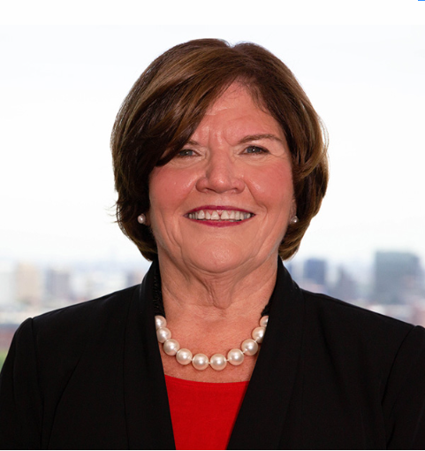



Stress First Aid Train the Trainer
Session II – February 23, 2024
Presenters
Susan Salmond
EdD, RN, ANEF, FAAN
Jennifer Polakowski
MPA
Shannon Patel
DNP, APN-C, NEA-BC, CPHQ

Slide 5
What’s Charging your Battery?

Slide 6
What’s Draining Your Battery

Slide 7
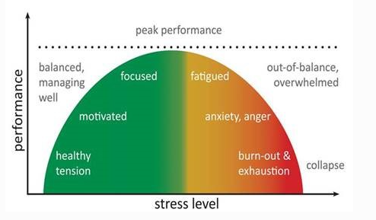
Stress and Stress Injury
Excessive stress can overwhelm compensatory systems and precipitate debilitating psychopathology
A STRESS INJURY is any severe and persistent distress or loss of ability to function caused by damage to the brain, mind, or spirit after exposure to overwhelming stressors
In this respect, the stressed brain is not unlike an exercised muscle: manageable doses can fortify the system, whereas an overload can cause permanent damage
STRESS INJURIES are invisible. You notice them in behaviors and words.
View stress on a continuum
Stress can be positive
Stress is part of our everyday work environment
Sometimes we function better under stress
But we must prevent stress injury

Slide 8
Enhancing Resilience
Individual, Unit, Organization
Prevent Getting to the Red
Positive Practices
Optimize the work environment
Recognize Stress & Reduce Injury
X

Slide 9
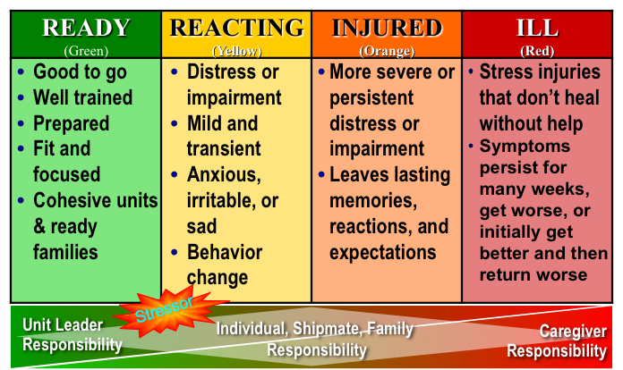
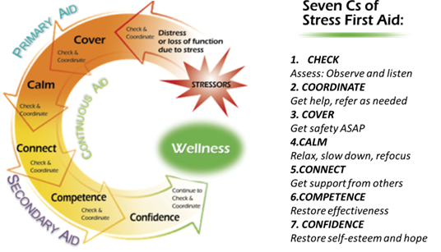
Major Concepts
Stress Continuum
Stress Injury
Stress First-Aid

Slide 10
Four Sources of Stress Injury
Intense or Prolonged Stress
Life Threat
Loss
Inner Conflict
Wear & Tear
A traumatic injury
Due to an experience of death-provoking terror, horror, or helplessness
A grief injury
Due to the loss of cherished people, things or parts of oneself
A moral injury
Due to behaviors or the witnessing of behaviors that violate moral values
A fatigue injury
Due to the accumulation of stress from all sources over time without sufficient rest and recovery

Slide 11
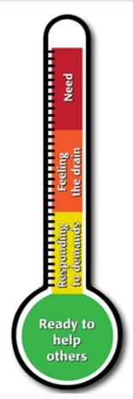
Stress Continuum/Thermometer
READY (Green) | REACTING (Yellow) | INJURED (Orange) | ILL (Red)
DEFINITION Optimal functioning Adaptive growth Wellness FEATURES At one’s best Well-trained and prepared In control Physically, mentally and spiritually fit Mission-focused Motivated Calm and steady Having fun Behaving ethically | DEFINITION Mild and transient distress or impairment Always goes away Low risk CAUSES Any stressor FEATURES Feeling irritable, anxious or down Loss of motivation Loss of focus Difficulty sleeping Muscle tension or other physical changes Not having fun | DEFINITION More severe and persistent distress or impairment Leaves a scar Higher risk CAUSES Life threat Loss Moral injury Wear and tear FEATURES Loss of control Panic, rage or depression No longer feeling like normal self Excessive guilt, shame or blame Misconduct | DEFINITION Clinical mental disorder Unhealed stress injury causing life impairment TYPES PTSD Depression Anxiety Substance use disorders FEATURES Symptoms persist and worsen over time Severe distress or social or occupational impairment

Slide 12
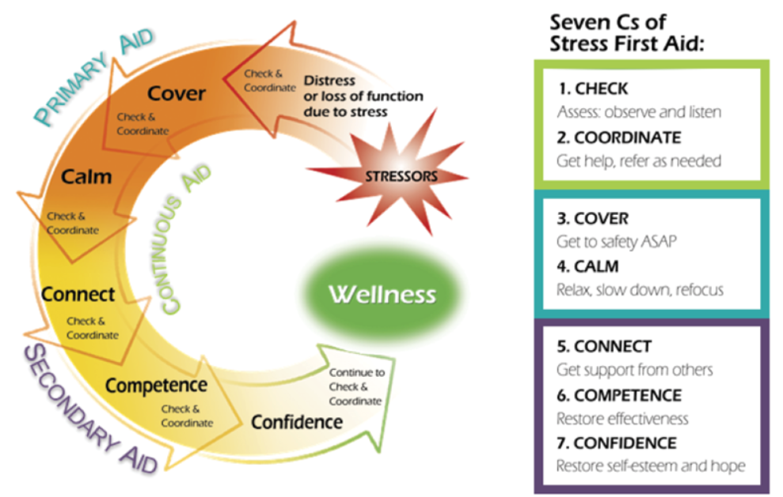
STRESS FIRST AID MODEL

Slide 13
Check Actions
Observe, Keep Track, Examine, Decide
Check Self | Check Peer/Leader | Check Leader/Organization
Permission for Self Care | Build Relationships | Well-Being Becomes a Pillar
SFA Thermometer Self Check | Know Normal & Red Flags of Team Members | Create a People First Culture
Self Awareness of Own Signs Reacting to Stress (Yellow to Orange) | Observe for Changes in Behavior & Communication | Track Data & Make Public (Turnover, Absenteeism, Engagement)
Self Awareness of Red Flags | Be Approachable Be Authentic | Rounds with Stress Checks
 | Check You Check Two | Support Time to Implement SFA and Other Programs
 | Use SFA Thermometer as a Daily or per shift stress check | Focus Groups: Meaning of Data & Unit Checks on biggest challenges & what is working and not working

Slide 14
Coordinate Actions
Collaborate, Inform, Refer
Coordinate Self | Coordinate Peer/Leader | Coordinate Leader/Organization
Develop a Self Care Plan and Share It | Coordinate and communicate plans for managing unit stress | Provide organizational resources available to staff as needed
Share With Others Your Red Flags | Coordinate rechecks | Communicate resources—what they are, how they can be accessed
Act in Presence of Red Flags | Debriefing: what worked, what didn’t, what can we learn moving forward | Respond and coordinate intervention for cases escalated to leadership
Ask for Help | Know Resources | Track reasons for escalation, keep aggregate information, decide if earlier intervention can be taken
Know Resources | Coordinate mentorship

Slide 15
Cover Actions
Stand By, Make/Others Safe, Encourage Perception of Safety
Cover Self | Cover Peer/Leader | Cover Leader/Organization
Speak up when you don’t feel safe | Remain available, assist as needed | Greater commitment to safety.
Speak up when you don’t think you can take a shift, an assignment (Set Boundaries) | Continue to observe, Check in and reduce high risk behavior, Give time off as needed | Reduction of chaos and rumors; Briefings before staff involved in high risk situations
Communicate Concerns | Hold person’s attention if panicky, Clearly communicate what to do (don’t focus on what not to do) | Disaster Drills, Debriefs—learn what can be done differently
Reach out to those who feel safe to you, get help from others | Get accurate understanding of specific risks; Communicate safety risks to others | Safety protocols & alerts, De-escalation trainings, stress education
Distract yourself by focusing on breath, nearby object, counting | Authoritative presence, Reassurance and Education | Systems for managing staff in danger zone
Stay positive | Briefings about changes in practice/strategies/resources; Be willing to share own vulnerability | Know what situations make staff feel unsafe

Slide 16
Calm Actions
Quiet, Compose, Recover, Soothe
Calm Self | Calm Peer/Leader | Calm Leader/Organization
Awareness of calming strategies that work for you | Promote coping and problem solving; Provide breaks for calming; guide in relaxation techniques | Policies and practices to promote distressing behaviors
Focus on gratitude, acceptance, understanding what you can control | Provide perspective by presenting situation from alternative vantage point (reframing) | Provide resources to promote calm: rejuvenation cart, tranquility space
Prioritize calming strategies to calm you down | Develop staff re stress response, coping, relaxation strategies | Mandatory breaks
Ask for Help | Reduce gossip and negativity | Provide flexible staffing
Get organized and problem solve to tackle problems directly | Sessions where staff can discuss challenges in caring | After Action Responses
STOP | Authoritative, Empathic Presence | Stress Management Approaches
 | Use person's name, get them to look at you, communicate what is needed

Slide 17

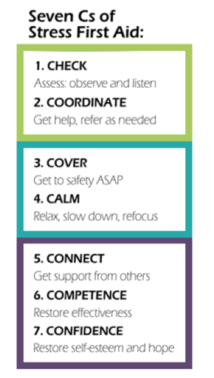


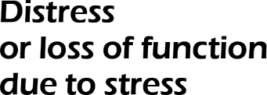





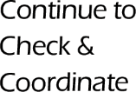

Secondary Aid: Connect, Competence, Confidence
Secondary Aid

Slide 18





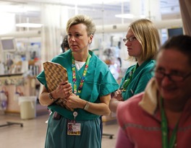
Stress First Aid Action: Connect
CHECK
Assess: Observe and listen
2. COORDINATE
Get help, refer as needed
3. COVER
Get safety ASAP
4.CALM
Relax, slow down, refocus
5.CONNECT
Get support from others
6.COMPETENCE
Restore effectiveness
7. CONFIDENCE
Restore self-esteem and hope

Slide 19
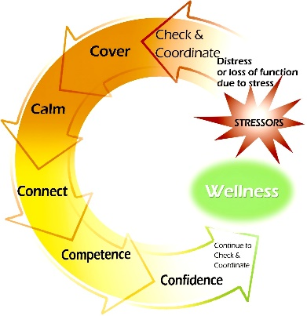
Connect Actions
Be With
Maintain presence
Promote Connection
Find trusted others
Reduce Isolation
Improve understanding
Keep eye contact
Listen
Empathize
Accept
Foster contact with others
Encourage contact with others
Correct misconceptions
Restore trust
Invite and include

Slide 20
Connect: Why & When?
Trust
Stress-related decrements in social skills
Lack of positive feedback or support
Exhaustion
Fear of being misunderstood or being a burden
Avoidance
Orange zone behaviors
Needs for different social support network
Stigma

Slide 21
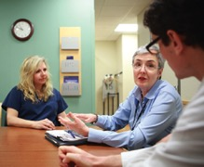
Connect: Different Types of Support
Instrumental support: material aid (such as assistance with daily tasks)
Informational support: relevant information (such as advice or guidance)
Emotional support: empathy, caring, reassurance and giving opportunities for venting
Inclusion: make efforts to pull the person in

Slide 22
Connect: In the Green & Yellow
CONNECT: Building Resilience, Growing the Green
CONNECT: Proactively Manage Stress
Plan for activities which provide social support
Know the value of good mentors and friends
Surround yourself with people who are genuine, authentic, and honest
Build trusting and supportive relationships
Hold employees accountable for treating each other with respect
Show validation and appreciation for employees
Foster opportunities for socialization
Act to remove obstacles to social support
Offer different types of social support (practical, inclusion, emotional)
Help link the person with supportive others
Address potential negative social influences, such as those who make the person feel judged, or people who endorse less healthy ways of coping
Help family and friends understand potential experiences that can occur on the job so have a support mechanism
Communicate when upset
Connect with supportive peers
Virtual Schwartz Rounds

Slide 23

Connect: In the Orange or Red
CONNECT: Stress Moving into an Urgent Zone
CONNECT: In Danger Zone—Take Immediate Action
Conflict management; understanding other’s positions
Identify who in the team is most trusted by the individual or has a positive attachment
Who in the chain of command does the individual most trust
Address problems, not personalities
If someone is stressed and resists support, be more authoritative in getting them the help they need
If someone is particularly stressed and isn’t functioning well, foster understanding and support in peers
If someone is having significant stress in their personal life, offer practical support if possible
Do not leave person alone
Connect with those people most trusted who can do a warm handoff to supportive resources
Escalation to leadership and use of outside resources
Confront and try to neutralize blame, guilt and shame
NURSE2NURSE Helpline
Connect with EAP
Taking time off and reconnecting

Slide 24
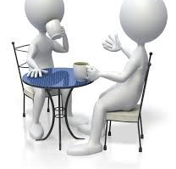
Connect Example: Individual
“For practical support I ask other peers to help me with my patients if I'm in an overwhelming situation.”

Slide 25
Connect Example: Individual: Reach Out
“The people I reach out to are honest. It’s about calling a spade a spade, not dancing around it. They’re able to give their perspective on my problem and say something like: ‘You need to pick up the pieces and move on.’ It serves to provide another’s perspective, and foster honesty. Or they might say, ‘That’s not normal for you.’ I am skeptical of self-diagnosis. I think you need to get a second opinion from someone who knows you - a fresh perspective.”

Slide 26

Connect Examples: Peer/Leader Support
“I try to make my staff laugh as much as possible throughout the work day. I also take advantage of any lulls throughout the day to hold round tables with the staff. During these round tables, staff can voice their concerns over anything that bothers them. I also try to make myself available and approachable to staff at all times during the work day.”
“I try to help a co-worker who is drowning by giving a medication to a patient or starting an IV - just a simple task to allow them to catch up.”

Slide 27
Connect Example: Peer/Leader Support
“We would write our name on the department whiteboard if we thought we were in the green zone that day, to give permission for peers to approach us for support without worrying about being a burden. We could erase our name during the shift if we were no longer in the green.”

Slide 28
Connect Examples: Support
“You walk into the break room and someone has left a treat for you, and it’s just those little actions that show that somebody’s thinking about you. They validate that you are significant person and that you are important.”
“Every season I give my office a healthcare item for that season. For winter they get a hand warmer and lip balm. It’s not much, but it is a little something to let them know I care.”
“We go take a walk, just about a 15-minute walk just to get out of the office.”

Slide 29
Connect Examples: Peer Support
“There are a lot of opportunities that come about to lend support to the people you work with, whether it's a family member who’s sick or somebody who has passed away. There is value in a text message saying, "Hey, I'm thinking about you. I hope that you're doing okay. Things will be better tomorrow." It's really important that we maximize those situations, to foster that sense that someone else is thinking about them when things aren't going well.”

Slide 30

Group Discussion
What are some examples of how connection might be needed in your work?
What are some ways that you have been able to increase connection for yourself?
What are some ways that you have offered or been offered competence-enhancing actions?

Slide 31


Slide 32



Stress First Aid Action: Competence
CHECK
Assess: Observe and listen
2. COORDINATE
Get help, refer as needed
3. COVER
Get safety ASAP
4.CALM
Relax, slow down, refocus
5.CONNECT
Get support from others
6.COMPETENCE
Restore effectiveness
7. CONFIDENCE
Restore self-esteem and hope

Slide 33
Competence: Why and When
Inexperience
Stress Reactions
Stress Reactions
Distress or Trouble Functioning

Slide 34
Competence Actions
Occupational Skills
Well-Being Skills
Social Skills
Improve occupational skills to reduce risk of stress reactions in inexperienced staff:
Train
Retrain
Reassign
Mentor back to duty
Re-establish or learn new skills to deal with stress reactions:
Calming
Problem-solving
Health and fitness
Managing trauma and loss reminders
Re-establish or learn social skills to deal with stress-reactions:
Requesting support
Conflict resolution
Assertiveness
Seeking mentoring

Slide 35
Competence: In the Green & Yellow
COMPETENCE: Building Resilience, Growing the Green
COMPETENCE: Proactively Manage Stress
Strong residency programs
Ongoing educational development
Unit based educators
Mentorship programs
Reflecting on the joy in work
Self-Awareness of strengths and weaknesses
Affirmations, positive self talk
Ask for help
Reach out to others who have experienced similar situations
Balance between work and personal life
Celebrating near misses
Setting priorities
Problem Solving

Slide 36
Competence: In the Orange or Red
COMPETENCE: Stress Moving into an Urgent Zone
COMPETENCE: In Danger Zone—Take Immediate Action
Interrupt situation and take over
Connect with those people most trusted who can do a warm handoff to supportive resources
Escalation to leadership and use of outside resources
If you’re under too much stress, do something that is easy for you to give you a sense of accomplishment
Confront and try to neutralize blame, guilt and shame
Reach out for help
Debriefings
Code Orange Huddles
Lessons Learned
Goal setting

Slide 37

Examples of a Need for Competence
An intern new to an infectious disease rotation becomes anxious and has concerns about his own safety.
A nurse involved in a pandemic feels unsure of her actions in the face of changing directives coming down from above.
A nurse who was the target of a violent patient experiences persistent mental confusion and slowed, unclear thinking.
A nurse who developed wear-and-tear stress injury loses the ability to stay calm when dealing with co-workers.
A manager who loses a staff member because that person became infected with hepatitis C when they were stabbed by a violent patient becomes hesitant about sending staff into potentially hazardous situations, increasing the danger to the entire department.

Slide 38
Competence Actions: Individual
When struggling with something, use positive self-talk and don’t be afraid to ask for help and guidance from mentors
If overwhelmed, find ways to focus on one thing at a time
When tough things happen, establish new relationships with those who have been through similar situations
If you’re under too much stress, do something that is easy for you, to give you a sense of accomplishment
Find people or ways to be more effective in counteracting stress with healthy habits
Regularly reflect on the balance between the satisfaction of fulfilling work duties and the personal sacrifices you are making. Be prepared to adjust behaviors and expectations if that balance changes over time
Seek out opportunities to learn new skills
Practice skills in a new context

Slide 39
Competence Actions During Prolonged Stress
Make a commitment to endure, using whatever coping skills work best for you, as well as these potential actions
Divert attention temporarily (humor, acceptance)
Keep worrying circumscribed to actual potential risks and be disciplined about not letting fears derail important life tasks.
Shift expectations about what to expect from day to day and about what is considered a “good day”
Clarify top priorities and focus on taking steps towards what is most important.
Create routines of living and try to let that structure organize and guide you

Slide 40
Competence Actions: Peers/Leaders
Provide targeted training in work and well-being skills
Be authentic, normalize stress reactions, and give simple examples of ways to cope
Give the stressed individual responsibility little by little so that they do not feel overwhelmed
Remind the person of coping strategies and skills that have worked for them before
Encourage active coping
Help problem-solve and set achievable goals
Mentor others by offering advice on how you got through similar situations

Slide 41
Restoring Competence in the face of Orange Zone Stress
Action | Specific Intent | Examples of Phrases to Use
Stop | Make sure there is time given to rest and recover if needed Identify challenges to functional capabilities Do not keep doing what is not working | “We need to pause. I can cover this. Take a 10-minute break” “The HER is down. Take a break and step away from the keyboard. What do you need to get done?”
Back-up | Retrain and refresh old occupational, well-being, or social skills Give training in new occupational, well-being, or social skills Help mentor, problem-solve or explore new options | “You have been doing this a long time and it feels like everything changed in the last few months. What new skills or ways of thinking do we need now and going forward?”
Move forward | Provide practice in refreshed skills Provide practice to perfect new skills Assist in integrating back into duties and in finding new directions and goals | “I am glad that you completed the communications training and are back to work. Remember that not everyone knows that you are trying to change,. I will check in with you to see what is and is not working; you can check in with me too.”

Slide 42
Competence Actions: Peers/Leaders
During highly stressful times or after mistakes, give extra attention/training/mentoring
For those who need a break, reassign or temporarily suspend key job duties
Integrate back into duties by assigning responsibility in a stepped, gradual way
Help the person “recalibrate” their expectations and goals to meet current circumstances
Before you have a conversation with somebody who you think needs time off, make sure taking time off is feasible for that individual
Connect the person to relevant resources

Slide 43
Competence Actions: Organization
Create and promote enabling environments for research, innovation and learning
Health system resilience as “the capacity of health actors, institutions, and populations to prepare for and effectively respond to crises;
Maintain core functions when a crisis hits; and, informed by lessons learn during the crisis, reorganize if conditions require it.”
Career Ladders
Tuition reimbursement and seminar support
Annual needs analysis
Access to continuing educational programs
Education Department resources and competence

Slide 44

Competence Example: Support
“When a new staff member becomes a part of our burn unit team, we all work really hard to mentor and support that person. This work can be exhausting both physically and emotionally. There are so many difficult sights, smells and procedures. Some people try this work only to find that it is not for them. We make it possible for them to leave with support and hopefully without shame.”
Notes:
44

Slide 45

Competence Example: Self-Care
“When I’m under too much stress, I revert to doing something that is easy for me. It gives me a sense of accomplishment, like tidying the garage, or shoveling snow for a widowed neighbor. It doesn’t take much thought, but it gives me a sense of accomplishment.”
Notes:
45

Slide 46
Competence Example: Self-Care
“Switching specialties was a struggle for me. I utilized all the resources I could and was not afraid to ask my supervisor or other peers for help and guidance. I was honest about my lack of confidence in my abilities, and I sought out (and continue to seek help) from other specialists.”
Notes:
46

Slide 47
Competence Examples: Support
“We help people when they're exposed to different things, such as teaching techniques to stay focused on the present and not ruminate on memories.”
“We had training in positive psychology that included gratitude journals with writing three things that you’re thankful for every day, and it really seemed to help us to get a different perspective.”
Notes:
47

Slide 48

SFA Competence Example
“You can mitigate a lot of issues with the right mentoring. The platinum rule of treat others the way they need to be treated, it’s the same thing with teaching. It’s not about me, it’s about how are you going to learn this and how are you going to then get confidence to teach it as well. A lot of one on one is the way to do it.”

Slide 49
SFA Competence Example
“If you are seeing a decrease in someone’s level of competence, something that I've seen done is to say, "Can I share how I've done something similar, or even worse?" or "I went through a similar thing.” I think when we can share our experience, how it affected us and how our performance dropped when we were dealing with something, it probably helps the person to understand, “all right, I'm going to be okay.” It's not permanent and it's a normalizing thing, and it's part of the process.”

Slide 50
Group Discussion
What are some examples of how competence might be needed in your work?
What are some ways that you have been able to increase sense of competence in yourself?
What are some ways that you have offered or been offered competence-enhancing actions?

Slide 51










Stress First Aid Action: Confidence
CHECK
Assess: Observe and listen
2. COORDINATE
Get help, refer as needed
3. COVER
Get safety ASAP
4.CALM
Relax, slow down, refocus
5.CONNECT
Get support from others
6.COMPETENCE
Restore effectiveness
7. CONFIDENCE
Restore self-esteem and hope

Slide 52
Confidence Actions
Trust
Hope
Self-Worth
Meaning
Trust in:
Peers
Equipment
Leaders
Mission
Forgiveness of self
Forgiveness of others
Imagining the future
Belief in self
Accurate self-concept
Self-respect
Making sense
Purpose
Faith
Joy

Slide 53

Confidence: Why and When
Someone whose failure to take proper precautions contributes to the death of a patient. He feels extremely guilty and becomes self-destructive
An individual who develops wear-and-tear stress reaction loses respect for leaders and becomes angry and irritable
Someone who is regularly exposed to significant life threat suffers lowered functioning, loses spiritual faith, and becomes depressed

Slide 54
Confidence: In the Green & Yellow
CONFIDENCE: Building Resilience, Growing the Green
CONFIDENCE: Proactively Manage Stress
Mentor others
Use skills in new contexts
Reflection on how nursing has made a difference
Look for learning opportunities
Foster positive relationships
Give regular positive feedback
Positive Affirmations
Remind other of their positive impact, values, skills and competence
Take breaks
Providing accurate information, reduce rumors and gossip
Support & Empathy for peers
Re-establish believe in colleagues who have stress reactions by debriefing
Be non-judgmental

Slide 55
Confidence: In the Orange or Red
CONFIDENCE: Stress Moving into an Urgent Zone
CONFIDENCE: In Danger Zone—Take Immediate Action
Interrupt situation and take over
Connect with those people most trusted who can do a warm handoff to supportive resources
Escalation to leadership and use of outside resources
Be available– may need to talk over and over
connect them to treatment or to people who have dealt with similar situations
Bring in pastoral care, resiliency team
Listen for & confront distorted perceptions
Provide accurate information, reduce rumors and gossip
Be authentic, empathic, and nonjudgmental
Counter guilt by normalizing reactions and letting people know they are not alone in experiencing stress reactions

Slide 56
Confidence: Self Actions
Use small triumphs to build confidence
If you have self-doubt, read more self-help books or articles
Don’t push yourself to “process” a situation in any particular time frame, but if something triggers you, give yourself time and space to integrate it
Use the wisdom gained from hard experiences to reconfirm your values, make changes in your life, appreciate what you value, or help others
Use positive self-talk
Focus on ways that you've made a difference
Adopt a long-term perspective

Slide 57
Confidence: Peer/Leader
Be authentic, empathic, and nonjudgmental.
Buddy up and debrief on hard cases.
Help the person counter guilt by normalizing their reactions and letting them know they are not alone in experiencing stress reactions.
Help them focus on the present.
Encourage them to remember their personal strengths, positive relationships, spiritual change, appreciation for life, or other things they value.
Help them make meaning of difficult events or losses by encouraging them to find ways to memorialize or honor those events or losses.
Be willing to talk with them as many times as they need, give them relevant reading materials, and connect them to treatment or to people who have dealt with similar situations.

Slide 58
Confidence: Leader Actions
Set realistic expectations
Discuss preferred values
Focus on learning opportunities
Confront stigma about stress reactions
Be a role model to show peers how to get through difficult situations

Slide 59
Confidence Actions: Organization
Consistence presence during crisis and beyond
Strong communication plans
Lessons Learned: Establish new resources/processes/ policies post crisis to prepare for future episodes
Adapt and reorganize core functions to meet demand

Slide 60

Confidence Example: Self
“You can be the most skillful person in the entire world but if you don’t have faith in yourself you are doomed. You’re never going to get through it. And vice versa, you can be overconfident but not able to learn from mistakes to be more effective. There is a fine line between the two. The better you are at one, the better you will be at the other one. Even small triumphs can help with confidence.”
Notes:
60

Slide 61

Confidence Examples: Peer/Leader
“For the person who lacks confidence, I will talk the through the task and what it will take to complete it successfully. I will reinforce their good ideas and help think through other strategies for the parts that are more difficult.”
“When the nurses’ roles on the unit will be changing, we discuss each nurse’s strengths, and how they can use these strengths in their new roles.”

Slide 62
Confidence Example: Leader
“We had a particularly endearing child die of an unexpected complication after being in the hospital for a while. A number of people felt responsible, so I got them in a room for an After-Action Review. The ground rules were that they had to keep it to what they saw and did at the scene (to get all the puzzle pieces together) and to keep emotion out of it. Through the discussion they were able to see that they weren’t responsible.”
Notes:
62

Slide 63
Group Discussion
What are some examples of how confidence might be needed in your work?
What are some ways that you have been able to increase sense of confidence in yourself?
What are some ways that you have offered or been offered confidence-enhancing actions?

Slide 64



End of C’S
Primary Aid
Secondary Aid

Slide 65
How Can You Use SFA?
 | Cover | Calm | Connect | Competence | Confidence
Grief |  | X | X
Anxiety | X | X
Guilt/Shame | X | X | X | X
Isolation |  |  | X | X
Sleep Problems |  | X |  | X | X
Severe Inability to Function |  |  |  |  | X
Check:
What is your colleague describing?
What are you observing?
Coordinate:
What approach would best serve needs?

Slide 66

Questions / Comments

Slide 68
Awareness Brief

Slide 69
Next Steps
Implementation Guide Overview & Expectations
Awareness Brief Assignment
  Schedule a time to Present Awareness Brief
  Select a Small Group (3-8 participants-unit, peers, council, or committee)
  Handout to share with participants
  After the Awareness Session, Complete the Feedback Form, via link by
  March 4, 2024.
Day III Session
Discuss/Share: Awareness Brief Presentation Experience & Implementation/ Next Steps

Slide 70

Questions/ Wrap Up

Slide 71
Cover Scenario
A respected member of your staff has had a hard couple of years. He had an injury, financial problems, and lost a close friend to a motor vehicle accident. Recently, he separated from his spouse and had to move out of the family home.
He has been drinking a lot and often appears to be under the influence of alcohol when not at work.
He is distracted and expresses a sense of hopelessness that things will improve.
Today, he arrives to work late.
When you begin to talk with him about your observations he says, “what difference does it make? Nothing really matters anyway. It doesn’t matter if I’m here or not.”
What kind of stress injury may be present?
What SFA action(s) would you use?
What is your plan for approaching the situation?
What other information would you want to know?
Outline the exact words/sentences you would use.

Slide 72
CALM SCENARIO
A nurse who you know has been having marital issues has trouble with entering data into an electronic record and throws a stack of papers on the floor and runs to the bathroom.
What kind of stress injury may be present?
What SFA action(s) would you use?
What is your plan for approaching the situation?
What other information would you want to know?
Outline the exact words/sentences you would use.

Slide 73
Connect Scenario
A staff member with a well-respected reputation who has recently been transferred to your unit becomes upset when other staff make jokes and comments that seem to bother him.
He begins to become more irritable and isolative and tells you that he finds the behavior of the other staff offensive.
What kind of stress injury may be present?
What SFA action(s) would you use?
What is your plan for approaching the situation?
What other information would you want to know?
Outline the exact words/sentences you would use.

Slide 74
Competence Scenario 1
Your pediatric ICU unit responds to a child who is injured from suspected physical and sexual abuse
Your team includes a nurse who has been on the job for about one year
When the child’s vitals take an emergent turn for the worse and the nurse is asked to assist, she freezes
You call her name, but she doesn’t respond. You then tap her on the shoulder and she responds immediately, re-engaging in the task at hand
A few shifts later, she tells you “I just don’t know if I can keep doing this”
As you talk further, she tells you, “I froze in that instance. What if I freeze again and someone dies because I don’t react fast enough?
What kind of stress injury may be present?
What SFA action(s) would you use?
What is your plan for approaching the situation?
What other information would you want to know?
Outline the exact words/sentences you would use.

Slide 75
Competence Scenario 2
You are training a nurse. Up to this point, she has been a quick study and eager to learn
She is becoming increasingly frustrated and throws the papers she is holding and starts to walk away
Another nurse makes a snide comment as she passes by and she makes a rude gesture to her
You know that the nurse has had two deaths in her immediate family in the past month and is dealing with her child’s learning issues at school
What kind of stress injury may be present?
What SFA action(s) would you use?
What is your plan for approaching the situation?
What other information would you want to know?
Outline the exact words/sentences you would use.

Slide 76
Competence Scenario 3
You and your team hold a small celebration on the day than an intern returns to work
Six months earlier, he was injured in a workplace violence incident and has just returned o work
Later during the day, you notice that the intern is unusually quiet, but when asked if everything is ok, he assures you that he is fine, but just a little tired
As he walks into the same hallway where the workplace violence incident occurred, you notice that he is breathing very rapidly and sweating
What kind of stress injury may be present?
What SFA action(s) would you use?
What is your plan for approaching the situation?
What other information would you want to know?
Outline the exact words/sentences you would use.

Slide 77
Confidence Scenario
Your unit has been responding to a particularly virulent viral outbreak that results in a rash of illnesses on the ward, and two staff members falling seriously ill with pneumonia.
You notice that the conversation during lunch focuses on the lack of trust in leadership and whether the agency even cares about their safety.
What kind of stress injury may be present?
What SFA action(s) would you use?
What is your plan for approaching the situation?
What other information would you want to know?
Outline the exact words/sentences you would use.

Slide 78
Confidence Scenario
You notice that one of your co-workers is withdrawn, avoids contact with other staff and has stopped participating in off duty activities.
When you talk with her, she confides in you that she recently discovered that her 17-year-old son has an addiction and she is not sure what to do. She and her husband argue because they do not agree about what to do.
She tells you she doesn’t sleep well because she frequently checks to make sure her son is breathing.
When you ask her about work pressure, she tells you that she is struggling to complete a special project that her supervisor asked her to do. She says, “I guess I am just a failure all the way around.”
What kind of stress injury may be present?
What SFA action(s) would you use?
What is your plan for approaching the situation?
What other information would you want to know?
Outline the exact words/sentences you would use.

