Slide 1

Stress First Aid Train the Trainer
February 21, 2024
CE Certified Live Activity
Provided by:
Rutgers, The State University of New Jersey, School of Nursing, Center for Professional Development
Activity Overview and Description
SFA is a set of supportive and practical actions to assist nurses experiencing stress. SFA helps team members identify and address early signs of stress reactions in themselves and others in an ongoing way (not just after “critical incidents”). During the three sessions via zoom participants will learn the SFA model, training techniques and implementation strategies as a Trainer lens.
Learning Objectives: Upon completion of this activity, participants will be better able to:
Describe approaches for reducing stigma and normalizing the assessment and management of stress
Identify how to recognize stress injuries in health care professionals
Describe how to administer Stress First Aid (SFA) at the individual, unit, and organizational level
Describe strategies to maintain healthy stress and resilience
Target Audience
This activity is designed for professional Registered Nurses.
Accreditation
In support of improving patient care, this activity has been planned and implemented by Rutgers Biomedical and Health Sciences and NJ-NEW.
Rutgers Biomedical and Health Sciences is jointly accredited by the Accreditation Council for Continuing Medical Education (ACCME), the Accreditation Council for Pharmacy Education (ACPE), and the American Nurses Credentialing Center (ANCC), to provide continuing education for the healthcare team.
Nurses
This activity is awarded 12 contact hours.

Slide 2
Stress First Aid Train the Trainer
February 21, 2024
Method of Participation
In order to meet the learning objectives and receive continuing education credits, participants are expected to attend 100% of the program, and complete an online evaluation form at the conclusion of the activity. A letter certifying attendance and credit verification will be emailed to participants upon completion of the online evaluation survey.
Activity Director -Susan Salmond, EdD, RN, ANEF, FAAN Planning Committee -Edna Cadmus, PhD, RN, NEA-BC, FAAN & Jennifer Polakowski, MPA
Guest Faculty
Susan Salmond, EdD, RN, ANEF, FAAN
Disclosure Declarations
In accordance with the disclosure policies of RBHS and to conform with Joint Accreditation requirements and FDA guidelines, individuals in a position to control the content of this educational activity are required to disclose to the activity participants: 1) the existence of any relevant financial relationship with any entity producing, marketing, re-selling, or distributing health care goods or services consumed by, or used on, patients, with the exemption of non-profit or government organizations and non-health care related companies, within the past 12 months; and 2) the identification of a commercial product/device that is unlabeled for use or an investigational use of a product/device not yet approved.
Faculty Financial Disclosures
The following faculty have no relevant financial relations to disclose:
  Susan Salmond, EdD, RN, ANEF, FAAN
  Shannon Patel, DNP, APN-C, NEA-BC, CPHQ
The following faculty have relevant financial relations to disclose: N/A
CE Content Peer Reviewers
In order to help ensure content objectivity, independence, and fair balance, and to ensure that the content is aligned with the interest of the public, CPD has resolved all potential and
real conflicts of interest through content review by non-conflicted, qualified reviewers. This activity was peer-reviewed for relevance, accuracy of content, and balance of presentation
by: Jeannette Manchester, DNP, MBA,RN, who has no financial relevant relationships to disclose.

Slide 3
Stress First Aid Train the Trainer
February 21, 2024
Rutgers Biomedical and Health Sciences Center for Professional Development
Jeannette Manchester, DNP, MBA, RN, Assistant Professor, Assistant Dean, Center for Professional Development, Rutgers, the State University of New Jersey School of Nursing. Mariely Rosario, BS, Program Assistant, Center for Professional Development Rutgers, the State University of New Jersey School of Nursing.
Off-Label/Investigational Use
This activity does not contain information on commercial products/devices that are unlabeled for use or investigational uses of products not yet approved.
Disclaimer
The views expressed in this activity are those of the faculty. It should not be inferred or assumed that they are expressing the views of any manufacturer of pharmaceuticals and/or medical devices or Rutgers.
It should be noted that the recommendations made herein with regard to the use of therapeutic agents, varying disease states, and assessments of risk, are based upon a combination of clinical trials, current guidelines, and the clinical practice experience of the participating presenters. The drug selection and dosage information presented in this activity are believed to be accurate. However, participants are urged to consult all available data on products or procedures before using them in clinical practice. Rutgers reserves the right to modify the program contents and faculty if necessary.
Questions
For questions or concerns regarding nursing contact hours for this activity, please call the Center for Professional Development at 973-972-6655 or email cpdn@rutgers.edu
INSTRUCTIONS FOR EVALUATION AND
CE CERTIFICATES AND ATTENDANCE LETTERS
Following the program, please take a few moments to complete the online evaluation survey that will be provided in the zoom chat and emailed. Completion will assist us in
assessing the effectiveness of this activity and to make recommendations for future educational offerings. Your response will help ensure that future programs are informative
and meet the educational needs of all participants. All surveys must be completed 4 weeks after the course.
In order to obtain a CE certificate/attendance letter for this activity, you must complete the online evaluation survey after the activity has concluded.

Slide 4
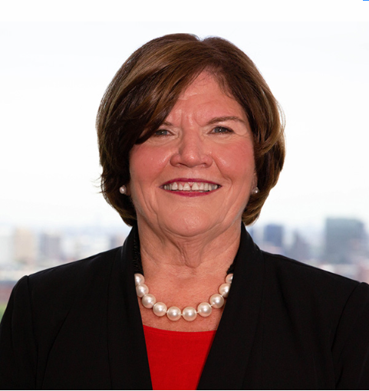



Stress First Aid Train the Trainer
Session I – February 21, 2024
Presenters
Susan Salmond
EdD, RN, ANEF, FAAN
Jennifer Polakowski
MPA
Shannon Patel
DNP, APN-C, NEA-BC, CPHQ

Slide 5
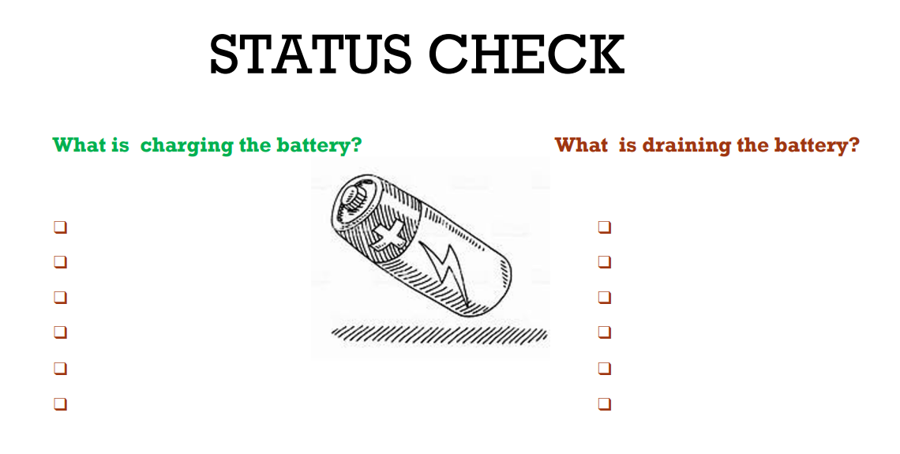
Introductions
Name
Work

Slide 6
Learning Objectives
Describe approaches for reducing stigma and normalizing the assessment and management of stress
Identify how to recognize stress injuries in health care professionals
Describe how to administer Stress First Aid (SFA) at the individual, unit, and organizational level
Describe strategies to maintain healthy stress and resilience

Slide 7
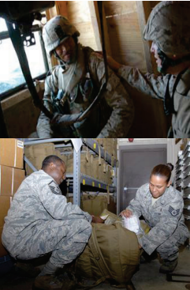
Background of Stress First Aid
Background
Stress First Aid was adapted from the Navy/Marine Corps
The Stress Continuum Model, the foundation of SFA, was developed as a visual tool for assessing an individual's stress response
SFA Model
The Stress First Aid (SFA) model is a self-care, leadership, and peer support model developed for those in high-risk occupations.
It includes seven actions that will help you to identify and address early signs of stress reactions in yourself and others in an ongoing way (not just after “critical incidents”).
NJ SFA Work
257 Trainers & 96 organizations (Acute, Community, Academia & LTC)
Expansion of the SFA Model to Enhance Resilience

Slide 8


Why SFA?
The Work of Nursing is Stressful
The Systems in Which Nurses Work
are Stressful
Occupational stress creates challenges and risks for individuals and teams
Occupational Stress Injury is a manageable risk—counteract with resilience, effective coping and healthy work environments

Slide 9
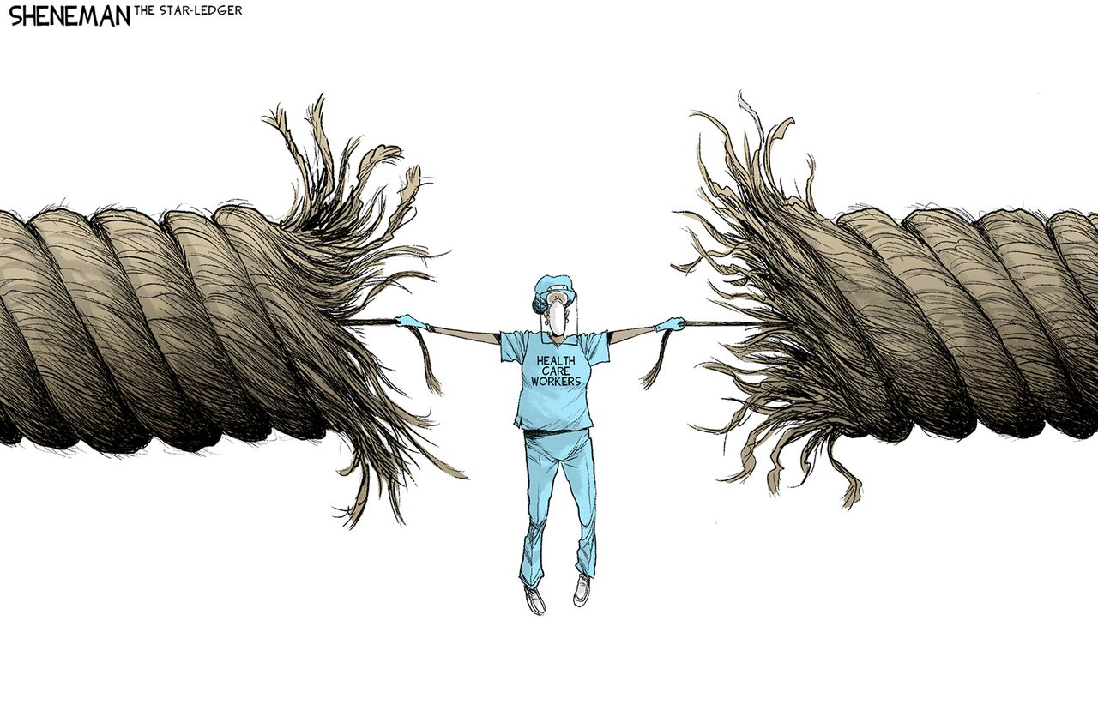
And Needed More Than Ever Before

Slide 10
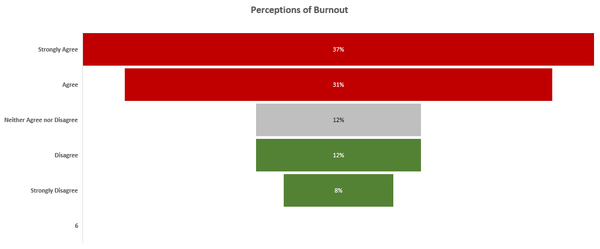
Share of registered nurses who feel burned out on most days in the United States in 2023
https://www.statista.com/statistics/1389778/nurses-feeling-burnout-united-states/

Slide 11

Running on Empty

Slide 12
How has the COVID-19 pandemic affected your commitment to nursing?

Slide 13
Nurses' mental health has not rebounded to its pre-pandemic levels
Trusted Health: Frontline Nurse Mental Health & Well-Being Survey. https://works.trustedhealth.com/research/2023-frontline-nurse-mental-health-well-being-survey

Slide 14
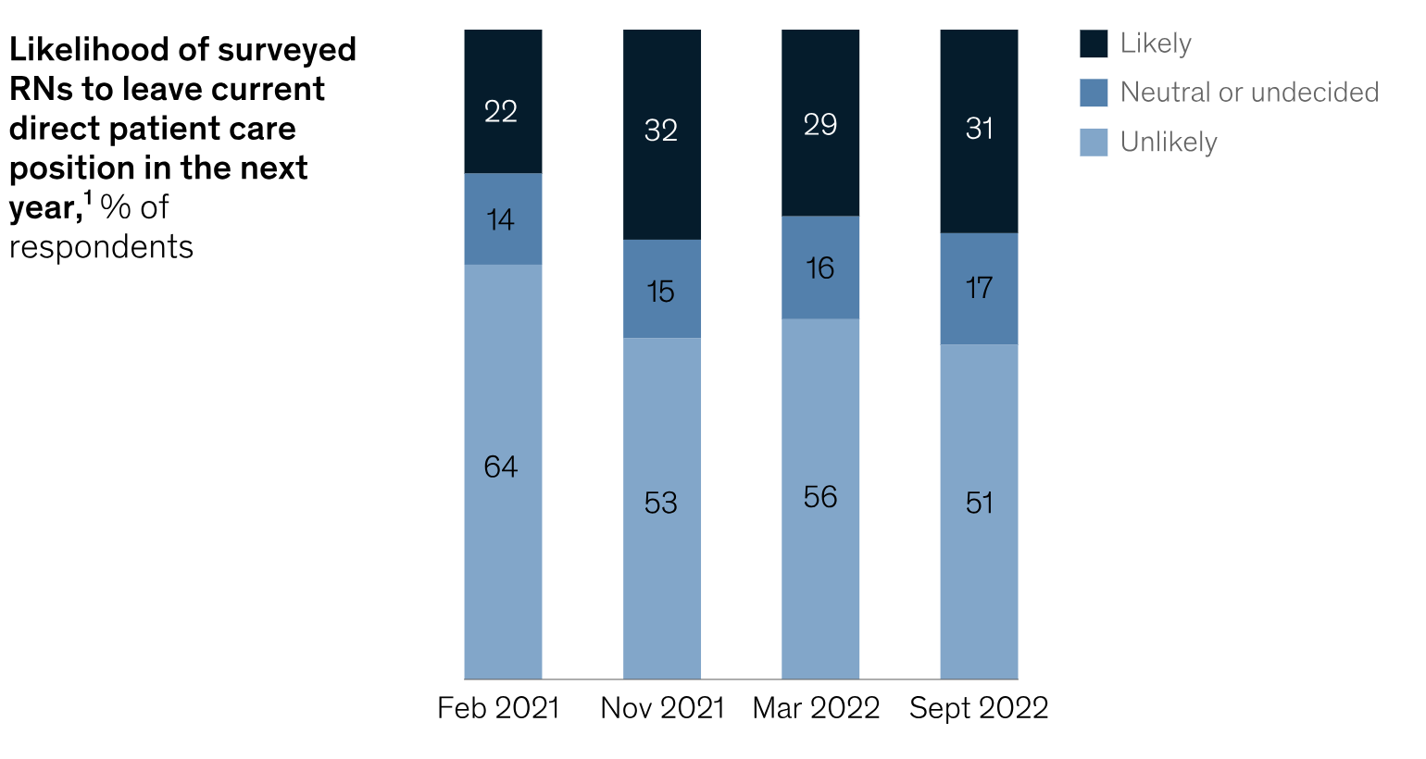
Likelihood to Leave Direct Patient Care
McKinsey and Company 2023 survey
https://www.mckinsey.com/industries/healthcare/our-insights/nursing-in-2023

Slide 15
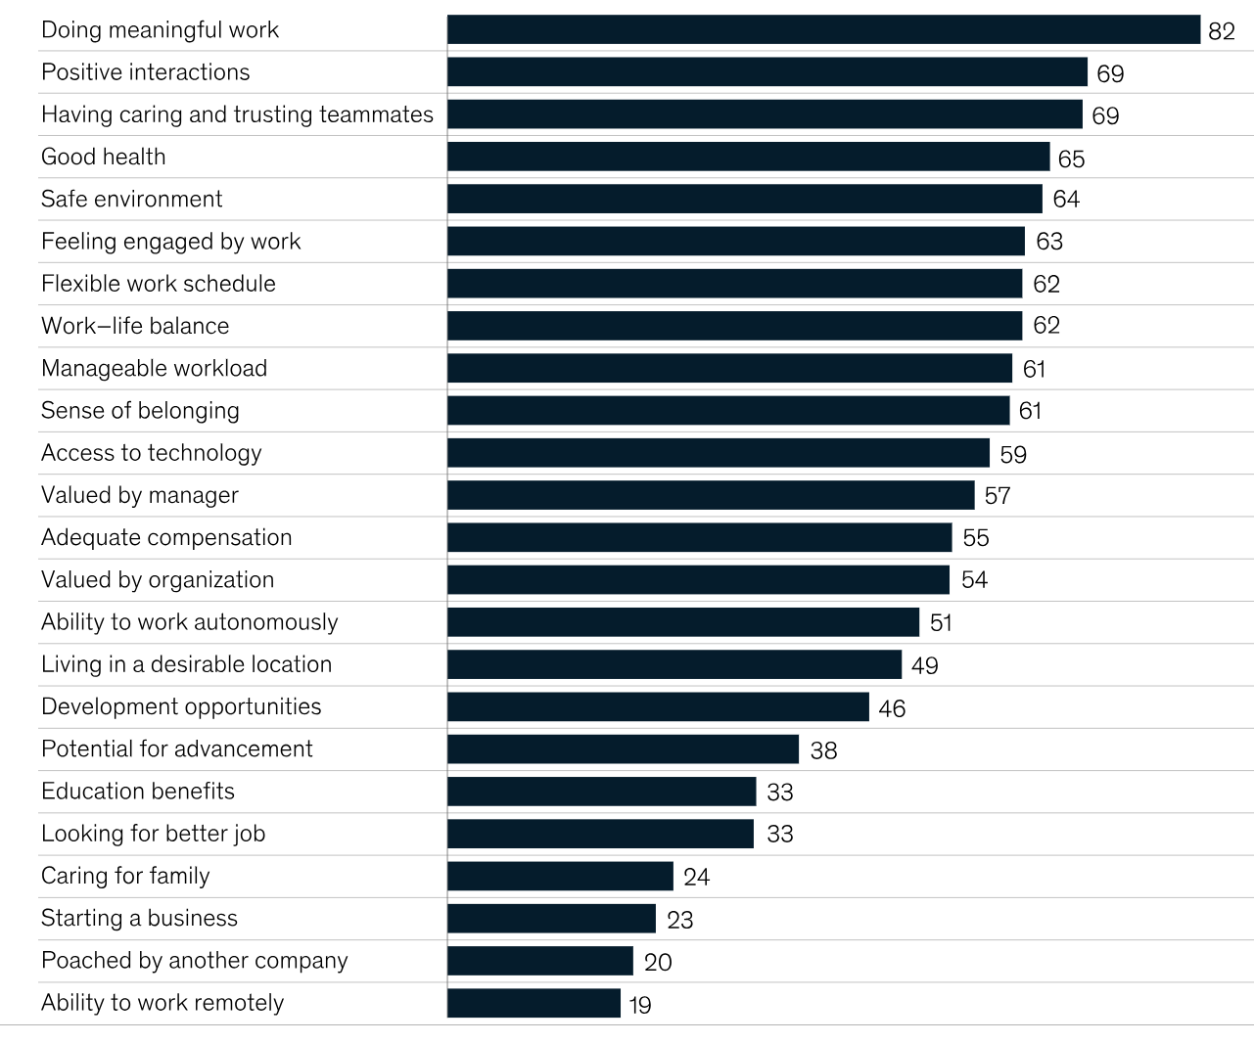
Top Factors in Likelihood to Stay

Slide 16
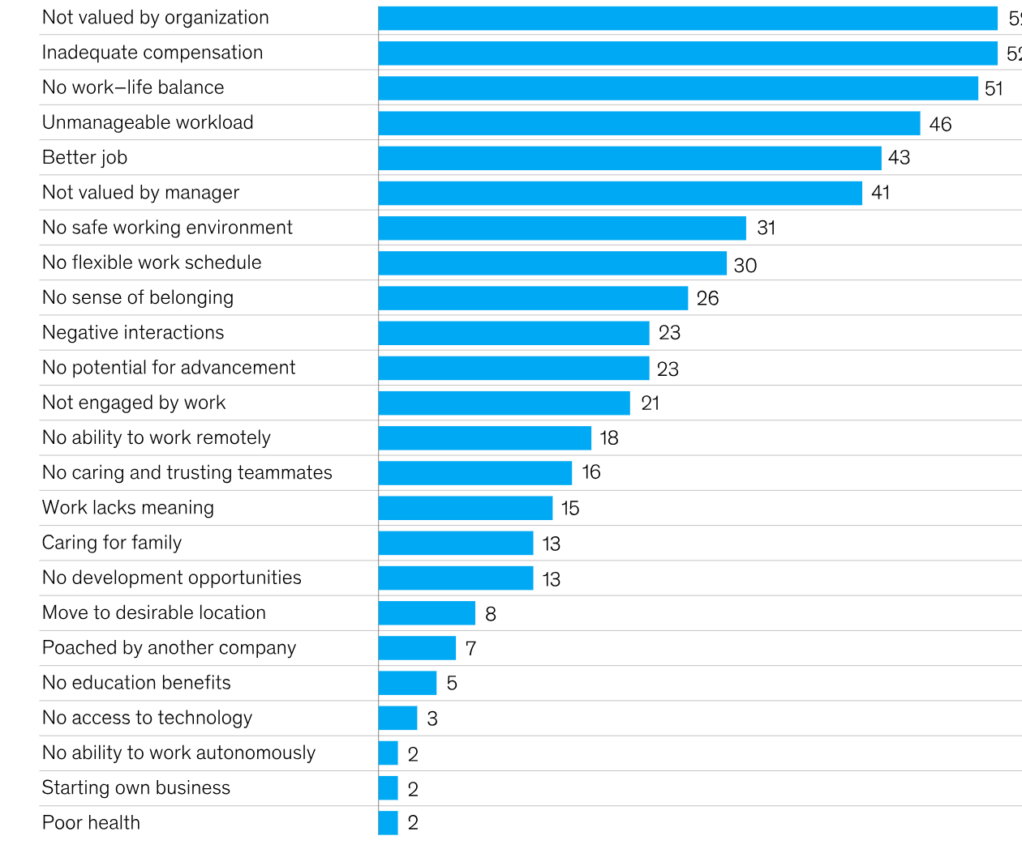
Top Reasons for Leaving

Slide 17
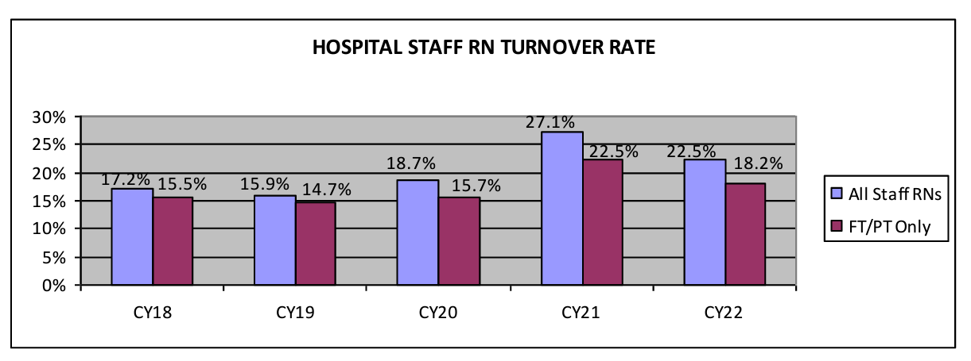
Turnover Rate:
2023 NSI National Health Care Retention & RN Staffing Report
file:///C:/Users/19734/Downloads/NSI_National_Health_Care_Retention_Report.pdf

Slide 18
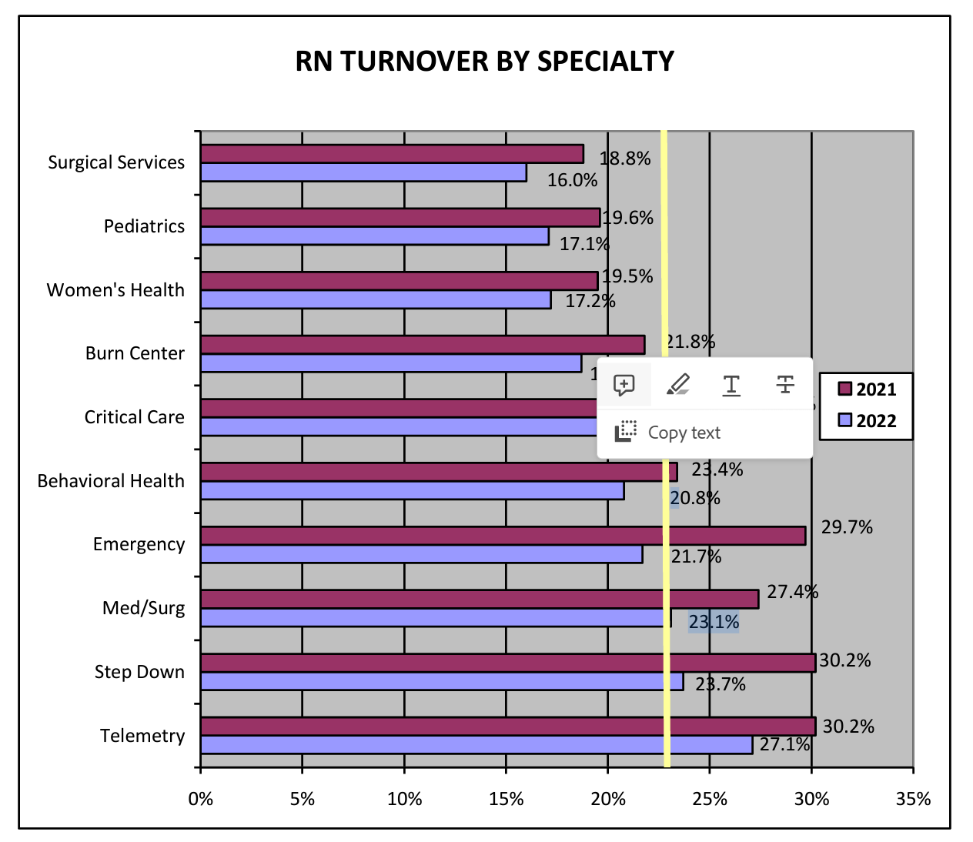
Turnover by Specialty:
2023 NSI National Health Care Retention & RN Staffing Report

Slide 19
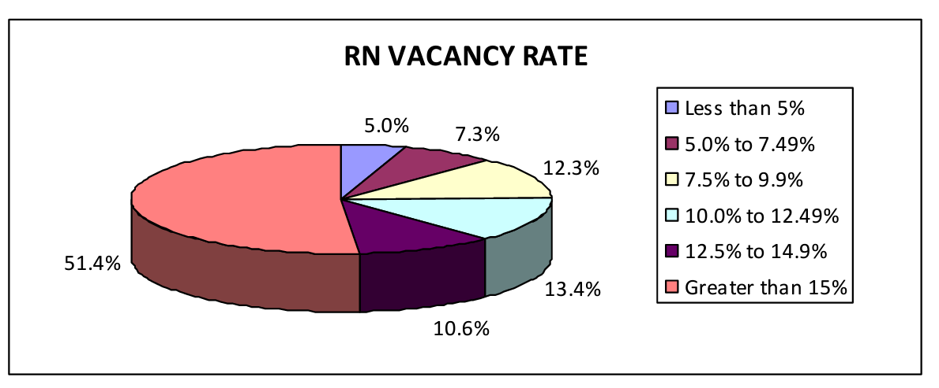
RN Vacancy Rates

Slide 20
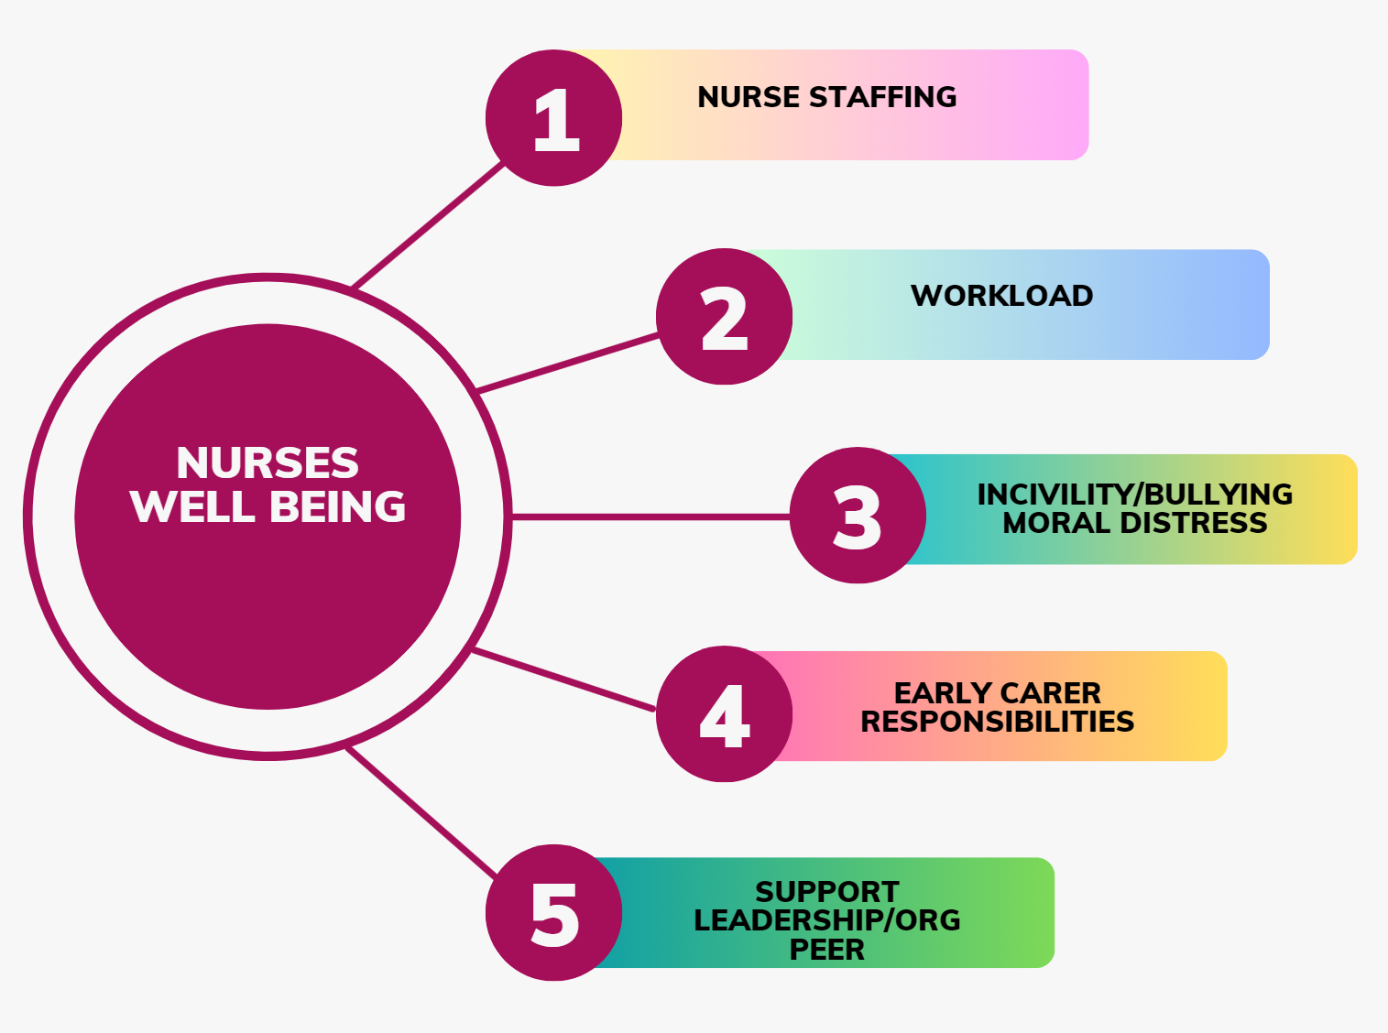
Factors Influencing Burnout & Mental Health

Slide 21


Underlying Issue to Burnout and Mental Health

Slide 22
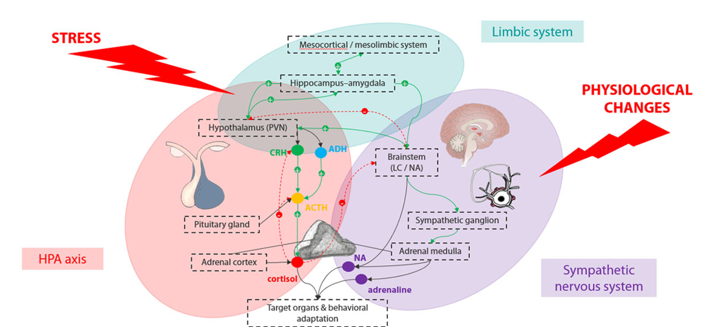
Impact of Stress from a Neurophysiologic Perspective
  Dampen the immune system
  Promote inflammation
  Promote heart disease
  Promote premature aging
  Promote diabetes
  Increase likelihood of mental illness
SAM axis
The Pharmaceutical Journal, PJ, July 2021, Vol 307, No 7951;307(7951)::DOI:10:1211/PJ.2021.1.95709

Slide 23


Promoting Resilience & Decreasing Stress
Mind-Body Skills

Slide 24

What is SFA?
Peer-Support & Self-Care Model
Stress First Aid is an evidence-based set of knowledge and skill tools to manage stress at an individual, unit and organizational level
A model to increase awareness of stress and stress injury in self and others
A model to destigmatize stress and emotional reactions to stress and encourage early response
The principles of SFA can be used in a preventive mode to build individual and unit resilience

Slide 25
Evidence Supporting Stress First Aid Model
Sense of Safety
Hope
Calming
Self Efficacy
Connect

Slide 26
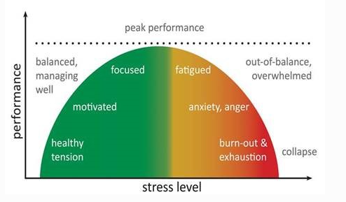
Stress and Contributors to Stress
View stress on a continuum
Stress can be positive
Stress is part of our everyday work environment
Sometimes we function better under stress
Our values, attitudes, and behaviors may add to or mitigate stress
But we must prevent stress injury

Slide 27
Double Edged Sword of Values and Ideals
Looking at Values which Could Lead to Stress in Nurses
Strength | Guiding Ideal | Vulnerability
Placing the welfare of others above one’s own welfare | Selflessness | Not seeking help for health problems because personal health is not a priority
Commitment to helping patients heal and supporting their families | Loyalty | Guilt and complicated bereavement after perceived failure or loss
Toughness and ability to endure hardships without complaint | Stoicism | Not aware of / acknowledging significant symptoms /suffering
Following an internal moral compass to choose “right” over “wrong” | Moral Code | Feeling frustrated and betrayed when others fail to follow a moral code
Becoming the best and most effective professional possible | Excellence | Feeling ashamed / denial or minimization of imperfections

Slide 28
Attitudinal Self Obstacles that Contribute to Stress
“It would be selfish to take a break from this work.”
“I’m okay, I’m fine, I’m not even tired.”
“The needs of those I’m supporting are more important than my own needs.”
“I’m not doing enough.”
“I can contribute the most by working all the time.”
“I don’t want anyone to know how affected I am.”
“Only I can do x, y, and z.”

Slide 29
Behavioral Self Obstacles that Contribute to Stress
Working too long by yourself without checking in
Keeping stress to oneself
Ignoring drops in functioning
Underestimating needs
Relying only on alcohol / substances to relax for extended periods of time
Becoming more disengaged / isolated
Overdoing without balance
Underdoing what is needed
Not seeking help / expertise

Slide 30

Stress Injury
Excessive stress can overwhelm compensatory systems and precipitate debilitating psychopathology
A STRESS INJURY is any severe and persistent distress or loss of ability to function caused by damage to the brain, mind, or spirit after exposure to overwhelming stressors
  50% of nurses in Trusted Health Survey reported extreme stress, trauma and/or PTSD
In this respect, the stressed brain is not unlike an exercised muscle: manageable doses can fortify the system, whereas an overload can cause permanent damage
STRESS INJURIES are invisible. You notice them in behaviors and words.

Slide 31
Enhancing Resilience
Individual, Unit, Organization
Prevent Getting to the Red
Positive Practices
Optimize the work environment
Recognize Stress & Reduce Injury
X

Slide 32
Promoting Resilience, Self
Balance Skills (universal):
  Finding shifts that fit lifestyle
  Consciously making time for meals, sleep and social activities
  Being able to set boundaries, able to ‘switch off’ after work
  ‘Professional shielding’
  Able to seek out social support
Varied Coping Strategies (individually tailored):
  Self-reflection through journaling, prayer, and faith
  Processing emotions
  Being able to accept that you cannot fix everything
  Being aware of the potential adversities
  Focusing on purpose and meaning
  Delegation of work
  Basic time management
Huey & Palaganas (2020)

Slide 33

Promoting Resilience, Peer Support
Most people experiencing significant stress will cope, but some will become ill
Those that do become ill often do not seek formal help
Peers have shared experiences which promotes understanding and connection
Peers can decrease stigma and normalize stress/vulnerability
Peers can give informal support to prevent more significant problems
They can also be a bridge to more formal treatment
There is evidence that early treatment for significant stress is effective

Slide 34

Key Component: Organizational Support
Healthcare Research: Organizational Factors
Related to Resilience
Related to Resilience
A genuine interest in the wellbeing of staff
Accessibility to support without being judged as ‘not coping’
Enhance peer support and social support
Safe discussions of events and sharing
Provide opportunities for peers to work collaboratively
Recognize the importance of boundaries between work
and home life
Greater autonomy over time and content of work
Regulated working hours and adequate staffing
Meaningful recognition
Huey & Palaganas (2020)

Slide 35
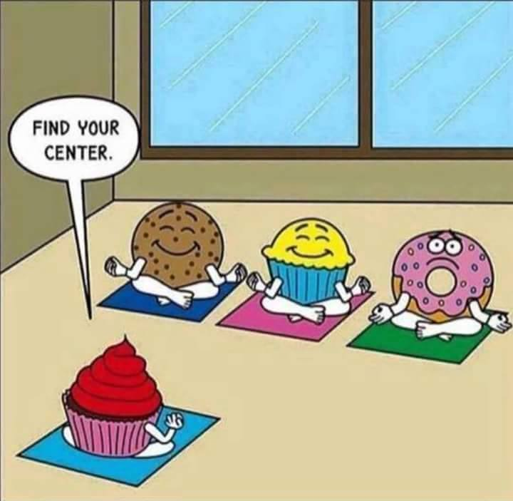
Why is it Hard to Implement Solutions
Stress
Burnout
Time Resources

Slide 36
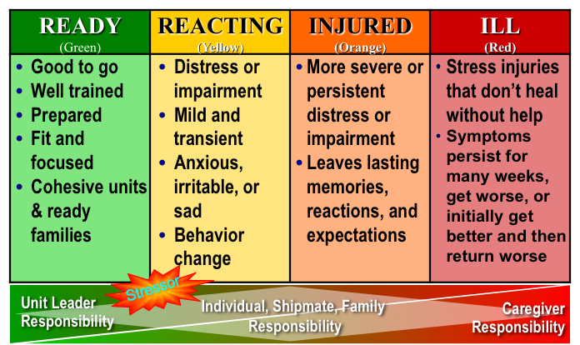
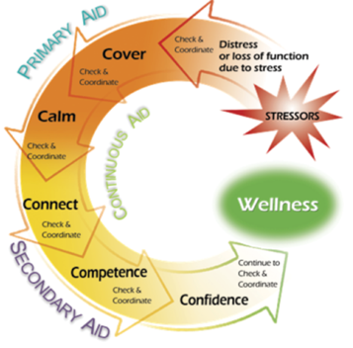
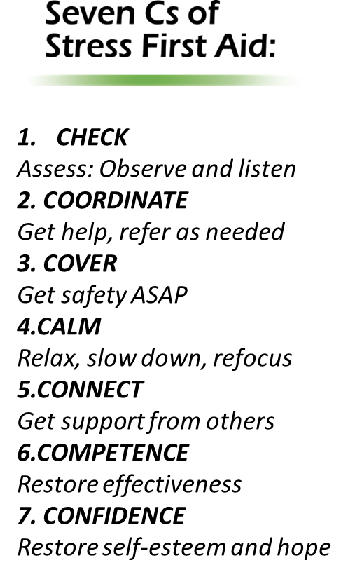
Major Concepts
Stress Continuum
Stress Injury
Stress First-Aid

Slide 37
Four Sources of Stress Injury
Intense or Prolonged Stress
Life Threat
Loss
Inner Conflict
Wear & Tear
A traumatic injury
Due to an experience of death-provoking terror, horror, or helplessness
A grief injury
Due to the loss of cherished people, things or parts of oneself
A moral injury
Due to behaviors or the witnessing of behaviors that violate moral values
A fatigue injury
Due to the accumulation of stress from all sources over time without sufficient rest and recovery

Slide 38
Four Causes of Stress Injury
Trauma
A traumatic injury
Loss
A grief injury
Inner Conflict
A moral injury
Wear and Tear
A fatigue injury
Due to the experience of or exposure to intense injury, horrific or gruesome experiences, or death.
Due to the loss of people, things or parts of oneself.
Due to behaviors or the witnessing of behaviors that violate moral values.
Due to the accumulation of stress from all sources over time without sufficient rest and recovery.

Slide 39
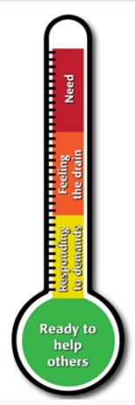
Stress Continuum/Thermometer
READY (Green) | REACTING (Yellow) | INJURED (Orange) | ILL (Red)
DEFINITION Optimal functioning Adaptive growth Wellness FEATURES At one’s best Well-trained and prepared In control Physically, mentally and spiritually fit Mission-focused Motivated Calm and steady Having fun Behaving ethically | DEFINITION Mild and transient distress or impairment Always goes away Low risk CAUSES Any stressor FEATURES Feeling irritable, anxious or down Loss of motivation Loss of focus Difficulty sleeping Muscle tension or other physical changes Not having fun | DEFINITION More severe and persistent distress or impairment Leaves a scar Higher risk CAUSES Life threat Loss Moral injury Wear and tear FEATURES Loss of control Panic, rage or depression No longer feeling like normal self Excessive guilt, shame or blame Misconduct | DEFINITION Clinical mental disorder Unhealed stress injury causing life impairment TYPES PTSD Depression Anxiety Substance use disorders FEATURES Symptoms persist and worsen over time Severe distress or social or occupational impairment

Slide 40
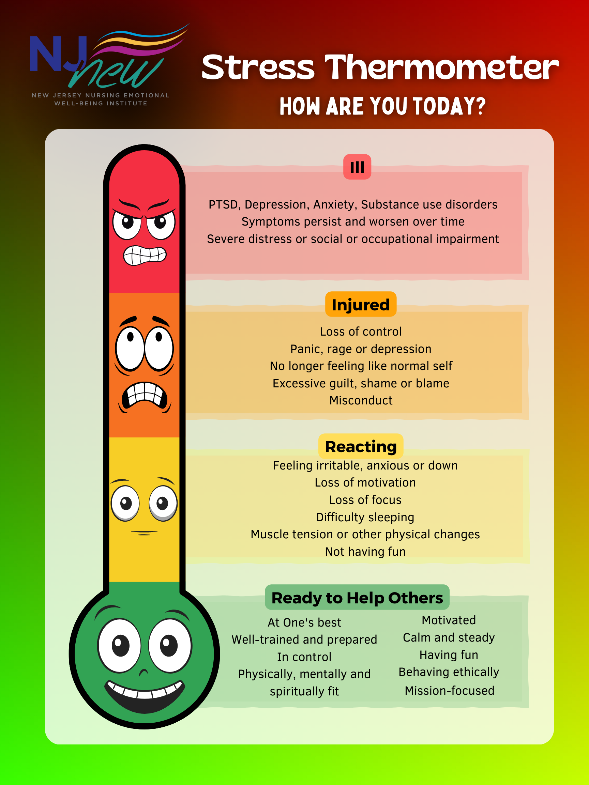
Poll Group Stress Level

Slide 41
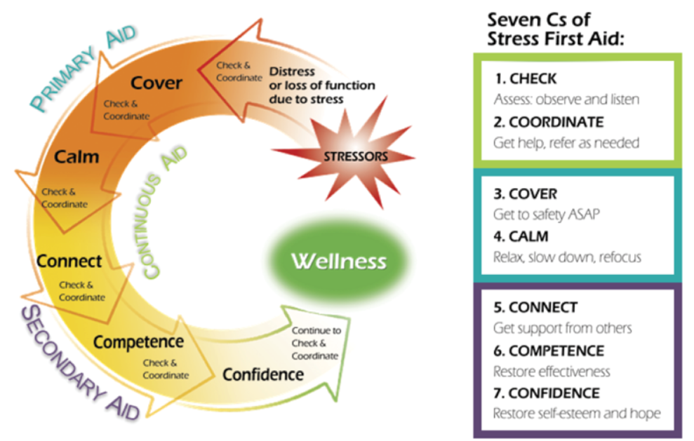
STRESS FIRST AID MODEL

Slide 42




Stress First Aid is NOT:
An event only intervention
A one-time only intervention
A replacement for medical or behavioral health interventions
A replacement for prevention efforts

Slide 43
Stress First Aid Core Principles
SFA fosters strong peer and leadership support
SFA is fluid, not one-size-fits all
SFA is both preventive and reactive
SFA bridges individuals to higher levels of care
SFA is an ongoing process best integrated into unit culture
SFA provides a common language to normalize discussion of stress

Slide 44
Stress First Aid Essentials
Recognize
Recognizing Stress levels as part of everyday assessment
Act
Know
Know at least 2 trusted resources you would offer to a stressed peer to make a connection or provide assistance
Monitor ongoing stress levels so you can notice changes
Be aware of signs of Stress injury
Integrate resilience strategies as part on-going practice
All adopt empathic stance
If you see something, say something

Slide 45

Group Discussion: SFA Model
What overall impressions do you have of the model?
To what extent do you think the people in your organization would agree that responsibility of managing stress includes unit peers and the organization?
To what extent is stress normalize within your organization?

Slide 46
Recognize Stress Zone Transitions:
Demand: Resource Balance
Green “Ready” | Yellow “Reacting” | Orange “Injured” | Red “Ill”
100%
35%
5%
Healthy
Well
Fit
Safe
Connected
Capable
Confident
Drained
Sore
Irritable
Anxious
Down
Routine Stressors
Cumulative stress without sufficient resources
Resilience
Hurt
Out of control
Symptomatic
Distressed
Dysfunctional
Clinically symptomatic
Impaired
Worsening
Disordered
?
Toxic Stressors
Recovery
Recovery

Slide 47
Stress Continuum Support Strategies
“Grow the Green”
Ready
Reacting
Injured
Ill
Intention
Awareness
Self-mastery
Fostering Positive Mindset
Compassion/ Empathy
Communication
Highlighting purpose and meaning of work
Being Present
Huddles
Active Problem Solving Strategies
Unit Mitigation Strategies
Peer Support
Stress Communication Skills
Stress Reduction Skills
Engage Additional Coping Resources
EAP Proactive & Interventional Resources
Peer Support
Leader Support
Mentoring
Self-care Coaching
Early Referrals
Encourage Time Management
Individualize Resources for Specific Injury Behaviors (i.e. EAP, emotional support)
Ethics Consults
Voluntary and Mandatory Referrals
EAP Support Programs
Treatment Resources

Slide 48


Slide 49





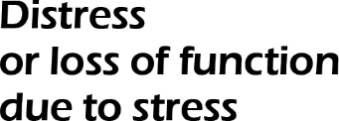


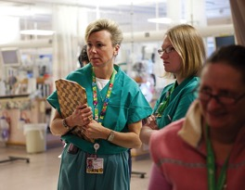



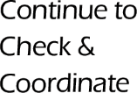

Stress First Aid Action: Check
CHECK
Assess: Observe and listen
2. COORDINATE
Get help, refer as needed
3. COVER
Get safety ASAP
4.CALM
Relax, slow down, refocus
5.CONNECT
Get support from others
6.COMPETENCE
Restore effectiveness
7. CONFIDENCE
Restore self-esteem and hope

Slide 50
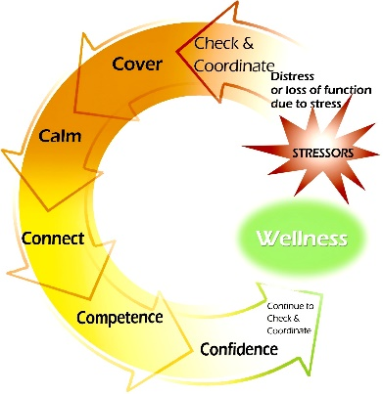
Check Actions
Observe
Look
Keep Track
Stressors
Examine
One-to-one interactions
Collateral information
Decide
Dangerousness
Listen
Distress
Changes in functioning
Response to SFA Actions
Stress zone
Needs

Slide 51

Check: Why is it Needed?
Those injured by stress may be the last to recognize it
Stigma can be an obstacle to asking for help
Stress zones and needs change over time
Risks from stress injuries may last a long time

Slide 52
Check: In the Green & Yellow
CHECK: Building Resilience, Growing the Green
CHECK: Proactively Manage Stress
Calm
Steady
Focus
Enjoying what you are doing
Having Fun
Productive
Getting anxious
Irritable
Not having fun
Hard to focus

Slide 53

Check: In the Orange or Red
CHECK: Stress Moving into an Urgent Zone
CHECK: In Danger Zone—Take Immediate Action
Becoming more isolated from others
Uncharacteristic behavior
Making mistakes
Compulsive behavior
Sleep changes or nightmares
Loss of focus, memory, or the ability to think rationally
Intense feelings – anxiety, depression
Inability to engage in or enjoy things you usually like
Feeling unusually numb or uncaring
Compulsive behavior
Wanting to avoid situations or reminders

Slide 54
How to “Check In”: OSCAR
Observe
Observe:
Actively observe behaviors; look for patterns that vary from baseline
State
State Observations:
State your observations of the behaviors; just the facts without interpretations or judgments
Clarify
Clarify Role:
State why you are concerned about the behavior to validate why you are addressing the issue
Ask
Ask why:
Seek clarification; try to understand the other person's perception of the behaviors
Respond
Respond:
Let person respond to your concerns and discuss potential next steps or plans

Slide 55
Check Skill: OSCAR Examples
Observe
Observe:
You notice your peer has been less and less talkative, and more isolated from others over the last few weeks
State
State Observation: “Hey Joe, I haven’t been seeing you around as much lately, and you seem to be really quiet the last few weeks.”
Clarify
Ask
Ask:
“Am I right in my guess that something might be going on with you?”
Respond
Respond:
Joe says yes, and you say, “Why don’t we go get some coffee so we can talk away from others. Does that sound okay to you?”
Clarify Role:
“I’m only bringing this up because I care about you and want to make sure that you’re okay.”

Slide 56


Self Check Actions
Give yourself permission to take care of yourself
Make a conscious effort to keep tabs on yourself
Become aware of personal red flags
Pay attention to red flags sooner rather than later
When red flags occur, take steps to mitigate them
Inform key family, friends, or peers about your personal red flags and make a plan as to what to do when they occur

Slide 57

Peer Check Actions
Build a foundation based on good relationships
Unit culture: values the importance of looking out for each other
Pay attention to social withdrawal and other changes in behavior, emotional tone, and diminished work performance—know each other’s red flags
Monitor/check regularly— “Check you, check two”
Check in more than once, especially on anniversaries, following difficult events, or when noticing signs of distress
Be approachable and authentic
Have a plan for how to approach concerns

Slide 58
Organization/Leader Check Actions
Creating a culture that encourages employees to receive support or to reach out to help will make it easier for employees to most effectively check in on one another.
  Well-being pillar, People First, Caring is Contagious
  Rounds inclusive of stress
  Shared governance: wellness, resilience, workplace violence
Be authentic and approachable
Monitor and Make Public Data
  Turnover Rate
  Absenteeism/Call Outs
  Engagement Surveys
Focused Assessments as needed

Slide 59
Stress First Aid Action: Coordinate
CHECK
Assess: Observe and listen
2. COORDINATE
Get help, refer as needed
3. COVER
Get safety ASAP
4.CALM
Relax, slow down, refocus
5.CONNECT
Get support from others
6.COMPETENCE
Restore effectiveness
7. CONFIDENCE
Restore self-esteem and hope

Slide 60
Coordinate Actions
Collaborate
To promote recovery
Inform
Supervisor(s)
Refer
Recommend resources
To ensure safety
To get more information
Peers
Family
Consultation
Direct hand-off

Slide 61

Coordinate: Why Needed?
If you have checked and don’t follow through, establish distrust
Need resources available following check and resources may not be clearly coordinated
To plan so check needs are followed through with:
  SMART coordinated goals

Slide 62
Coordinate: In the Green & Yellow
COORDINATE: Building Resilience, Growing the Green
COORDINATE: Proactively Manage Stress
Narrating actions that will be taken to manage the stressors
Debriefing
Plan a recheck
Asking for help
Uncertainty regarding stress level, dangerousness or level of impairment
No immediate need for coordination
Think proactively: what other approaches, services can build resiliency
Coordinate to advance prevention and resilience efforts– the goal is you are making it part of the culture…gratitude sharing, self-care coaching, mindfulness, proactive resourcing to prevent stress injury

Slide 63
Coordinate: In the Orange or Red
COORDINATE: Stress Moving into an Urgent Zone
COORDINATE: In Danger Zone—Take Immediate Action
Know resources available for referral
Poses a threat to self or others
OSCAR. Refer based on SMART goals
Trusted colleague, EAP, Family
Plan an ongoing check plan monitoring for mistakes, behavioral changes—worsening or improvement?
Mentorship plan
Urgent intervention
Escalation to leadership
Navigate and escort to resources

Slide 64


Example: Self-Check and Coordinate
Check Self: the day before her first of three 12 hour days in a row, Alisia noticed she was breathing fast and unable to focus on preparing herself for the upcoming days. She recognized that she was starting to feel anxious about her readiness for the upcoming workload.
Coordinate Self: Alisia considered whether resources were needed—why was she feeling that way? She chose to discuss this with her trusted mentor/colleague.

Slide 65
Example: Peer/Leader-Check and Coordinate
Check: A nursing unit suffered the loss of a long time pediatric cancer patient. During rounds on the unit you see the staff is visibly shaken and upset. Some of the team members are crying.
Coordinate Debriefing: After seeing team members upset after the recent loss of a long time cancer patient, the peer emotional support team is contacted to schedule a group talk therapy session. The meeting is held that day and many of the staff attend. The team members are given the numbers to the employee assistance program & the 24/7 team member support and navigation line.

Slide 66
Example: Leader Check and Coordinate
Check: “I try to get to know each of my staff individually, so I know their baselines and what could potentially be a red flag. I make a point to sit and talk with them during breaks and at other times when there is down time.”
Coordinate: That helped when one of my staff members had a pregnant wife, and we responded to a stillborn birth.
Recognizing that he may identify with the situation, after that call I took a little extra time to sit and talk with him, to make sure that he was okay.

Slide 67
Example: Leader/Organization Check and Coordinate
Check: We decided that with many changes occurring in our organization, we would try to check with all employees about their concerns and brainstorm possible ways to improve conditions in the organization. We asked about what’s needed, and staff’s biggest challenges, but also asked about what’s working. We communicated that although everything might not be able to be fixed or address, our goal was to work together as a team to creatively mitigate challenges
Coordinate: We had workshops, blogs, and an online platform to gather concerns and collect information on approaches to problems. We made sure that all employees were given different ways to give input and assigned a team to sort and make sense of that input in a way that respected all employee input.
We reported the aggregate and unit based findings back to staff and together prioritized challenges. Leadership worked to identify and develop resources responsive to needs.

Slide 68
Group Discussion: Check/ Coordinate
Is check part of your cultural now?
What are ways you have successfully integrated check?
What gets in the ways in checking?
What are some check strategies not mentioned?

Slide 70

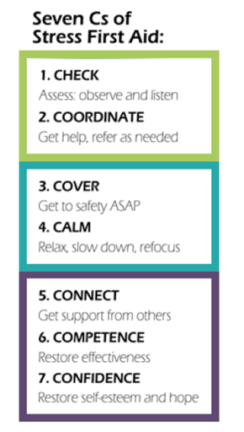


Primary Aid Strategies: Cover and Calm
Primary Aid

Slide 71
Stress First Aid Action: Cover
CHECK
Assess: Observe and listen
2. COORDINATE
Get help, refer as needed
3. COVER
Get safety ASAP
4.CALM
Relax, slow down, refocus
5.CONNECT
Get support from others
6.COMPETENCE
Restore effectiveness
7. CONFIDENCE
Restore self-esteem and hope

Slide 72
Cover Actions
Stand By
Ready to assist
Make / Others Safe
In charge presence
Encourage Perception of Safety
Caring presence
Watch and listen
Hold attention
Communicate safety concerns
Protect
Assist
Interventional Resources
Initiation Safety Resources
Listen and communicate
Reduce chaos
Reduce danger
Caring & nurturing presence

Slide 73
COVER: Why/When Needed?
Violence
Security precaution not working
Someone in a life-threatening situation is not thinking clearly or not making good decisions because of stress
Someone has frozen or panicked in an intense situation
Someone has threatened others
Someone expresses serious thoughts of suicide

Slide 74
COVER: In the Green & Yellow
COVER: Building Resilience, Growing the Green
COVER: Proactively Manage Stress
Proactively identify safety alert mechanisms– install and use
Know the exit strategies
De-escalation training
Educate about stress reactions, what to expect, how to feel safer
Shifting ways of thinking so culture values self-care
Seeking or providing information
Communicate concerns, request help, communicate with those who need to know
Prioritize, Problem solve with group
Set boundaries
Call on those people, places, or actions that feel safe to you
Distraction
Educate about stress reactions, what to expect, how to feel safer
Brief staff about changes in practice/strategies/resources/events

Slide 75
COVER: In the Orange or Red
COVER: Stress Moving into an Urgent Zone
COVER: In Danger Zone—Take Immediate Action
Activating safety alert
Urgent intervention
Shelter in place
Escalation to leadership and use of outside resources
Reduce anything that makes the person feel unsafe
Remind them that they are safe here and now
Provide an authoritative, accurate voice to limit perceived threat
Brief staff about changes in practice/strategies/resources/events
Navigate and escort to resources

Slide 76
Self Cover Actions
When you feel unsafe, distract yourself by focusing on something near you or your own breath or thought (e.g., counting).
Call on those people, places, or actions that feel safe to you
Get help with personal responsibilities
Actively seek information that can help you feel safer
Request help from peers or supervisors
Get an accurate understanding of risks in order to better plan
Get help with personal responsibilities
Self-monitor for stress reactions
Give yourself permission to take care of yourself and set boundaries for yourself
Say No if something is going to interfere with your priorities or health, Set boundaries
Tell yourself it is not your responsibility to……

Slide 77
Self Cover Actions
Avoid negaholics
Realize that no one is perfect, and everyone is going to have strengths and vulnerabilities – be aware of your own.
Tell your family about work-related situations that might occur
Educate your family/colleagues about potential red flags that you might demonstrate if you are overly stressed, so they know when to support you so they don’t take them personally
Talk with family/colleagues about the best ways you can keep each other safe
Practice more helpful ways of thinking to foster healthy changes in behaviors

Slide 78
Potential Ways of Thinking to Enhance Cover
Original Thought | More Helpful Thought
“It would be selfish to take a break from this work.” | “Taking an occasional break from this work will help me be more effective.”
“I’m okay, I’m fine, I’m not even tired.” | “Even though I feel fine I need to pace myself.”
“The needs of those I’m supporting are more important than my own needs.” | “I can better care for others if I also attend to my own needs.”
“I’m not doing enough.” | “I’m doing enough.”
“I can contribute the most by working all the time.” | “I can contribute the most by pacing myself.”
“I don’t want anyone to know how affected I am.” | “Letting someone know know how affected I am can help me.”
“Only I can do x, y, and z.” | “I can trust that others can fill in when it’s necessary.”

Slide 79
Peer/Leader Cover Actions
Stand by ready to assist. Know your colleagues; support one another through challenging or threatening situations
Cover one another for personal issues
  Become more aware of and supportive during times when there are significant issues at home, in order to provide a safety net
  Check in and reduce high-risk behavior
Reduce anything that makes the person feel unsafe
Get an accurate understanding of specific risks in order to better plan and guide others
Reassure that they are safe in the moment
Educate the person about how to be or feel safer

Slide 80
Peer/Leader Cover Actions
Make others safe
Check in via text, offer time to chat
Gather as a group if patient is aggressive or violent
Focus the person on what to do rather than what not to do
Work to make situations safer by focusing on lessons learned, preparing and training personnel, and reducing threatening situations
Slowly implement SFA actions into the organization so it is normal to check in and discuss things well in advance of anything happening

Slide 81
Organizational/Leadership Cover Actions
Debrief, (huddle) give people chance to review after incidents (lessons learned approach)
  What could have been done differently
  What do you need?
  Ask each person individually
  Call and say sorry after incident
  Can’t always promise safety and that it won’t happen again
  Need to be careful because sometimes nothing could’ve been done better
Work to make situations safer
  Learn which situations feel unsafe to employees and work to improve their safety
  Have peers work in partnership
  Train personnel on situational awareness
  Give briefings before workers are involved in potentially unsafe situations
  Reduce anxiety by taking a team approach to difficult cases

Slide 82
Organizational/Leadership Cover Actions
Improve boundaries
  Mentor individuals who feel overwhelmed or overworked because of their trouble setting work boundaries
  Give time off for those needing a break
  Be more abrupt or directive if it is necessary to keep a staff member safe
  Be a good role model for setting boundaries for yourself or your peers
  Give permission and guidance about how to set boundaries and limits
  Allow people to go home if needed
  Find out what boundaries work best for staff
  Help workers make decisions at times when they may not make the best decisions for themselves
  Show vulnerability yourself
  Help people problem-solve solutions to situations in which they don’t feel safe

Slide 83

Cover Example: Self and Peer Support
When a nurse is overwhelmed after an exceptionally busy shift many leaders and experienced nurses will remind the nurse that "healthcare is a 24 hour business for a reason, if there are things that can't get done during one shift will be addressed by the oncoming shift"
Notes:
83

Slide 84

Cover Example: Leader
At the beginning of the shift, we realized that we were short a nurse and had two patients that might switch to 1:1s because of complexity. We did up the assignment and got to work. The supervisor was present almost every hour—she was willing to stand by and take action if it was needed. This is providing cover and support. Knowing she was there and willing to help even though we didn’t need her intervention was really comforting.

Slide 85
Group Discussion: Cover
What are some ways that you have seen that cover might be needed in your work?
What are some ways that you find cover for yourself?
What are some ways that you have offered or been offered cover?

Slide 86
Cover Scenario
A respected member of your staff has had a hard couple of years. He had an injury, financial problems, and lost a close friend to a motor vehicle accident. Recently, he separated from his spouse and had to move out of the family home.
He has been drinking a lot and often appears to be under the influence of alcohol when not at work.
He is distracted and expresses a sense of hopelessness that things will improve.
Today, he arrives to work late.
When you begin to talk with him about your observations he says, “what difference does it make? Nothing really matters anyway. It doesn’t matter if I’m here or not.”
What kind of stress injury may be present?
What SFA action(s) would you use?
What is your plan for approaching the situation?
What other information would you want to know?
Outline the exact words/sentences you would use.

Slide 87



Stress First Aid Action: Calm
CHECK
Assess: Observe and listen
2. COORDINATE
Get help, refer as needed
3. COVER
Get safety ASAP
4.CALM
Relax, slow down, refocus
5.CONNECT
Get support from others
6.COMPETENCE
Restore effectiveness
7. CONFIDENCE
Restore self-esteem and hope

Slide 88
Calm Actions
Quiet
Stop physical exertion
Compose
Draw attention outwards
Recover
Recuperate
Soothe
Reduce hyper-alertness
Slow down heart rate
Relax
Distract
Re-focus
Grounding /Reappraisal/ Centering Techniques
Sleep
Time out
Breathing techniques
Setting intentions
Gratitude
Exercise
Virtual Schwartz Rounds
Listen empathically
Reduce emotional intensity
Aroma therapy
Guide mediation

Slide 89
Examples of a Need for Calm
Someone returning from responding to a particularly violent domestic violence case is talking too fast and not reacting appropriately to commands or questions.
Someone is pacing and wringing their hands while on duty. They just heard that their son, an Army sergeant deployed overseas, has been seriously injured.
Alcohol is the only thing a person feels they can turn to calm themselves.
Someone is upset because one of his team took their own life.
Someone punches their locker after just returning from responding to a baby who is in a coma after being shaken by a parent.
An experienced worker begins to make careless mistakes and notices his adrenaline increase when several others gather to watch him perform an action.
Never in the history of calming down has anyone ever calmed down by being told to calm down

Slide 90
CALM: In the Green & Yellow
CALM: Building Resilience, Growing the Green
CALM: Proactively Manage Stress
Implement policies and interventions to promote destressing behaviors
Promote coping and problem solving abilities
Focus on gratitude
Teach and role model about stress responses, coping, and relaxation strategies
Promote self care strategies
Take a break from stressful situations for a short time. Mandatory breaks/lunch
Taking actions to reduce stress reactions
Prioritize simple strategies to calm down: Breathing, mindfulness, Reflection, Prayer, Meditation. Make sure staff is aware of these self-calming strategies
Acknowledge possible stressors and the potential need for support in a matter of fact ahead of difficult events
Reduce gossip and negativity
Reframing
VSR type of rounds
Provide perspective by presenting the situation from an alternative vantage point

Slide 91
CALM: In the Orange or Red
CALM: Stress Moving into an Urgent Zone
CALM: In Danger Zone—Take Immediate Action
Reassure by authority and presence
Facilitate a break from the situation
Guide the person through relaxation technique i.e. box breathing, visualization, etc.
Do not leave person alone
Escalation to leadership and use of outside resources
Navigate and escort to resources
Show understanding
Ask for help to empower and distract the person
Get stressed person to look at you, then be very specific and detailed about what you want them to do
Use the person's name and communicate exactly what is needed din a calm, methodical voice
Find ways to make meaning and memorialize together after losses
Insist on a break
Connect with emotional support resources

Slide 92

Calm Self Actions
Focus on
Whatever helps you to keep focused on the present moment
Taking actions to reduce stress reactions
Acceptance
Gratitude
What you can control
Changing beliefs that don’t serve you
When or how pain temporarily eases
Prioritize simple strategies to calm down
Physical activity
Breathing more slowly, evenly
Meditation, mindfulness
Spend time with family and close friends (social support)
Listen to music, read, take a walk
Humor

Slide 93

STOP Technique
Stop: pause for a moment
Take a Breath: to calm
Observe: what am I feeling
What are my goals?
What are my choices?
Proceed with awareness
“Between stimulus and response there is a space” Viktor Frankl

Slide 94

Calm Peer/Leader Actions
Immediate Calm:
Ask for help to empower and distract the other person
Long Term Calm:
Emphasize the importance of personalized self-calming strategies
If the person can’t focus or make good decisions, calmly use their name and say exactly what is needed
Check in on each other regularly
Make every effort not to call attention to someone’s stress
Use light humor, positive reinforcement, validation of feelings
Talk to each other, vent, listen with empathy, have daily huddles
Set clear goals for each other, problem solve, provide alternative solutions
Encourage mindfulness, breaks
Acknowledge future stressors and possible need for support in a matter-of-fact way
STOP technique
Ask the person for help with something unrelated, to empower and distract them

Slide 95

Calm Organization Strategies
Lavender rooms
Resilience Carts
Flex Staffing
Additional support staff
After Actions Response
Stress Management programs
Wellness/Resilience Committees
Peer Support Programs

Slide 96
Calm Actions for Aggressive Behavior
Distract:
  Suggest taking a break
  Let them know you will be there when they return
  Ask them for help with something
Defuse:
  Suggest looking at the situation in a different way or from another’s viewpoint
  Suggest talking to a friend or loved one
Distance:
  Separate those who are angry at each other, or keep them otherwise engaged
Deter:
  Ask for assistance if you feel uncomfortable or threatened

Slide 97
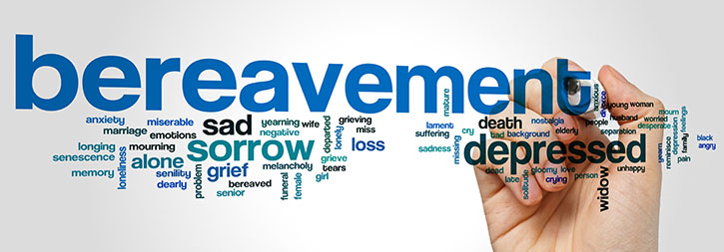
Calm Actions for Bereaved Peers
If you don’t know what to say, just stay present and listen; Let the person know you’re there for them
Don’t try to make a grieving person feel better, just be there to support them
If they want to talk about the loss, listen and provide support
Offer a menu of options for support
Be genuine and reliable
Be sensitive to unique factors that affect them
Check in over the next few months

Slide 98
Making Friends With Uncertainty
Learn your own ‘uncertainty feeling’
Experiment with uncertainty (change a routine or experiment with something new).
Begin to find ways to distinguish ‘uncertain’ from ‘unsafe’.
Make changes to behaviors in ‘low stakes’ life areas to show that uncertainty can be safe (e.g. taking a new route to walk the dog).
Make changes to more resource-intensive uncertainty areas to increase ability to engage with ‘safe uncertainty’ (e.g. go on a day trip to somewhere totally new).
Experiment with behaviors linked to your area of concern
  Find routines that are feasible in the new context.
  Give help when you can and accept help when needed.
Mofrad, Tiplady, Payne, & Freeston

Slide 99
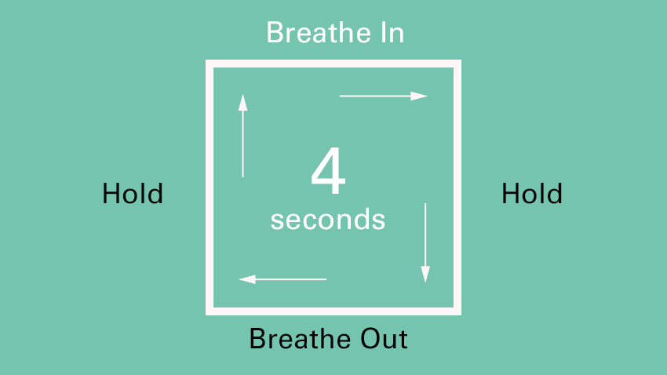
Examples of Techniques
Box Breathing

Slide 100
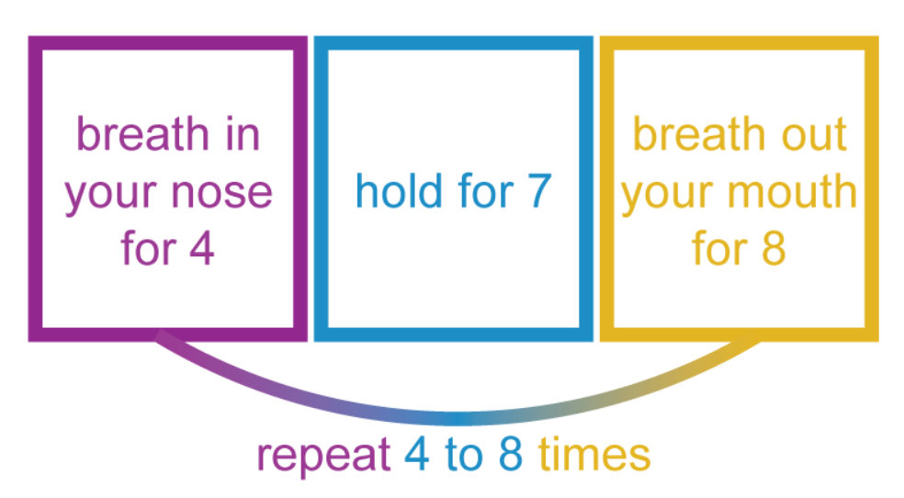
Examples of Techniques
4-7-8 Breathing
STEPS
Close your mouth and inhale quietly through your nose to a mental count of four.
Hold your breath for a count of seven.
Exhale completely through your mouth, making a whoosh sound to a count of eight.
Now inhale again and repeat the cycle three more times for a total of four breaths.
WHY?
Changing our breathing helps to reset (down regulate) the fight, flight, or freeze response
Improves ability to make critical decisions during periods of high stress
Can create "muscle memory" to reduce the physical demands of the stress response

Slide 101

Examples of Techniques
Visualization Exercise (Body Scan / Autogenic Training)
Progressive Muscle Relaxation
Mindfulness Meditation
Guided Imagery
Yoga
Repetitive Prayer

Slide 102

Calm Examples: Self
“What helps calm me is breaking down responsibilities into manageable pieces, making lists and being organized.”’
“To reduce stress in myself at work, I try to refocus and take a deep breath. I remind myself that I am only one person and I am doing the best job that I can possibly do. I also try to step off the unit when there is adequate coverage just take get fresh air and regroup.”

Slide 103

Calm Example: Peer /Leader Support
“If something is going wrong on a unit, someone will say “orange huddle.” That means, “everyone take a breath, we’re coming together. It’s not blaming or shaming, there’s an issue, we feel it, someone saw it, something is happening, it’s tense. Let’s all take a breath, this is the shift from hell, we’ll make it through.”

Slide 104
Group Discussion: Calm
What are some examples of how calm might be needed in your work?
What are some ways that you find calm for yourself?
What are some ways that you have offered or been offered calming actions?

Slide 105
CALM SCENARIO
A nurse who you know has been having marital issues has trouble with entering data into an electronic record and throws a stack of papers on the floor and runs to the bathroom.
What kind of stress injury may be present?
What SFA action(s) would you use?
What is your plan for approaching the situation?
What other information would you want to know?
Outline the exact words/sentences you would use.

Slide 106

DAY 1 Summary
Understanding Stress
SFA Model / 1-4 C’s
Self, Peer & Organization Strategies

Slide 107
Next Steps
Implementation Guide Overview & Expectations
Awareness Brief Assignment
  Schedule a time to Present Awareness Brief
  Select a Small Group (3-8 participants-unit, peers, council, or committee)
  Handout to share with participants
  After the Awareness Session, Complete the Feedback Form, via link by
  March 4, 2024.
Day III Session
Discuss/Share: Awareness Brief Presentation Experience & Implementation/ Next Steps

Slide 108

Final Questions / Comments

