Slide 1

Stress First Aid Train the Trainer
March 7, 2024
CE Certified Live Activity
Provided by:
Rutgers, The State University of New Jersey, School of Nursing, Center for Professional Development
Activity Overview and Description
SFA is a set of supportive and practical actions to assist nurses experiencing stress. SFA helps team members identify and address early signs of stress reactions in themselves and others in an ongoing way (not just after “critical incidents”). During the three sessions via zoom participants will learn the SFA model, training techniques and implementation strategies as a Trainer lens.
Learning Objectives: Upon completion of this activity, participants will be better able to:
Describe approaches for reducing stigma and normalizing the assessment and management of stress
Identify how to recognize stress injuries in health care professionals
Describe how to administer Stress First Aid (SFA) at the individual, unit, and organizational level
Describe strategies to maintain healthy stress and resilience
Target Audience
This activity is designed for professional Registered Nurses.
Accreditation
In support of improving patient care, this activity has been planned and implemented by Rutgers Biomedical and Health Sciences and NJ-NEW.
Rutgers Biomedical and Health Sciences is jointly accredited by the Accreditation Council for Continuing Medical Education (ACCME), the Accreditation Council for Pharmacy Education (ACPE), and the American Nurses Credentialing Center (ANCC), to provide continuing education for the healthcare team.
Nurses
This activity is awarded 12 contact hours.

Slide 2
Stress First Aid Train the Trainer
March 7, 2024
Method of Participation
In order to meet the learning objectives and receive continuing education credits, participants are expected to attend 100% of the program, and complete an online evaluation form at the conclusion of the activity. A letter certifying attendance and credit verification will be emailed to participants upon completion of the online evaluation survey.
Activity Director -Susan Salmond, EdD, RN, ANEF, FAAN Planning Committee -Edna Cadmus, PhD, RN, NEA-BC, FAAN & Jennifer Polakowski, MPA
Guest Faculty
Susan Salmond, EdD, RN, ANEF, FAAN
Disclosure Declarations
In accordance with the disclosure policies of RBHS and to conform with Joint Accreditation requirements and FDA guidelines, individuals in a position to control the content of this educational activity are required to disclose to the activity participants: 1) the existence of any relevant financial relationship with any entity producing, marketing, re-selling, or distributing health care goods or services consumed by, or used on, patients, with the exemption of non-profit or government organizations and non-health care related companies, within the past 12 months; and 2) the identification of a commercial product/device that is unlabeled for use or an investigational use of a product/device not yet approved.
Faculty Financial Disclosures
The following faculty have no relevant financial relations to disclose:
  Susan Salmond, EdD, RN, ANEF, FAAN
  Shannon Patel, DNP, APN-C, NEA-BC, CPHQ
The following faculty have relevant financial relations to disclose: N/A
CE Content Peer Reviewers
In order to help ensure content objectivity, independence, and fair balance, and to ensure that the content is aligned with the interest of the public, CPD has resolved all potential and
real conflicts of interest through content review by non-conflicted, qualified reviewers. This activity was peer-reviewed for relevance, accuracy of content, and balance of presentation
by: Jeannette Manchester, DNP, MBA,RN, who has no financial relevant relationships to disclose.

Slide 3
Stress First Aid Train the Trainer
March 7 2024
Rutgers Biomedical and Health Sciences Center for Professional Development
Jeannette Manchester, DNP, MBA, RN, Assistant Professor, Assistant Dean, Center for Professional Development, Rutgers, the State University of New Jersey School of Nursing. Mariely Rosario, BS, Program Assistant, Center for Professional Development Rutgers, the State University of New Jersey School of Nursing.
Off-Label/Investigational Use
This activity does not contain information on commercial products/devices that are unlabeled for use or investigational uses of products not yet approved.
Disclaimer
The views expressed in this activity are those of the faculty. It should not be inferred or assumed that they are expressing the views of any manufacturer of pharmaceuticals and/or medical devices or Rutgers.
It should be noted that the recommendations made herein with regard to the use of therapeutic agents, varying disease states, and assessments of risk, are based upon a combination of clinical trials, current guidelines, and the clinical practice experience of the participating presenters. The drug selection and dosage information presented in this activity are believed to be accurate. However, participants are urged to consult all available data on products or procedures before using them in clinical practice. Rutgers reserves the right to modify the program contents and faculty if necessary.
Questions
For questions or concerns regarding nursing contact hours for this activity, please call the Center for Professional Development at 973-972-6655 or email cpdn@rutgers.edu
INSTRUCTIONS FOR EVALUATION AND
CE CERTIFICATES AND ATTENDANCE LETTERS
Following the program, please take a few moments to complete the online evaluation survey that will be provided in the zoom chat and emailed. Completion will assist us in
assessing the effectiveness of this activity and to make recommendations for future educational offerings. Your response will help ensure that future programs are informative
and meet the educational needs of all participants. All surveys must be completed 4 weeks after the course.
In order to obtain a CE certificate/attendance letter for this activity, you must complete the online evaluation survey after the activity has concluded.

Slide 4
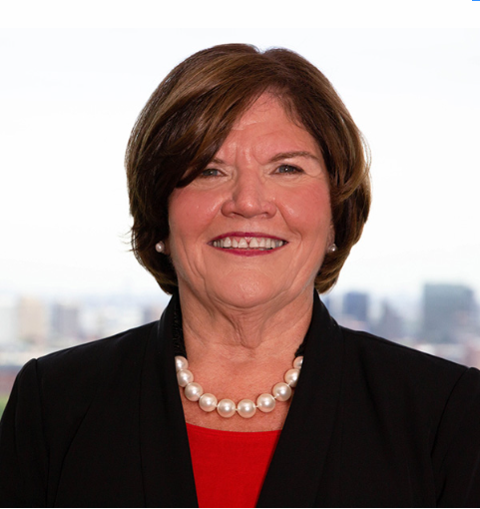
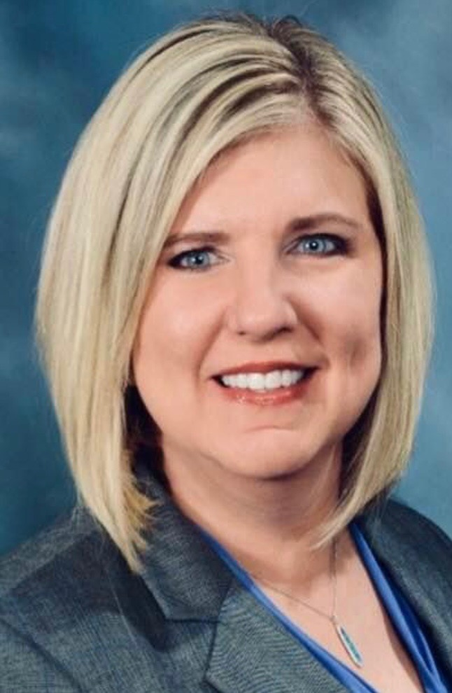


Stress First Aid Train the Trainer
Session III – March 7, 2024
Presenters
Susan Salmond
EdD, RN, ANEF, FAAN
Jennifer Polakowski
MPA
Shannon Patel
DNP, APN-C, NEA-BC, CPHQ

Slide 5

Welcome / Brief Overview

Slide 6
Breakout Groups Session I
Group I / Facilitator – Sue
Group II / Facilitator – Shannon

Slide 7
Breakout Group Questions
How comfortable were you presenting the material?
What other resources do you need to increase comfort?
What was the general feedback from the participants and their interest in learning more?

Slide 8

Facilitator Summaries

Slide 9


Slide 10
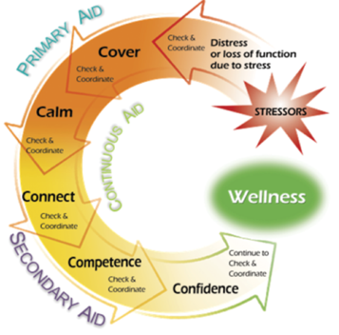
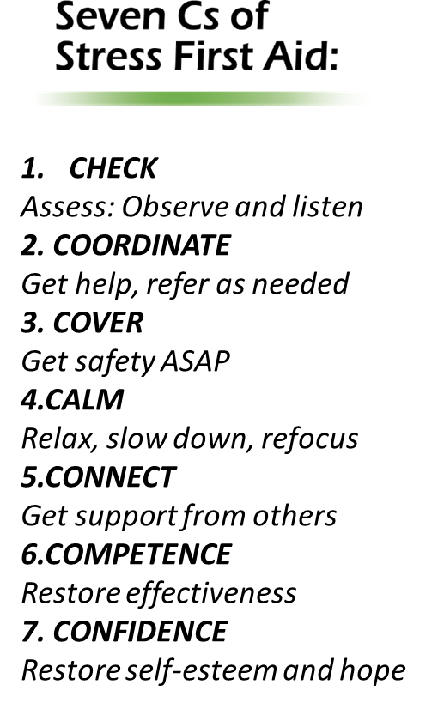
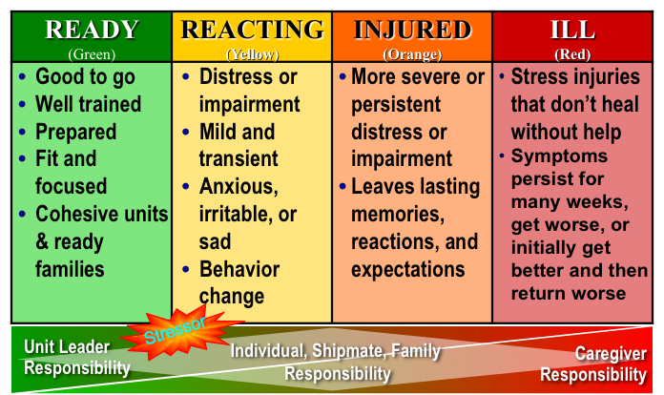
Implementation Strategies

Slide 11
Learning Objectives
Articulate the importance of SFA to obtain organizational/unit buy-in
Create a plan for implementing SFA with the workplace
Propose process and outcome metrics to evaluate SFA

Slide 12
SFA Implementation: Expected Goals & Outcomes
GOALS
Improved peer and leader abilities to recognize stress reactions and injuries using the stress continuum model
Enhanced peer and leader ability to tailor continuous, primary, and secondary aid approaches to individual and unit needs
Enhanced individual and team ability to have conversations about work stressors
Compassionate and restorative support demonstrated by leaders and peers to stress challenges
OUTCOMES
Increased resilience (individual and unit)
Increased well-being
Enhanced work environments
Enhanced team culture that improves engagement, retention and meaningful work

Slide 13
SFA Focus
Enhance individual resilience and interpersonal communication
Identify and reduce unnecessary stressors
Recognize caregiver stress and know how to respond
Improve individual and team well-being

Slide 14
SFA Activities
SFA Approaches
Assessment
Self Check
Resources
Stress Checks
Enhance Resilience
Positive Practices Workshops
Intervention
Comm. Skills
SFA
7 Cs
Team Development
Department/ Unit/team Level Interventions
1:1 Coaching

Slide 15
Assessment
Assessment
Self Check
Resources
Stress Checks

Slide 16
Take Action on Assessment
Enhance Resilience
Intervention
Positive Practices Workshops
Comm. Skills
SFA 7 Cs
Team Development
Department/ Unit/team Level Interventions
1:1 Coaching

Slide 17
Making the Case for SFA
Step 1: Know the resiliency resources in your organization and their
effectiveness
Step 2: Explore how SFA can be used as another resource and how it can
be integrated with other programs
Step 3: Articulate the need for SFA in your organization to key
stakeholders
Step 4: Read SFA resources, Become comfortable with the material

Slide 18
SFA Team Leaders
Two leaders to coordinate the roll out of SFA in the organization (training and implementation)
  Professional Background
  Awareness of organizational/unit stressors
  Passionate about SFA as an approach
  Team Leader Attributes
  Team Leader Roll Out Plan
  Protected Time

Slide 19
SFA Leadership/Advisory Team
Recognizes Emotional Well-Being as a Pillar
Guides the rollout and support of the program within the organization
Participants
  Influential
  Across Disciplines
Roles
  Build enthusiasm
  Plan rollout strategy (have a written plan)
  Elevator speech and communication plan
  Collaborate with other well-being programs/resources
  Decide on evaluation metrics
  Oversee implementation and evaluation plan
  Creating a central online repository of SFA materials
Requirements
  Participate in 90-minute training provided by Team Leaders
  Monthly meetings and then quarterly

Slide 20
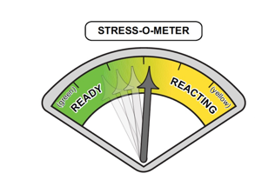
Organizational Roll Out: Baseline Metrics
Existing Data Sources
  Turnover Rate
    Stress Turnover/Growth Turnover
    3 times the annual salary (+ fringe) to replace one nurse
  Absenteeism/Call outs
    Consider costs related to travelers, shift incentives, burnout burden
  Engagement Surveys
    Sufficient unit staffing
    Few sleep disturbances related to work
    Staff satisfaction
    Intent to stay with the organization
    Interdisciplinary collaboration

Slide 21
Organizational Roll Out: Baseline Metrics
Focused Assessment
  Burnout Scales: ProQOL, Maslach
  AMA Covid-19 Coping Survey
  Cohen’s Perceived Stress Scale
  Connor-Davidson Resilience Scale
  Emotional Well-Being
  PTSD Checklist-Civilian (PCL-C)
  PHQ-9
  Focus Group: The 3 Questions and 2 Values Check questions for example

Slide 22
Prepare Marketing & Educational Materials
Develop unit-based tools and reminders about Stress Continuum, 7 Cs
  One Page Handout
  Three Page Handout
Develop educational calendar
  You Tube Awareness Sessions
  In person Awareness Sessions
Marketing messages with display screens
Stress continuum dashboards
Organizational repository of education programs and other resources
  NJ NEW - https://wellnesshub.njnew.org/
  Schwartz Center (https://www.theschwartzcenter.org/stress-first-aid-private/)
  National Center for PTSD (https://www.ptsd.va.gov/professional/treat/type/stress_first_aid.asp)

Slide 23
Organizational Roll Out
Conduct Awareness Briefs
  100% of Organization (1 Year)
  Mini-Briefings
    Need for peer support and use of stress continuum
  Awareness Briefings
    In-person and/or computer based
Select units with High Interest for Initial Rollout
  Awareness Brief to Councils or Units
  Interest and commitment: Train with 90 Minute program
  Avoid caustic units
  Select Units Interested in Roll Out to Start—and Have Staff Interested in Being SFA Champions

Slide 24
Unit/Department Roll Out Using Champions
Unit Based SFA Champions
At least 2 peers support champions per unit
    Some referent authority of being looked up to by team
    Has an appreciation of system thinking and how to effect change
Leader buy in
4 hour Training for peer champions & leaders
Champion Support
Biweekly call/check in, discuss successes, challenges, concerns, and questions that the team leads may have about implementation of the model
    Listen empathically and help the team problem solve. You do not have to---and likely cannot---solve their problems, but you can help them brainstorm solutions and consider alternatives
Additional training sessions for Champions re: growing the green, problem-solving recurring stressors

Slide 25
Unit/Department Roll Out of SFA Education
SFA Champions Implement Training
  Awareness Briefs
  Monthly peer support training (SFA, Unit Stress and Resiliency)
  Service line level activities with other unit champions
  Dedicated time

Slide 26
Unit/Department SFA Operationalization
Use of Stress Continuum
Daily Checks
Huddles
Unit poster/board/team meetings
Stress Continuum Dialog
  Focusing on the Yellow and Orange Zones:
    What does a yellow zone shift look like here?
      Behaviors, senses, feelings
      How do you know when it is increasing
      Is this a normal and desired space for the team
    What does an orange zone shift look like here?
      Behaviors, senses, feelings
      How do you know when it is increasing
      What are your concerns when you see orange zone behaviors/activity
    What helps to get back to the yellow zone

Slide 27
Unit Level Check Approaches Beyond Colors
The 3 question assessment
  Over the past (time frame)
    What has been your greatest challenges, hassles, or frustrations?
    What has been your greatest reward, success, or positive experience?
    What does it meant to be a (name role) in this unit?
  Follow-up assessment determines next set of actions. Offer support, provide coping information, refer for next level of service

Slide 28
Unit Level Check Approaches Beyond Colors
The 2 question Check in: Provides quick insight into top frustrations and top values
  Is an interactive qualitative quick assessment
  First ask about the unit then the individual
  2 core questions
    What 3 things need to change immediately to make this a better work place?
      Would you add anything to specifically meet your needs
    What 3 things should never change on this unit
      Would you add anything to specifically meet your needs

Slide 29
Unit/Department SFA Operationalization
Use of 7 Cs
Focused Training
Case Studies
Debriefings
Role model using the Language
Development to Grow the Green and Manage the Yellow
Positive Practices
Problem Solving based on Unit Level Check

Slide 30
Remove Obstacles, Build on the Change
Address Barriers to Implementation
Unit Based
System-Wide
Action Planning to Navigate Barriers
Ongoing Support to Team Leaders and Coaches
Bi-Weekly check ins of Champions and Team Leaders
Quarterly reporting to Leadership Team
Organizational Support
Contingency Plans
Additional Roll Out
Public recognition of champions, leaders, progress
NJ NEW Support

Slide 31
Tracking Roll Out
Process Evaluation
Comparison to Strategic Roll Out Plan
  Numbers Trained (Departments, % from Department, % from Shift)
  Tracking/Stories of How Used*
    Continuum
    7 Cs
    Growing the Green/Managing the Yellow
Evaluations after Training
Impact Evaluation

Slide 32
Implementation Strategies
Thoughts
Comments
Discussion
Questions

Slide 33

Wrap- Up/ Questions
Questions
Additional Information Needed?
Webinars:
Topics / Themes
What other Support or Development Needed?
THANK YOU
Final Thoughts

